Slide 1
The Kingdom of God
Luke 13:18-21

Slide 2
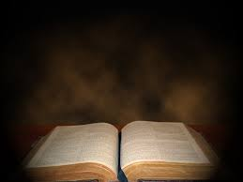
Then Jesus asked,
“What is the kingdom of God like?
What shall I compare it to?

Slide 3
It is like a mustard seed, which a man took and planted in his garden. It grew and became a tree, and the birds perched in its branches.”

Slide 4
Again he asked,
“What shall I compare the kingdom of God to?

Slide 5
It is like yeast that a woman took and mixed into about sixty pounds of flour until it worked all through the dough.”

Slide 6
Where was (is) the King?

Slide 7
Where was (is) the King?
Jesus came to preach the
. (L. 4:43)

Slide 8
Where was (is) the King?
Jesus came to preach the Kingdom of God. (L. 4:43)

Slide 9
Where was (is) the King?
In their minds, the Kingdom
was . (Mk 10:37)

Slide 10
Where was (is) the King?
In their minds, the Kingdom
was external. (Mk 10:37)

Slide 11
Where was (is) the King?
We ask, “Are you a King?”
– Pilate (J. 18:33)

Slide 12
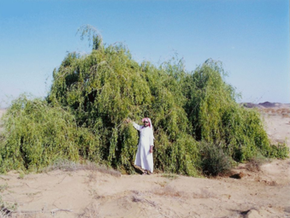
The Kingdom is a Mustard Seed

Slide 13
The Kingdom is a Mustard Seed
It was the ; it became the .
(Mt 17:20) .

Slide 14
The Kingdom is a Mustard Seed
It was the smallest; it became the largest.
(Mt 17:20) .

Slide 15
The Kingdom is a Mustard Seed
This is the . or growth.

Slide 16
The Kingdom is a Mustard Seed
This is the external or future growth.

Slide 17
The Kingdom is a Mustard Seed
Many of are prophecies for in the future (eg, Rev. 11.15)

Slide 18
The Kingdom is Leaven

Slide 19
The Kingdom is Leaven
This is the ,
Kingdom

Slide 20
The Kingdom is Leaven
This is the present,
internal Kingdom

Slide 21
The Kingdom is Leaven
The Kingdom is
all about influence.
exempli gratia negans – L. 12.1

Slide 22
The Kingdom is Leaven
Christianity in the world today:
  95% of the world has a translation of Bible.
  100-200 million new believers in China.
  1500 new churches every day.

