Slide 1


Slide 2


“PURE MUSIC”
Truth That Sings;
Doctrine Set to Music

Slide 3
“PURE MUSIC”
Ch.1 A Song of Purpose
Ch. 2 A Song of Grace
Ch. 3 A Song of Mystery
Ch. 4 A Song of Unity
Ch. 5 A Song of Love 1
Ch. 6 A Song of Love 2

Slide 4

Eph. 3:14-21
1. To what does “for this reason” refer?
2. What are Paul’s four main requests?
a. _____________(vs. 16, 18, 20)
Ephesians 3
Pure Music:
Our singing and dancing over God making his mystery known.

Slide 5
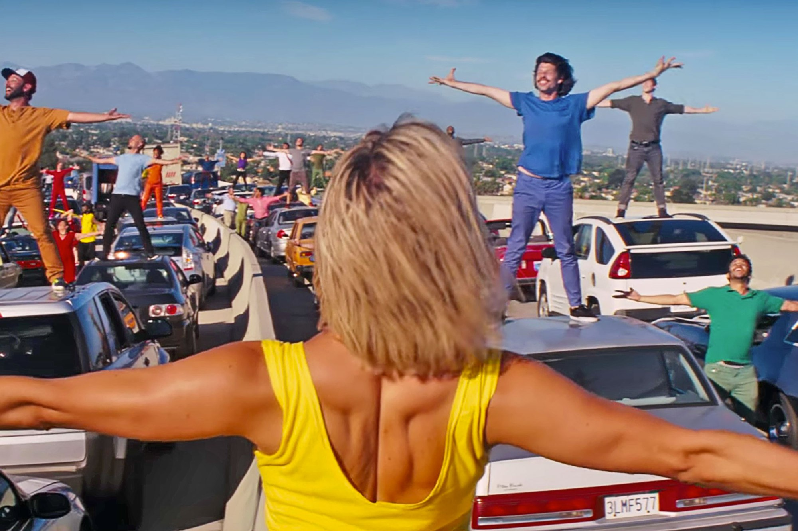

Slide 6
Eph. 3:14-21
1. To what does “for this reason” refer?
2. What are Paul’s four main requests?
a. _____________(vs. 16, 18, 20)
The Messenger – Paul A. - jazz piano teacher

Slide 7
Eph. 3:14-21
1. To what does “for this reason” refer?
2. What are Paul’s four main requests?
a. _____________(vs. 16, 18, 20)
The Messenger – Paul A. - jazz piano teacher
The Mystery – riffs, runs and vamps Paul revealed

Slide 8
Eph. 3:14-21
1. To what does “for this reason” refer?
2. What are Paul’s four main requests?
a. _____________(vs. 16, 18, 20)
The Messenger – Paul A. - jazz piano teacher
The Mystery – riffs, runs and vamps Paul revealed
The Meaning – finally playing a very amateur version of jazz piano

Slide 9
Eph. 3:14-21
1. To what does “for this reason” refer?
2. What are Paul’s four main requests?
a. _____________(vs. 16, 18, 20)
Ephesians 3:1-21
The Messenger

Slide 10
Eph. 3:14-21
1. To what does “for this reason” refer?
2. What are Paul’s four main requests?
a. _____________(vs. 16, 18, 20)
Ephesians 3:1-21
The Messenger
The Mystery

Slide 11
Eph. 3:14-21
1. To what does “for this reason” refer?
2. What are Paul’s four main requests?
a. _____________(vs. 16, 18, 20)
Ephesians 3:1-21
The Messenger
The Mystery
The Meaning

Slide 12
Eph. 3:14-21
1. To what does “for this reason” refer?
2. What are Paul’s four main requests?
a. _____________(vs. 16, 18, 20)
Ephesians 3:1-21
The Messenger
The Mystery
The Meaning
Paul’s Prayer

Slide 13
“A Song of Mystery”
Application
to our lives…
to our church…
to our community…

Slide 14
Eph. 3:14-21
1. To what does “for this reason” refer?
2. What are Paul’s four main requests?
a. _____________(vs. 16, 18, 20)

