Slide 1
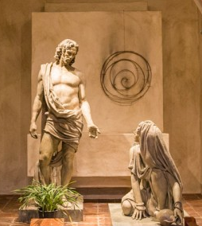
“I Am The Way, The Truth and The Life”
—Jesus
John 20:1-9

Slide 2

Early on the first day of the week, while it was still dark,

Slide 3
Mary Magdalene went to the tomb and saw that the stone had been removed from the entrance.

Slide 4
So she came running to
Simon Peter and the other disciple, the one whom Jesus loved, and said,

Slide 5
“They have take the Lord out of the tomb, and we don’t know where they have put him.”

Slide 6
So Peter and the other disciple started for the tomb. Both were running, but the other disciple outran Peter and reached to tomb first.

Slide 7
He bent over and looked in at the strips of linen lying there but did not go in.

Slide 8
Then Simon Peter, who was behind him, arrived and went into to tomb.

Slide 9
He saw the strips of linen lying there, as well as the burial cloth that had been around Jesus’ head.

Slide 10
The cloth was folded up by itself, separate from the linen.

Slide 11
Finally the other disciple, who had reached the tomb first, also went inside.

Slide 12
He saw and believed.
(They did not understand from Scripture that Jesus had to rise from the dead.)

Slide 13
“I will give them hearts that will recognize me as the LORD.
They will be my people and I will be their God.

Slide 14
And they will return to me wholeheartedly.”
Jeremiah 24:47

Slide 15
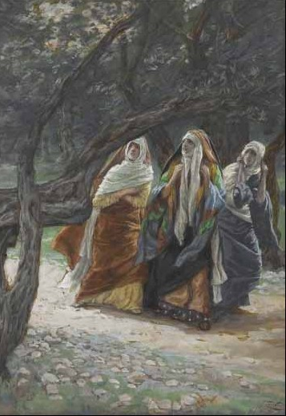
Why are you looking for the living among the dead?
Luke 24:5

Slide 16
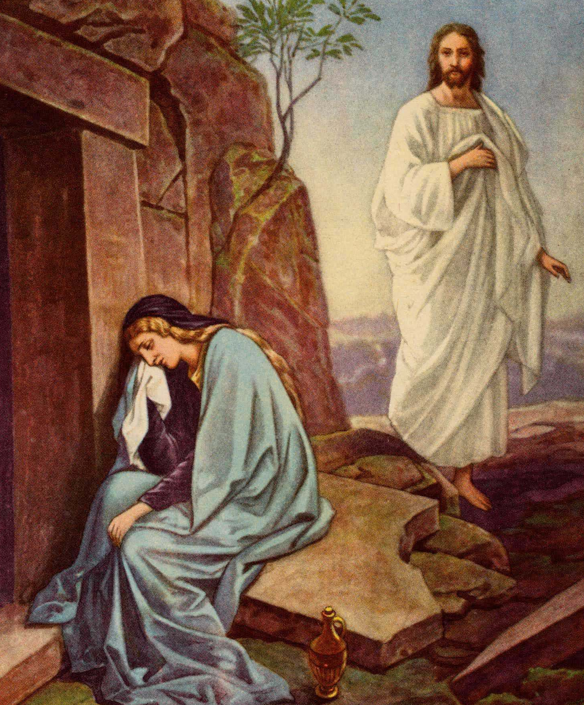
Why are you crying?
John 20:13

Slide 17
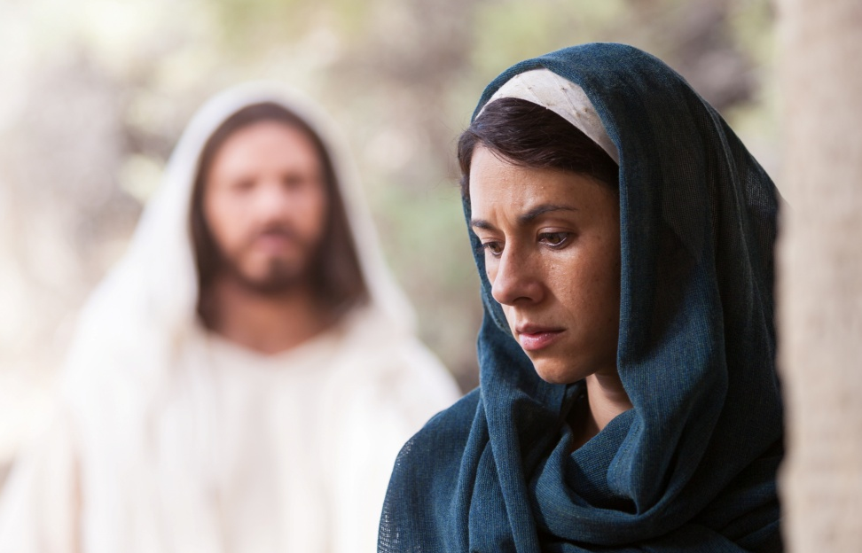
Woman, Why are you crying?
Who is it you are looking for?
John 20:15

Slide 18
“I am the resurrection and the life. He who believes in me will live, even though he dies; and whoever lives and believes In Me will never die.”
John 11:25-26

