Slide 1
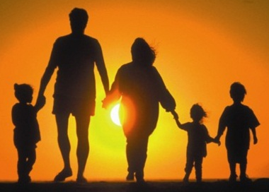
“A Way Of Life For All People” Romans 8: 5-17

Slide 2
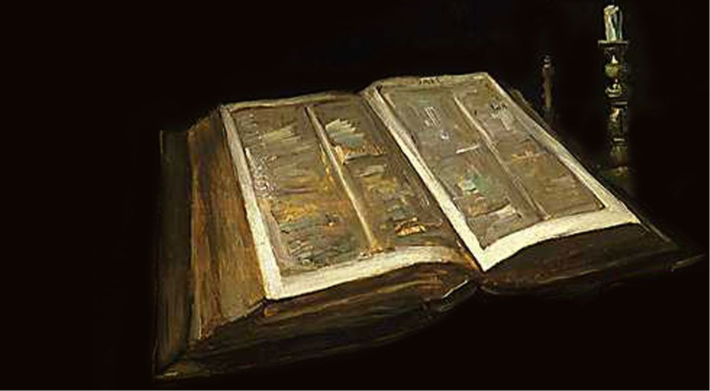
Those who live according to the sinful nature have their minds set on what that nature desires;

Slide 3
but those who live in accordance with the Spirit have their minds set on what the spirit desires.

Slide 4
The mind of sinful man is death, but the mind controlled by the Spirit is life and peace; the sinful mind is hostile to God.

Slide 5
It does not submit to God’s law, nor can it do so. Those controlled by the sinful nature cannot please God.

Slide 6
You, however, are controlled not by the sinful nature, but by the Spirit, If the Spirit of God lives in you.

Slide 7
And if anyone does not have the Spirit of Christ, he does not belong to Christ.

Slide 8
But if Christ is in you, your body is dead because of sin, yet your spirit is alive because of righteousness.

Slide 9
And if the Spirit of Him who raised Jesus from the dead is living in you,

Slide 10
He who raised Christ from the dead will also give life to your mortal bodies through His Spirit, who lives in you.

Slide 11
Therefore, brothers, we have an obligation— but it is not to the sinful nature, to live according to it.

Slide 12
For if you live according to the sinful nature, you will die;

Slide 13
but if by the Spirit you put to death the misdeeds of the body, you will live.

Slide 14
Because those who are lead by the Spirit of God are sons of God.

Slide 15
For you did not receive a spirit that makes you a slave again to fear, but you received the Spirit of son-ship.

Slide 16
And by Him we cry, “Abba, Father.” The Spirit himself testifies with our spirit that we are God’s children.

Slide 17
Now if we are children, then we are heirs—heirs of God and co-heirs with Christ,

Slide 18
if indeed we share in His sufferings in order that we may also share in His glory.

Slide 19
“A Way Of Life For All People” Romans 8: 5-17

Slide 20
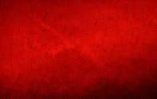
After John was put in prison, Jesus went into Galilee, proclaiming the good news of God. The time has come, the kingdom of God is near!

Slide 21
The Gospel, in the New Testament, is the Good News that God, the creator of this world, is becoming King.

Slide 22
Repent and believe the good News! The good News is that Jesus, who God raised from the dead is the world’s true Lord.

Slide 23
The Good News is the powerful announcement that God is God and that Jesus is Lord, and that the powers of evil have been defeated, that God’s new world has begun. “I saw Satan fall like l ightning from heaven.” Luke 10:18

Slide 24
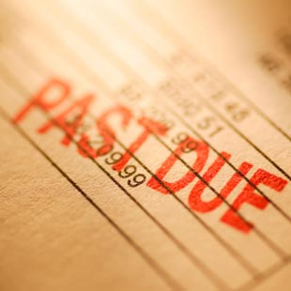
I am debtor.

Slide 25
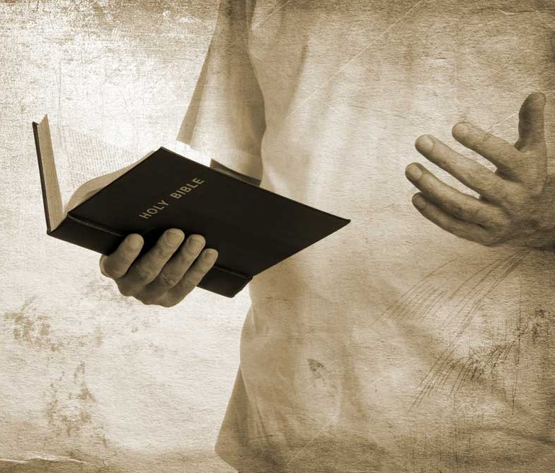
I am ready to preach the gospel

Slide 26
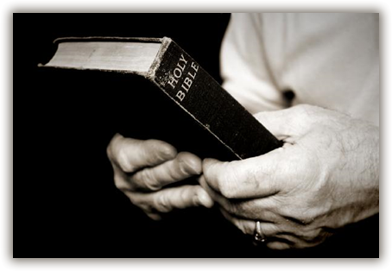
I am not ashamed of the gospel of Christ.

Slide 27
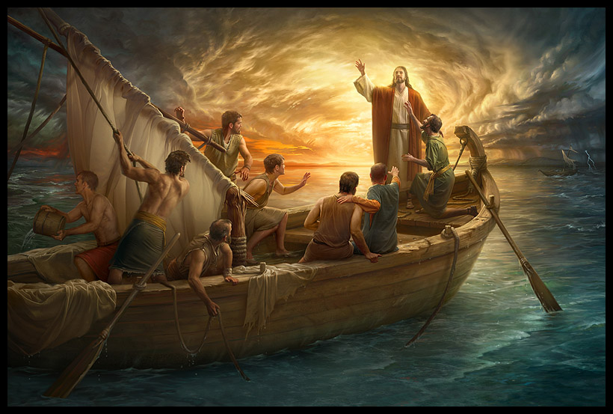
It is the power of God unto salvation to every one that believeth.

Slide 28
It is the righteousness of God revealed from faith to faith: as it is written, The just shall live by faith.

Slide 29
