Slide 1
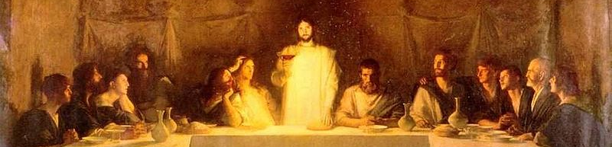
The Last Passover Luke 22:13-23

Slide 2

They left and found things just as Jesus had told them. So they prepared the Passover.

Slide 3
When the hour came, Jesus and his apostles reclined at the table. And he said the them:

Slide 4
“I have eagerly desired to eat this Passover with you before I suffer,

Slide 5
For I tell you, I will not eat it again until it finds fulfillment in the kingdom of God.”

Slide 6
After taking the cup, he gave thanks and said, “Take this and divide it among you.

Slide 7
For I tell you I will not drink again of the fruit of the vine until the kingdom of God comes.”

Slide 8
And he took bread, gave thanks and broke it, and gave it to them saying,

Slide 9
“This is my body given for you, do this in remembrance of me.”

Slide 10
In the same way, after the supper he took the cup, saying,

Slide 11
“This cup is the new covenant in my blood, which is poured out for you.

Slide 12
But the hand of him who is going to betray me is with mine on the table.

Slide 13
The Son of Man will go as it has been decreed, but woe to that man who betrays him.”

Slide 14
They began to question among themselves which of them it might be who would do this.

Slide 15
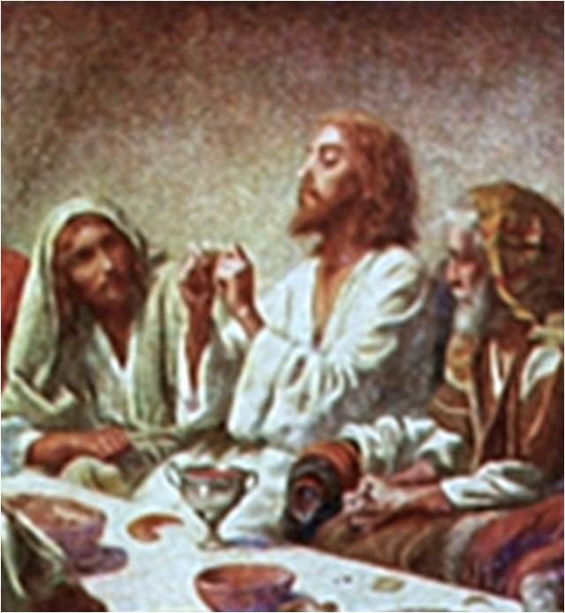
“I have eagerly desired to eat this Passover with you before I suffer.” Luke 22:15

Slide 16
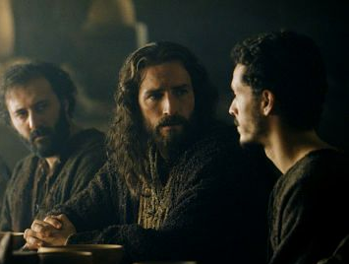
“For I tell you that I will not eat it again until it finds fulfillment in the kingdom of God.” Luke 22:16

Slide 17
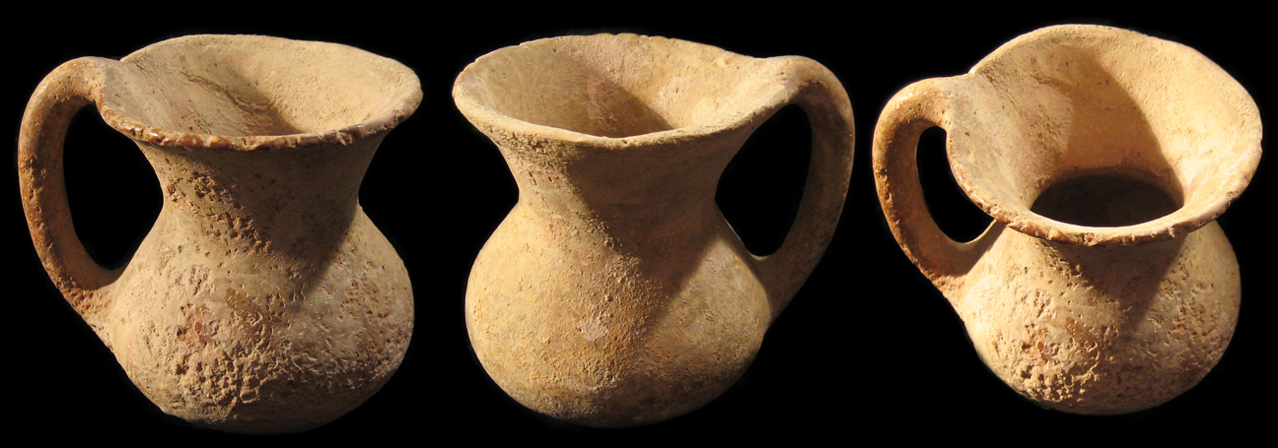
After taking the cup, he gave thanks and said, “Take this and divide it among yourselves. Luke 22:17

Slide 18
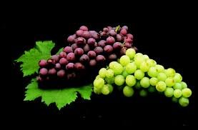
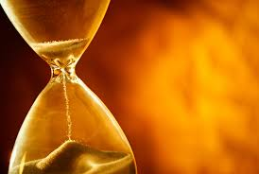
“For I tell you I will not drink again of the fruit of the vine until the kingdom of God comes.” Luke 22:18

Slide 19
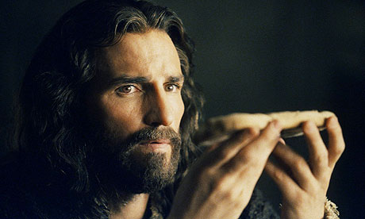
And He took bread, gave thanks and broke it, and gave it to them saying:

Slide 20
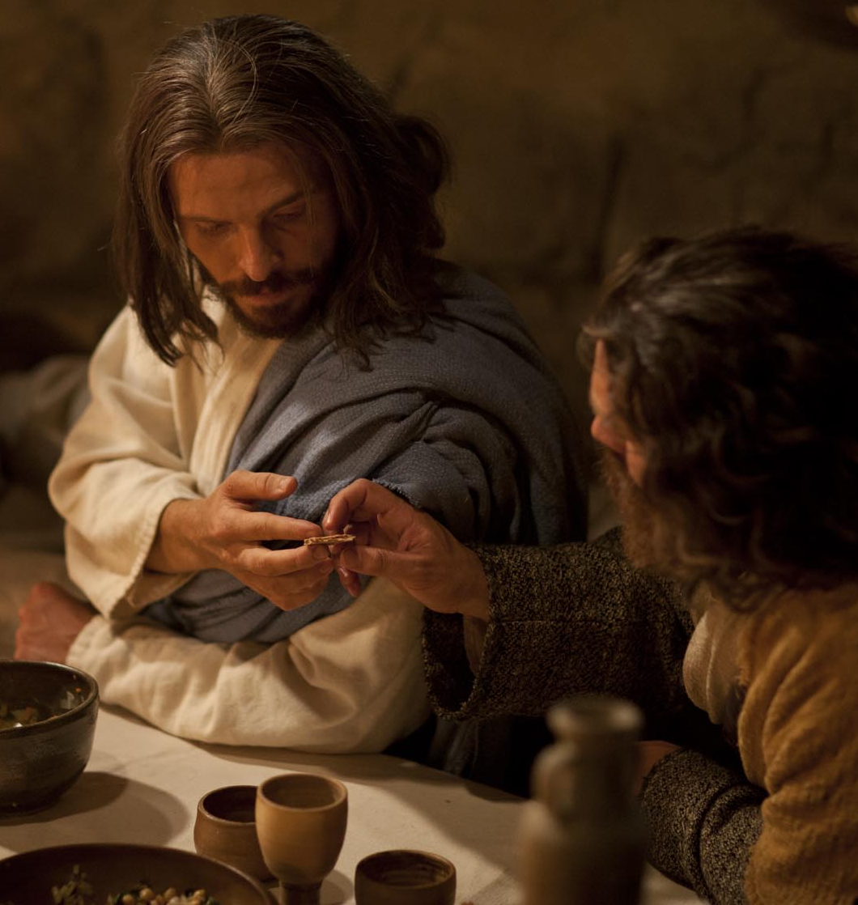
“This is my body given for you; do this in remembrance of me.” Luke 22:19

