Slide 1

“The Christian Hope”
2 Corinthians 5:1-19

Slide 2
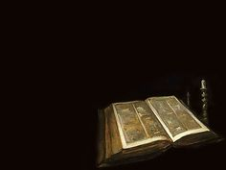
Now we know that if the earthy tent we live is destroyed, we have a building from God, an eternal house in heaven, not built by human hands.

Slide 3
Meanwhile we groan, longing to be clothed with our heavenly dwelling, because when we are clothed, we will not be found naked.

Slide 4
For while we are in this tent, we groan, and are burdened, because we do not wish to be unclothed

Slide 5
but to be clothed with our heavenly dwelling, so that what is mortal may be swallowed up by life.

Slide 6
Now it is God who has made us for this very purpose and has given us the Spirit as a deposit, guaranteeing what is to come.

Slide 7
Therefore we are always confident and know that as long as we are at home in the body we are away from the Lord.

Slide 8
We live by faith, not by sight.
We are confident, I say, and would prefer to be away from the body and at home with the Lord.

Slide 9
So we make it our goal to please Him, whether we are at home in the body or away from it.

Slide 10
For we must all appear before the judgment seat of Christ, that each one may receive what is due him,

Slide 11
for the things done while in the body, whether good of bad.

Slide 12
“For God did not appoint us to suffer wrath but to receive salvation through our Lord Jesus Christ.

Slide 13
He died for us so that, whether we are awake or asleep, we may live together with Him.

Slide 14
Therefore encourage one another and build each other up, just as in fact you are doing”.
1 Thessalonians 5:9-11

Slide 15
“The Christian Hope”
2 Corinthians 5:1-19

Slide 16
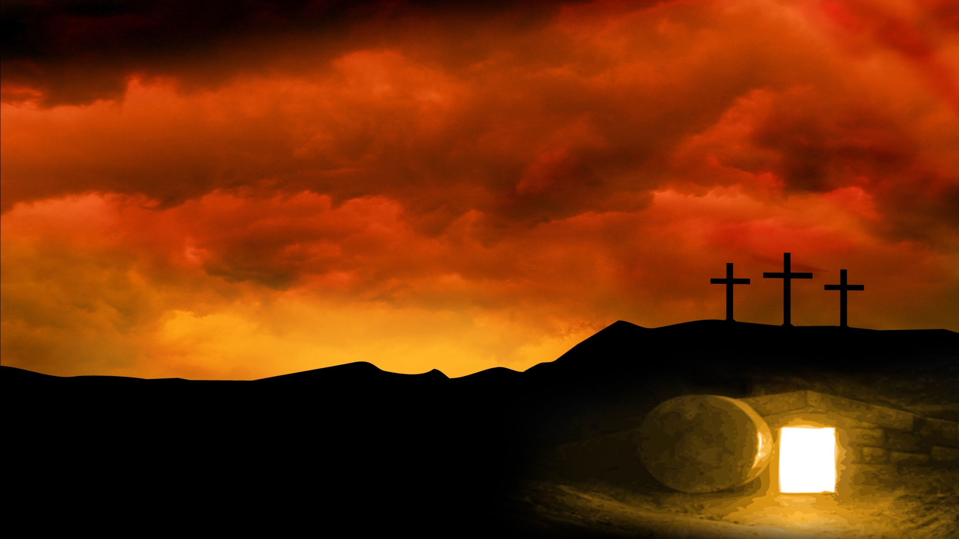
The Corinthians
“How can some of you say there is no resurrection of the dead?
1 Corinthians 12:12

Slide 17

The Prophet Daniel
But at that time your people— everyone whose name is found written in the book — will be delivered.

Slide 18
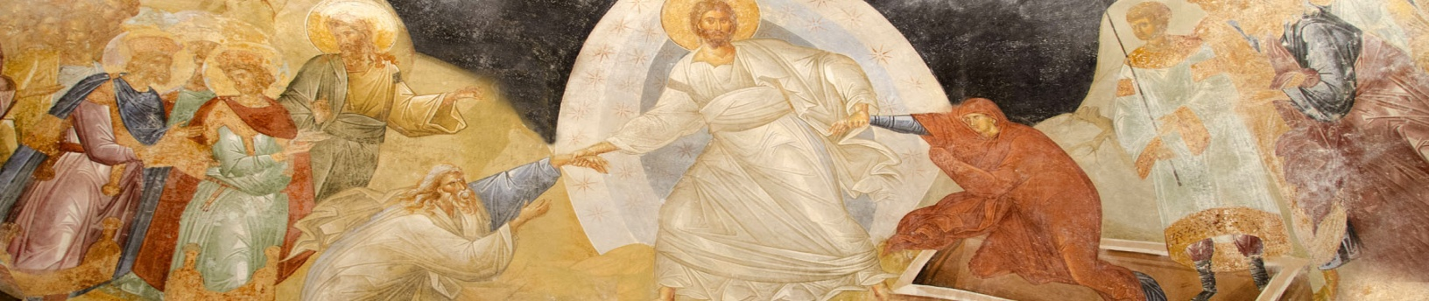
Multitudes who sleep in the dust of the earth will awake: some to everlasting life, others to shame and everlasting contempt.

Slide 19
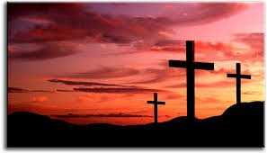
The Thief
“Jesus remember me when you come into your kingdom.”
Jesus answered him,
“Truly I tell you, today you will be with me in paradise.”
Luke 23:32-43

Slide 20
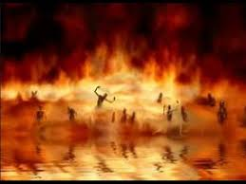
The Rich Man
“Father Abraham have pity on me and send Lazarus to dip the tip of his finger in water and cool my tongue because I am in agony in this fire.” Luke 16:19-31

Slide 21

The Apostle
“We live by faith, not by sight.
We are confident, I say, and would prefer to be away from the body and at home with the Lord.”
2 Corinthians 5:1-10

