Slide 1
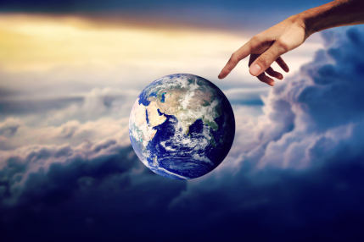
New Creation
2 Corinthians
4:5-15

Slide 2

For we do not preach ourselves, but Jesus Christ as Lord, and ourselves as your servants for Jesus’ sake,

Slide 3
For God, who said,
“Let light shine our of darkness,” made his light shine in our hearts

Slide 4
to give us the light of the knowledge of the glory of God in the face of Christ.

Slide 5
But we have this treasure in jars of clay to show that this all-surpassing power is from God and not from us.

Slide 6
We are hard pressed on every side, but not crushed; perplexed, but not in despair,

Slide 7
persecuted, but not abandoned; struck down, but not destroyed.

Slide 8
We always carry around in our body the death of Jesus,

Slide 9
so that the life of Jesus may also be revealed in our body.

Slide 10
For we who are alive are always being given over to death for Jesus’ sake,

Slide 11
so that his life may be revealed in our mortal body.

Slide 12
So then, death is at work in us, but life is at work in you.

Slide 13
It is written: ”I believed; therefore I have spoken.”

Slide 14
With our same spirit of faith we also believe and therefore speak,

Slide 15
because we know that the one who raised the Lord Jesus from the dead,

Slide 16
will also raise us with Jesus and present us with you in his presence.

Slide 17
All this is for your benefit, so that the grace that is reaching more and more people

Slide 18
may cause thanksgiving to overflow to the glory of God.

Slide 19

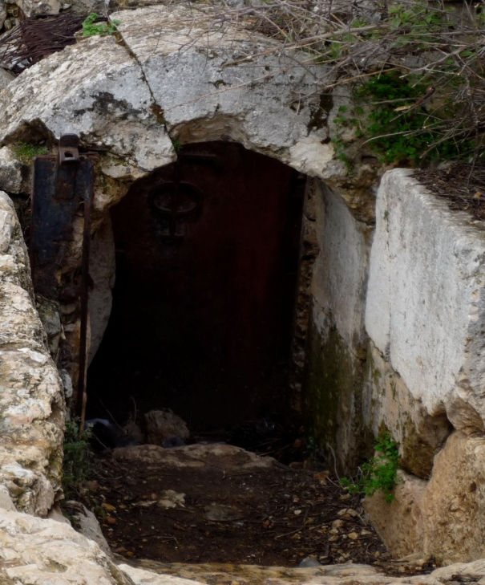
The Death and Resurrection of Jesus forms the backbone of what Paul has to say.

Slide 20
“For I determined not to know any thing among you, save Jesus Christ, and him crucified.”
1 Corinthians 2:2

Slide 21

Jewish Style Eschatology es·cha·tol·o·gy

Slide 22
The part of theology concerned with death, judgment, and the final destiny of the soul and of humankind.

Slide 23

1) involves the resurrection of the body. 1 Corinthians 15:1-20

Slide 24

2) and the liberation of creation.
Romans 8:20-21

Slide 25
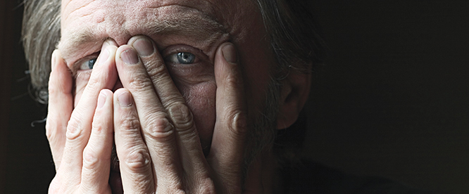
The Corinthians are ashamed of Paul. 1 Corinthians 4:8-13

Slide 26
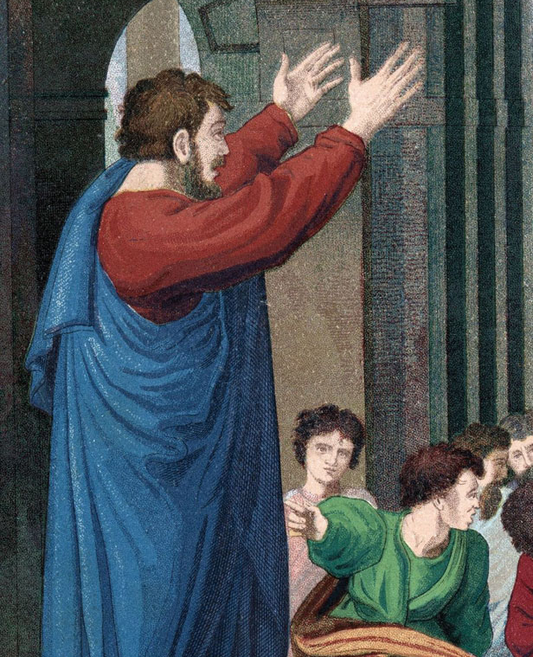
Paul speaks openly of his own death.
2 Corinthians
5:8 (5:1-11)

Slide 27

Paul sees the present in light of the future.

Slide 28
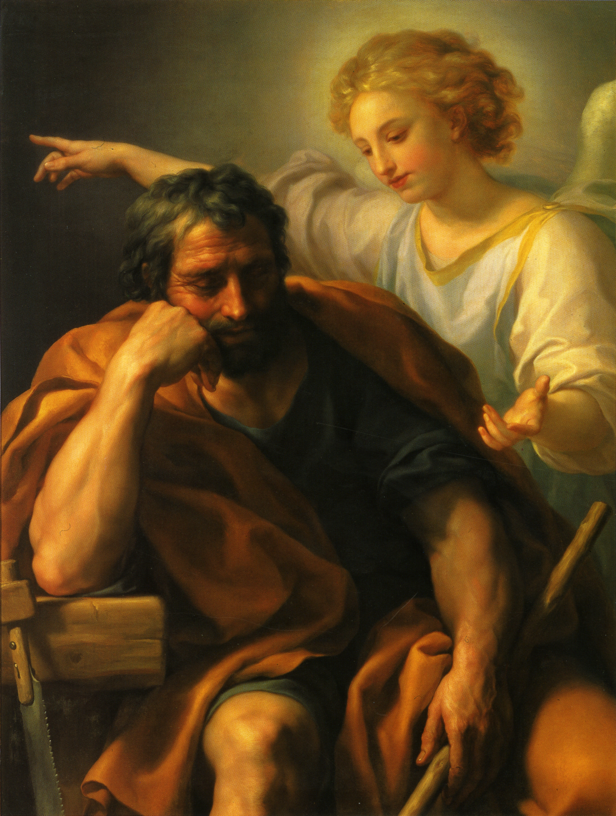
Paul sees the present in light of his suffering.

Slide 29

Paul sees his present suffering connected to the future in which there is:

Slide 30
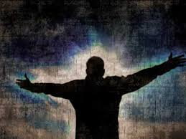
Resurrection 4:14
Glory 4:17
New Body 5;1
Judgment 5:10
Renewal of creation 5:17

