Slide 1
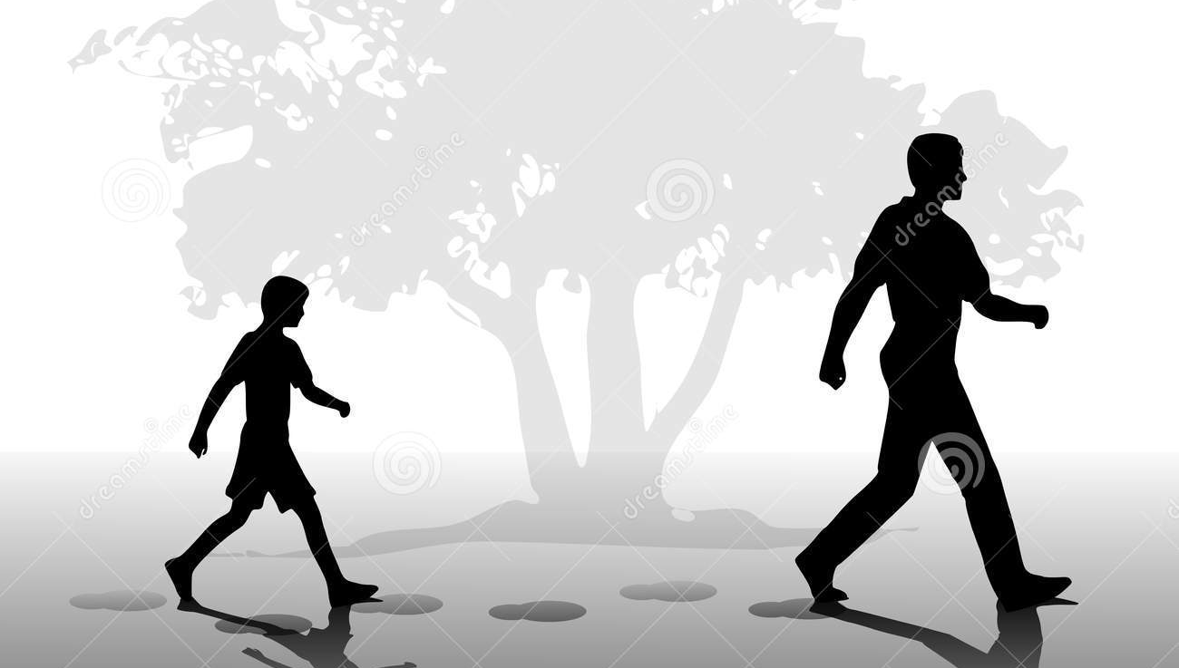
“In The Father’s Footsteps” Matthew 5:43-48

Slide 2
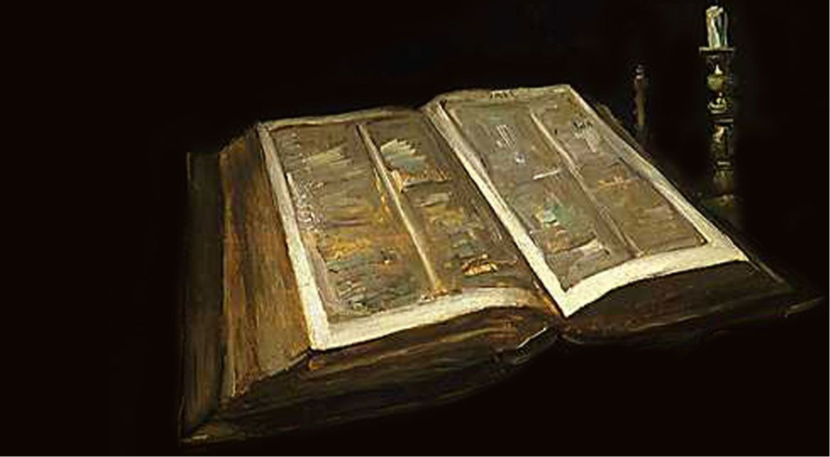
You have heard that it was said, “Love your neighbor and hate your enemy.”

Slide 3
But I tell you: Love your enemies and pray for those who persecute you, that you may be sons of your Father in heaven.

Slide 4
He causes His sun to rise on the evil and the good, and sends the rain on the righteous and the unrighteous.

Slide 5
If you love those who love you, what reward will you get? Are not even the tax collectors doing that?

Slide 6
And if you greet only your brothers, what are you doing more than others? Do not even pagans do that?

Slide 7
Be perfect, therefore, as your heavenly Father is perfect.

Slide 8
“In The Father’s Footsteps” Matthew 5:43-48

Slide 9

Could this be God’s love story? How do we learn to love?

Slide 10

We love because he first loved us.

Slide 11
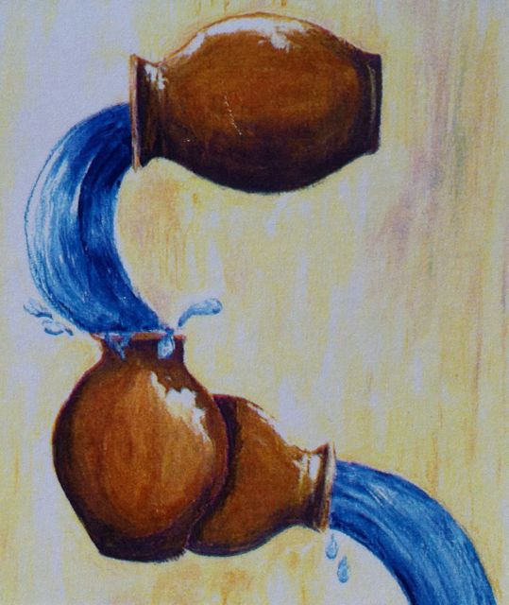
We love because God poured out His love into our heart by the Holy Spirit.

Slide 12


If we walk in the light, as He is in the light we have fellowship with one another,

Slide 13

and the blood of Jesus, His Son, purifies us from all sin.

