Slide 1
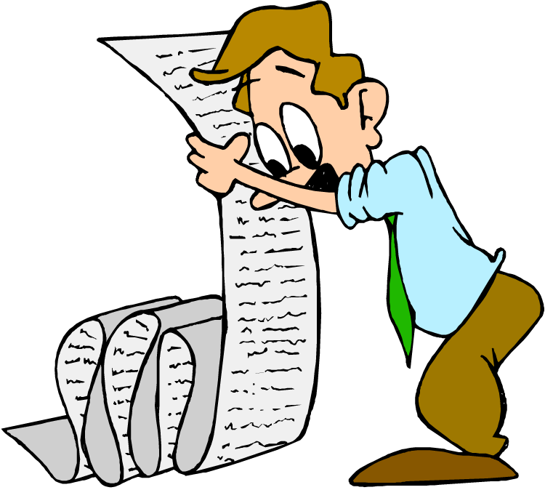
“Transparent Words”
Matthew 5:33-37

Slide 2
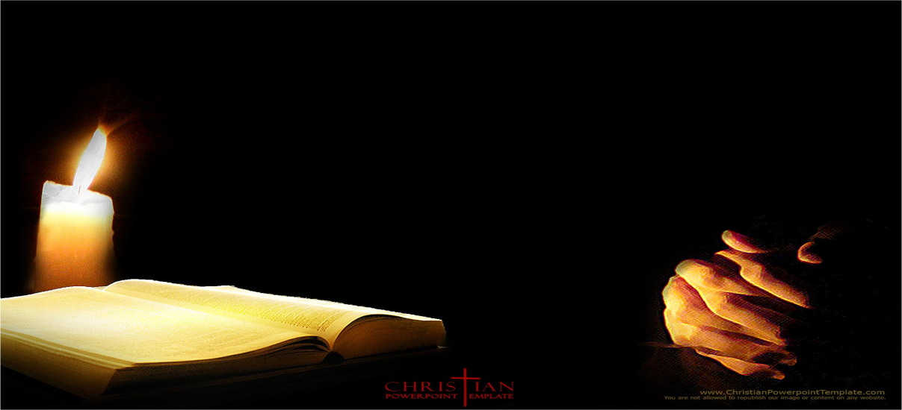
Again, you have heard that it was said to the people long ago,

Slide 3
“Do not break your oath, but keep the oaths you have made to the Lord.”

Slide 4
But I tell you, do not swear at all: either by heaven, for it is God’s throne;

Slide 5
or by the earth, for it is his footstool; or by Jerusalem, for it is the city of the Great King.

Slide 6
And do not swear by your head, for you cannot make even one hair white or black.

Slide 7
Simply let your “yes” be “yes” and your “no,” “no”; anything beyond this comes from the evil one.

Slide 8
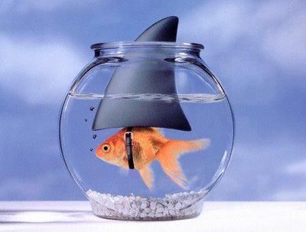
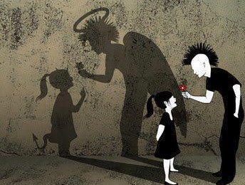
“Sincerity means that the appearance and the reality are exactly the same.

Slide 9
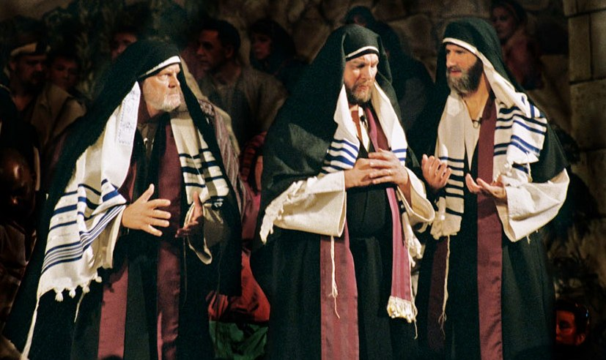
Remember, says Jesus, that you stand before God, not society;

Slide 10

practice the right kind of speech and your Father in heaven will back up all that is true.”
Oswald Chambers

Slide 11
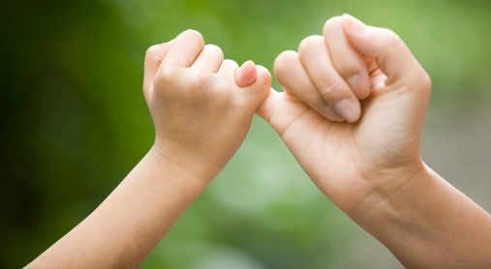
Jesus goes right to the heart of why people swear oaths.
Jesus goes right to the heart of why people swear oaths. He knew that they did it to impress others with their
sincerity.

Slide 12
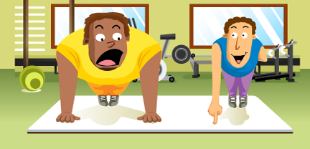
He knew that they did it to impress others with their sincerity.

Slide 13

Jesus says simply
“Don’t do it.”

Slide 14
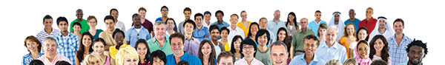
As God ‘s free creatures, we are to be left to make up our own mind about decisions without coercion or manipulation.

Slide 15

The evil inherent in making oaths is that it is the wrong way to approach other human beings.

Slide 16
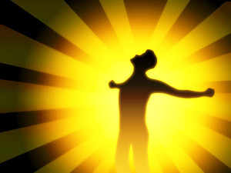
Kingdom Rightness respects the soul need of human beings

Slide 17
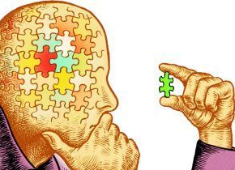
to make their judgments and decisions solely from what they have come to conclude.

Slide 18
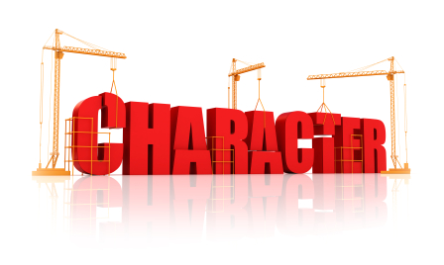
Kingdom Righteousness deals with a biological need that allows a persons character to develop.

Slide 19
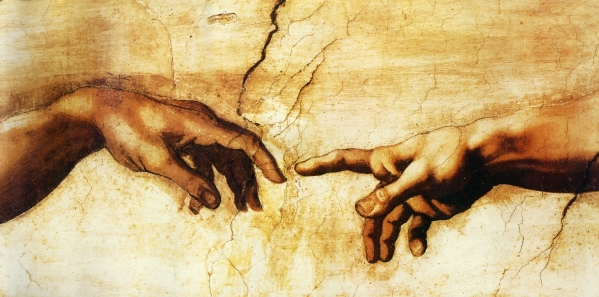
When this need is not respected, it thwarts the purpose of God in creation for men and women to freely receive Him.

