Slide 1

“The Vulnerability of the Heart” Matthew 5:38-42

Slide 2
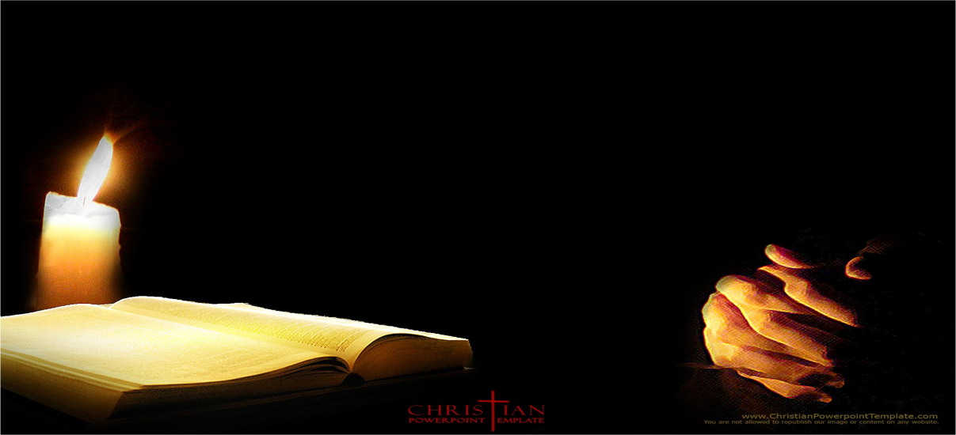
You have heard that it was said, eye for eye and tooth for tooth. But I tell you, do not resist an evil person.

Slide 3
If someone strikes you on the right cheek, turn to him the other also.

Slide 4
And if someone wants to sue you and take your tunic, let him have your cloak as well.

Slide 5
If someone forces you to go one mile, go with him two miles.

Slide 6
Give to the one who asks you, and do not turn away from the one who wants to borrow from you

Slide 7
“No good tree bears bad fruit, nor does a bad tree bear good fruit. Each tree is recognized by it’s own fruit. Luke 6: 43

Slide 8
The good man brings good things out of the good stored up in his heart,

Slide 9
and the evil man brings evil things out of the evil stored up in his heart.

Slide 10
For out of the overflow of this heart his mouth speaks.” Luke 6:45

Slide 11
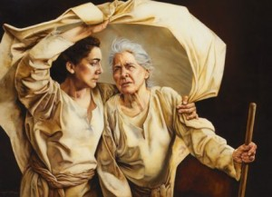
Actions do not emerge from nothing. They faithfully reveal what is in the heart.

Slide 12
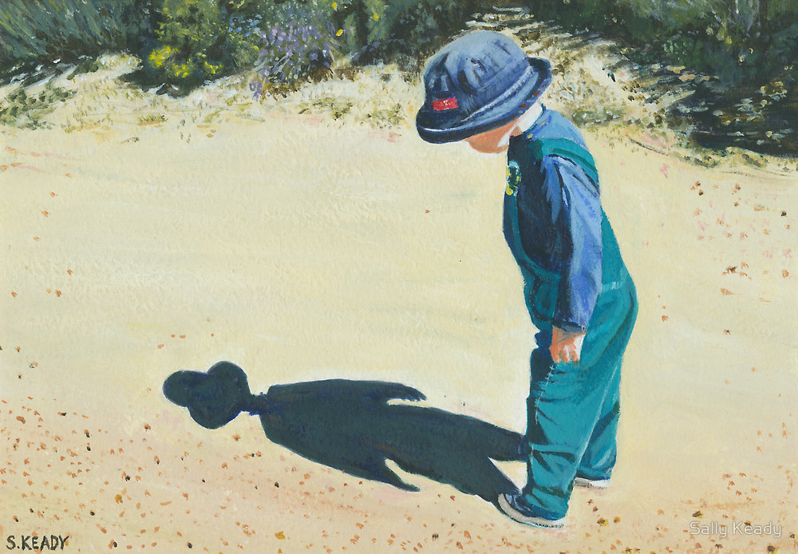
“The Kingdom of God is near you.”

Slide 13
“You have heard it said an eye for an eye And a tooth for a tooth. But I tell you do not resist an evil person..” Matthew 5:38-39a

Slide 14
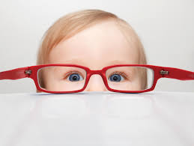
“Do not repay anyone evil for evil. Be careful to do what is right in the eyes of everyone.”

Slide 15
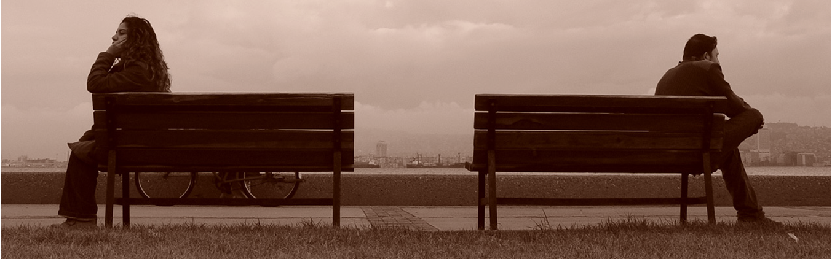
“Do not repay evil with evil or insult with insult.

Slide 16

On the contrary, repay evil with blessing,

Slide 17

because to this you were called so that you may inherit a blessing.”

