Slide 1

“Purity of Heart” Matthew 5:27-32

Slide 2

You have heard that it was said, “Do not commit adultery.”

Slide 3
But I tell you that anyone who looks at a woman lustfully has already committed adultery with her in his heart.

Slide 4
If your right eye causes you to sin, gouge it out and throw it away.

Slide 5
It is better for you to lose one part of your body than for your whole body to be thrown into hell.

Slide 6
And if your right hand causes you to sin, cut it off and throw it away.

Slide 7
It is better for you to lose one part of your body than for your whole body to go into hell.

Slide 8
It has been said: “Anyone who divorces his wife must give her a certificate of divorce.”

Slide 9
But I tell you that anyone who divorces his wife, except for marital unfaithfulness, causes her to become an adulteress,

Slide 10
and anyone who marries the divorced woman commits adultery.

Slide 11

“Purity is not a question of doing things Rightly, but of the doer on the inside being right.”

Slide 12
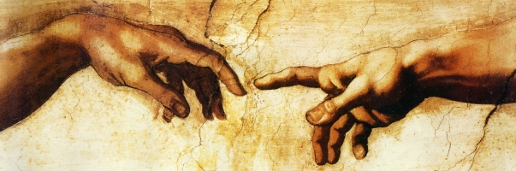
“The Gospel of God is not that Jesus died for my sins only, but that He gave Himself for me that I might give myself to Him.”

Slide 13

“God cannot accept goodness from me. He can only accept my badness, and He will give me the solid goodness of the Lord Jesus in exchange for it.” Oswald Chambers

Slide 14
“God made Him who had no sin to be sin for us, so that in Him we might become the righteousness of God.” 2 Corinthians 5:21

Slide 15

Either Jesus Christ must be the supreme authority on the human heart, or he is not worth listening to. Matthew 15:15

Slide 16

Our Lord’s teaching can be interpreted only by the new Spirit which He puts in;

Slide 17

it can never be taken as a series of rules and regulations. Oswald Chambers

Slide 18
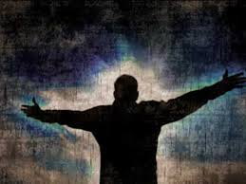
God must alter my heredity for me to be devoted to Him. “You must be born again.” John 3:17

Slide 19

How do we know that in Christ we are a new creation?

Slide 20
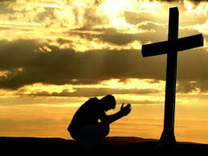
“If we are born again of the Holy Spirit and have the life of Jesus in us by means of His Cross,

Slide 21

we must show it in the way we walk and talk and transact all our business.” Oswald Chambers

