Slide 1
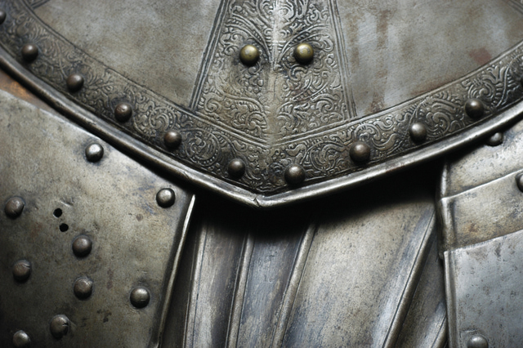
Righteousness Matthew 5:17-20

Slide 2
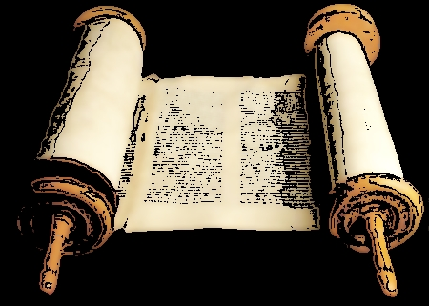
Do not think that I have come to abolish the Law or the Prophets; I have not come to abolish them but to fulfill them.

Slide 3
I tell you the truth, until heaven and earth disappear, not the smallest letter, not the least stroke of a pen;

Slide 4
will by any means disappear from the Law until everything is accomplished.

Slide 5
Anyone who breaks one of the least of these commandments and teaches others to do the same will be called least in the kingdom of heaven,

Slide 6
but whoever practices and teaches these commands will be called great in the kingdom of heaven.

Slide 7
For I tell you that unless your righteousness surpasses that of the Pharisees and the teachers of the law,

Slide 8
you will certainly not enter the kingdom of heaven.

Slide 9
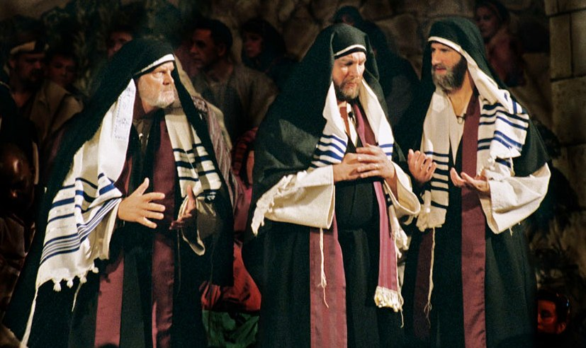
The Law of the Pharisees is hypocritical.

Slide 10
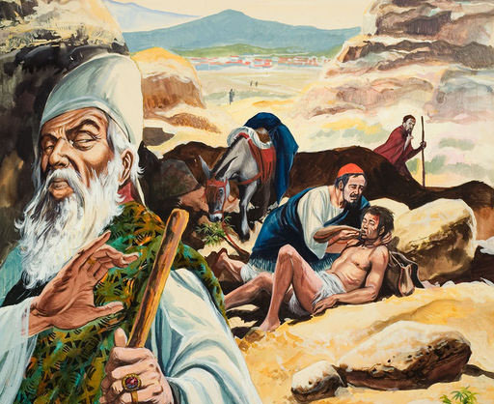
“But do not do what they do, for they do not practice what they preach.”

Slide 11
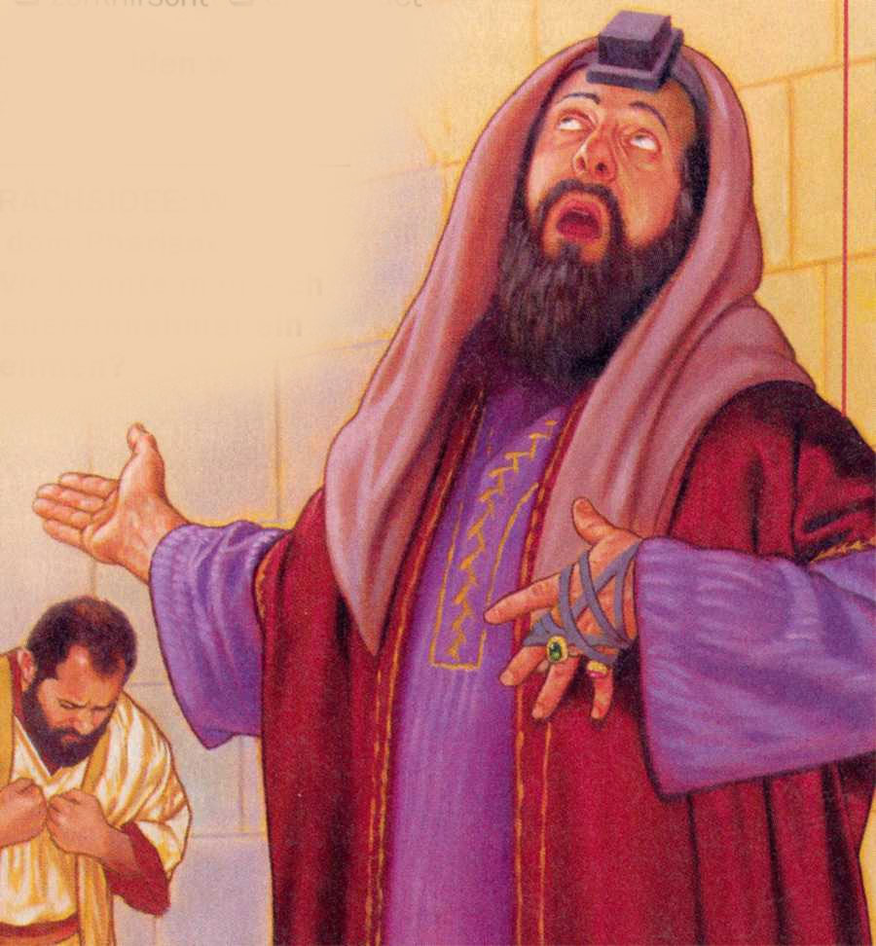
“When you fast, do not look somber as the hypocrites do.”

Slide 12
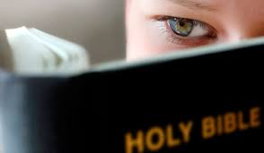
The Law is good.

Slide 13
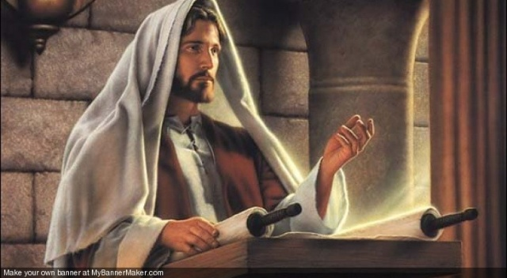
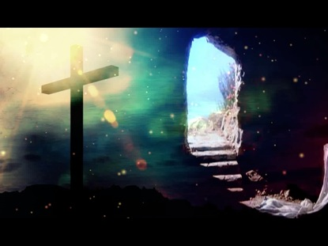

“Christ is the culmination of the law so that there may be righteousness for everyone who believes.”

Slide 14
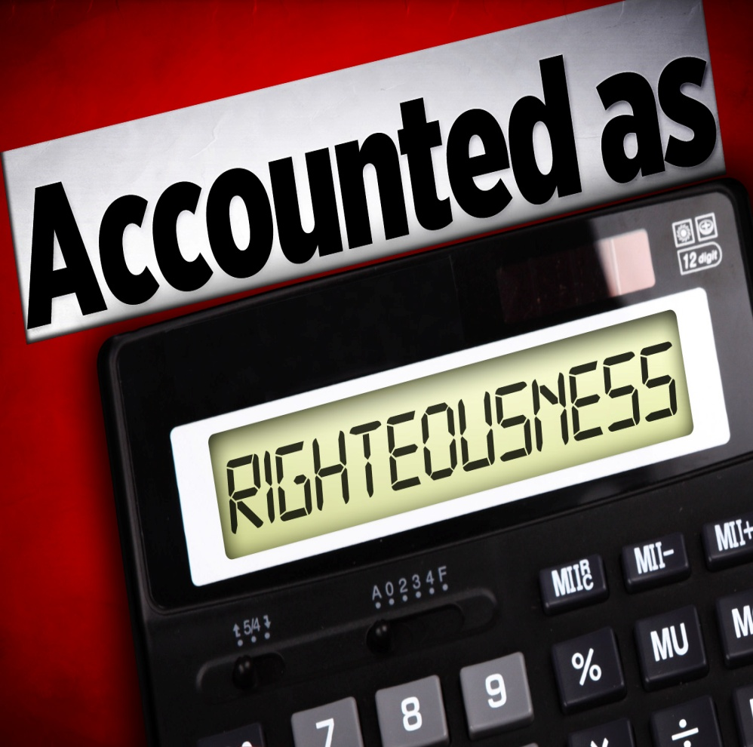
The Law is only completed in Christ.

Slide 15

But if Christ is in you, then even though your body is subject to death because of sin,

Slide 16

the Spirit gives life because of righteousness.

