Slide 1
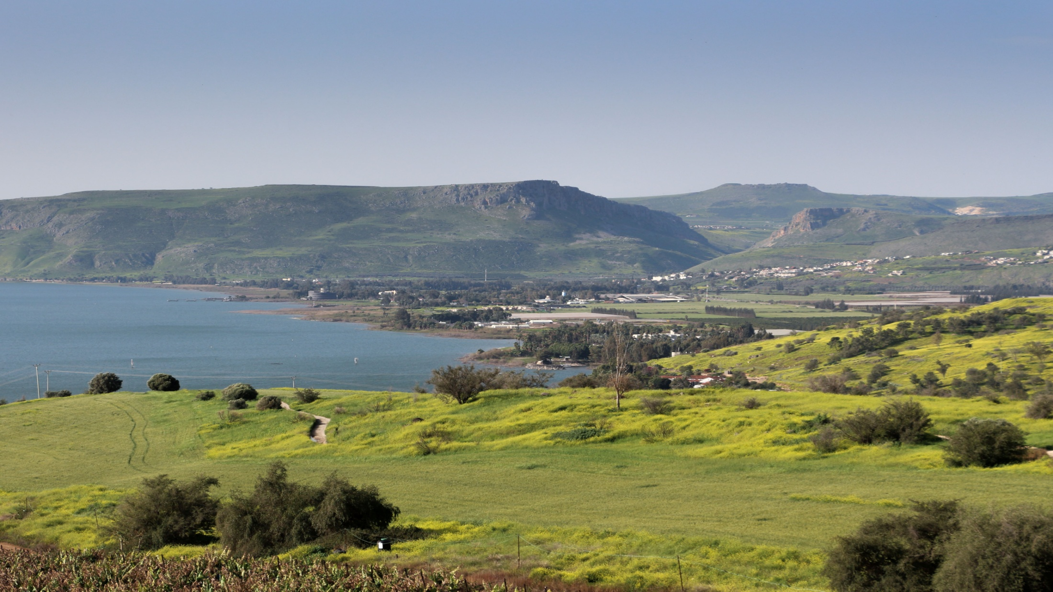
“Jesus’ Wisdom” Matthew 5:1-18

Slide 2

Now when he saw the crowds, he went up on a mountainside and sat down.

Slide 3
His disciples came to him, and he began to teach them saying:

Slide 4
Blessed are the poor in spirit, for theirs is the kingdom of heaven. Blessed are those who mourn, for they will be comforted.

Slide 5
Blessed are the meek, for they will inherit the earth. Blessed are those who hunger and thirst for righteousness, for they will be filled.

Slide 6
Blessed are the merciful, for they will be shown mercy. Blessed are the pure in heart, for they will see God.

Slide 7
Blessed are the peacemakers, for they will be called sons of God.

Slide 8
Blessed are those who are persecuted because of righteousness, for theirs is the kingdom of heaven.

Slide 9
Blessed are you when people insult you, persecute you and falsely say all kinds of evil against you because of me.

Slide 10
Rejoice and be glad, because great is your reward in heaven, for in the same way they persecuted the prophets who were before you.

Slide 11
“You are the salt of the earth. But if the salt loses its saltiness how can it be made salty again?

Slide 12
It is no longer good for anything except to be thrown out and trampled by men.

Slide 13
You are the light of the world. A city on a hill cannot be hidden.

Slide 14
Neither do people light a lamp and put it under a bowl. Instead, they put it on a stand, and it gives light to everyone in the house.

Slide 15
In the same way, let your light shine before men, that they may see your good deeds and praise your Father in heaven.

Slide 16
Do not think that I have come to abolish the Law or the Prophets; I have not come to abolish them but to fulfill them.

Slide 17
I tell you the truth, until heaven and earth disappear not the smallest letter, not the least stroke of a pen will by any means disappear from the Law until everything is accomplished.

Slide 18
Setting of the Sermon on the Mount

Slide 19
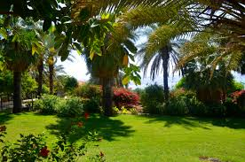
We automatically remember what makes a real difference in our life.

Slide 20

Jesus tied his teaching to actual events in people’s lives.

Slide 21
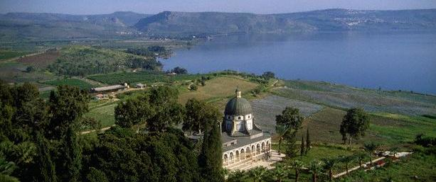
The religious were not interested in the crowds. But Jesus welcomed them.

Slide 22
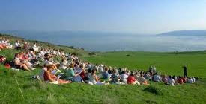
The Beatitudes reflect what the crowd experienced.

Slide 23

Blessed are those who mourn, for they will be comforted. Death, deserted Spouse deserted them, Unemployed

Slide 24
Blessed are the meek, for they will inherit the earth. Intimidated, unassertive

Slide 25
Blessed are those who hunger and thirst after righteousness. wronged, injustice

Slide 26
Blessed are the merciful, for they shall be shown mercy. It’s just business

Slide 27
“Do not think that I have come to abolish the Law or Prophets: I have not come to abolish them but to fulfill them.”

