Slide 1
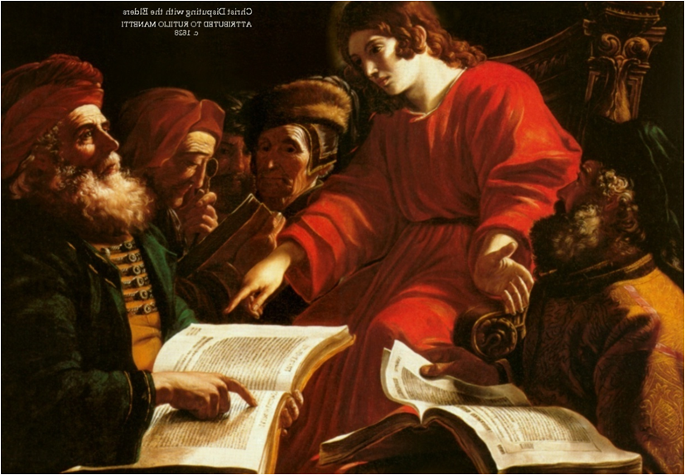
“Jesus At The Temple” Luke 2:39-52

Slide 2
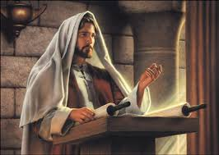
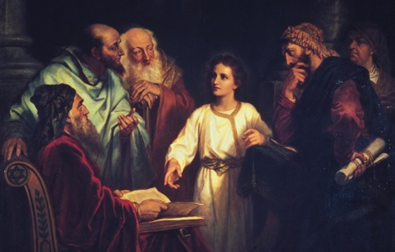
We often focus on his wisdom.

Slide 3
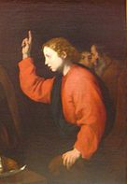
But the real climax, is Jesus’ reference to God as “My Father”

Slide 4
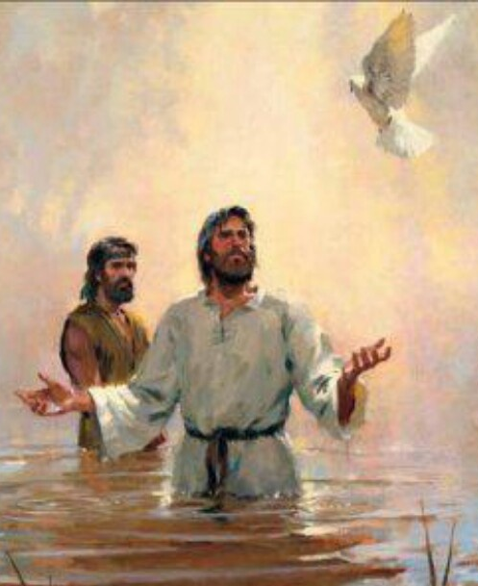
His was aware that He was God’s “only begotten Son.”

Slide 5
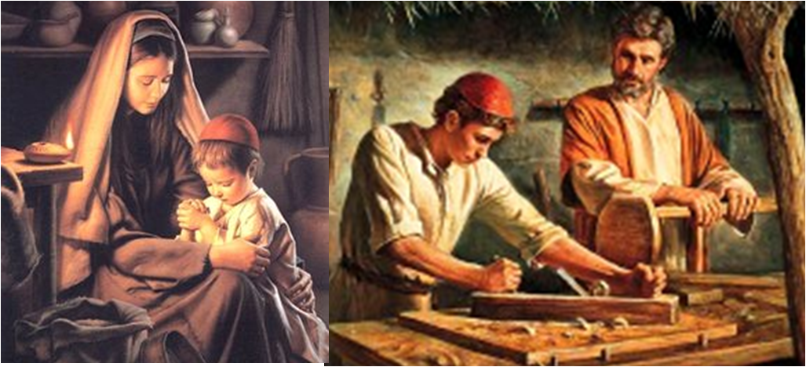
Jesus grew in wisdom.

Slide 6
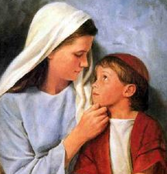
A pattern of speech: “Why are you searching for me?”

Slide 7
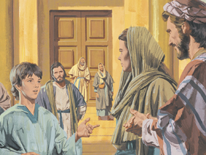
“Didn’t you know I had to be in My Father’s House?”

Slide 8
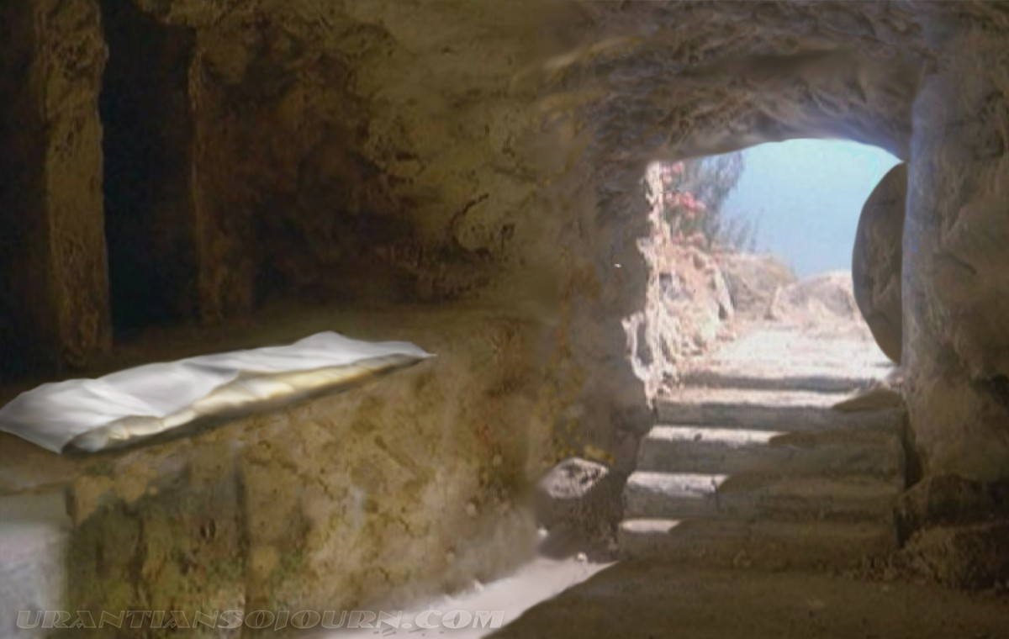
“Why do you look for the living among the dead? He is not here, He is risen!” Luke 24:6

Slide 9
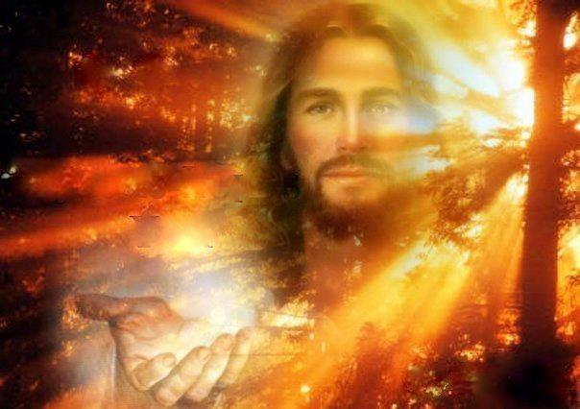
The Scriptures declare that Jesus is Deity. Luke 2:49

Slide 10
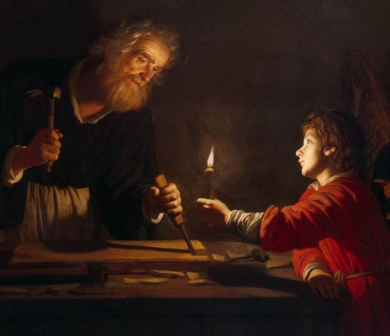
Luke declares Jesus’ humanity. Luke 2:51

Slide 11
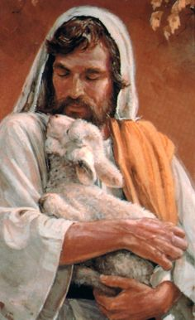
“Who, being in very nature God, did not consider equality with God something to be grasped,

Slide 12
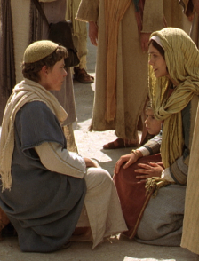
but made himself nothing, taking the very nature of a servant, being made in human likeness.

Slide 13
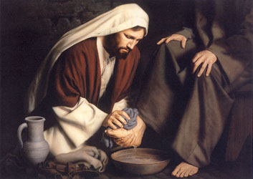
And being found in appearance as a man he humbled himself

Slide 14

“and became obedient to death— even death on a cross.” Philippians 2:6-8

