Slide 1
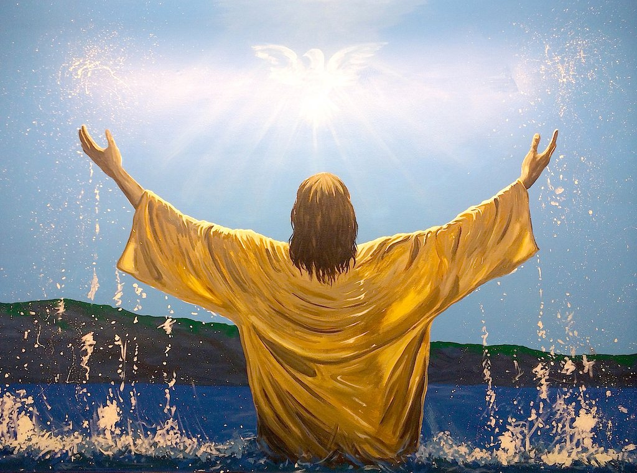
“The Baptism of the Messiah” Matthew 3:14-17 & Luke 3: 21-22

Slide 2

But John tried to deter him saying, “I need to be baptized by you, and do you come to me?”

Slide 3
Jesus replied, “Let it be so now, it is proper for us to do this to fulfill all righteousness.” Then John consented.

Slide 4
As soon as Jesus was baptized, he went up out of the water. At that moment heaven was opened,

Slide 5
and he saw the Spirit of God descending like a dove and lighting on him.

Slide 6
And a voice from heaven said, “This is my Son, whom I love, with him I am well pleased.” Matthew 3:14-17

Slide 7
When all the people were being baptized, Jesus was baptized too.

Slide 8
And as he was praying, heaven was opened and the Holy Spirit descended on him in bodily form like a dove.

Slide 9
And a voice came from heaven: “You are my Son, whom I love; with you I am well pleased.”

Slide 10
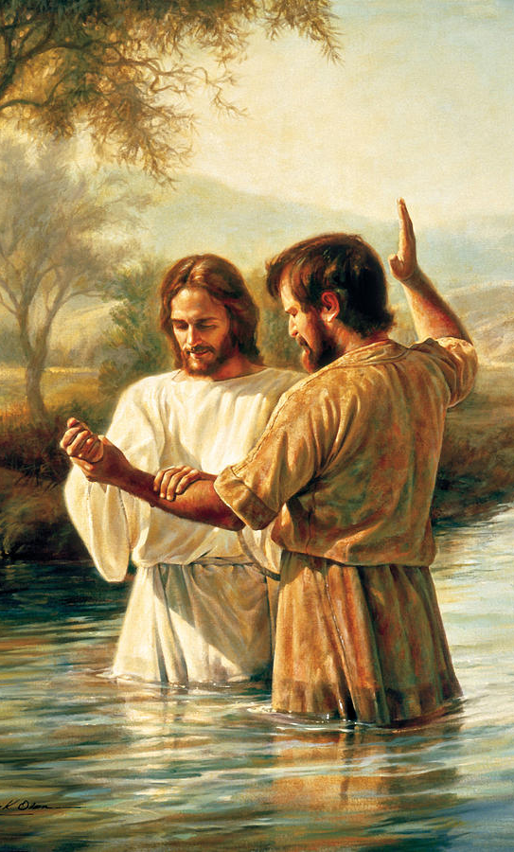
Jesus was baptized to identify himself with those he came to save.

Slide 11
Although Luke's description of the opening of the heavens is not as dramatic as Mark's it makes clear that Jesus is truly God.

Slide 12
"You are my Son, whom I love," designates Jesus as the Son of God.

Slide 13
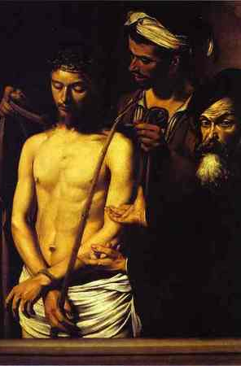
"With you I am well pleased,“ designates Jesus mission to be that of a suffering servant.

Slide 14
This outpouring does not change Jesus’ status. Rather it identifies Him as the promised servant and Son.

Slide 15

“What shall we say, then? Shall we go on sinning so that grace may increase?

Slide 16
By no means! We died to sin, how can we live in it any longer?

Slide 17
Or don’t you know that all of us who were baptized into Christ Jesus were baptized into his death?

Slide 18
We were therefore buried with him through baptism into death in order that just as Christ was raised from the dead through the glory of the Father, . we too may live a new life. . Romans 6:1-4

