Slide 1

“A Kingdom Heart”
Matthew
5:21-26

Slide 2


“You have heard that it was said to the people long ago,
“Do not murder, and anyone who murders will be subject to judgment.”

Slide 3
But I tell you that anyone who is angry with his brother will be subject to judgment.

Slide 4
Again, anyone who says to his brother, “Rach,” is answerable to the Sanhedrin.

Slide 5
But anyone who says,
“You Fool” will be in danger of the fire of hell.

Slide 6
Therefore, if you are offering your gift at the altar and there remember that your brother has something against you, leave your gift there in front of the altar.

Slide 7
First go and be reconciled to your brother, then come and offer your gift.

Slide 8
Settle matters quickly with your adversary who is taking you to court.

Slide 9
Do it while you are still with him on the way, or he may hand you over to the judge,

Slide 10
and the judge may hand you over to the officer and you may be thrown into prison.

Slide 11
I tell you the truth, you will not get out until you have paid the last penny.

Slide 12
“But the fruit of the Spirit is love, joy, peace, patience, kindness, goodness, faithfulness, gentleness, and self-control.

Slide 13
Against such things there is no law. Those who belong to Christ Jesus have crucified the sinful nature with its passions and desires.”

Slide 14
“A Kingdom Heart”
Matthew
5:21-26

Slide 15

The Kingdom Heart identifies “anger” and responds with love.

Slide 16
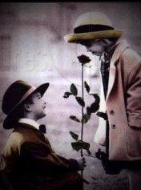
The Kingdom Heart understands “raca” and responds with gentleness.

Slide 17
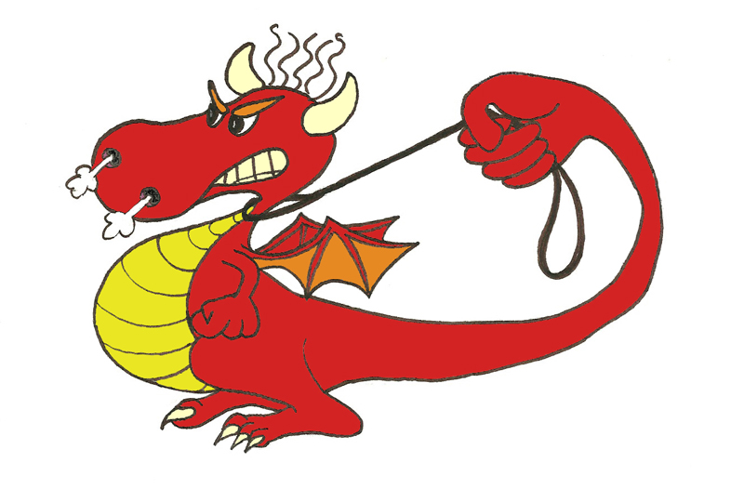
The Kingdom Heart values “fools” (people) and responds in self-control.

Slide 18
“Owe no man any thing, but to love one another: for he that loveth another hath fulfilled the law.”
Romans 13:8- (KJV)

