Slide 1
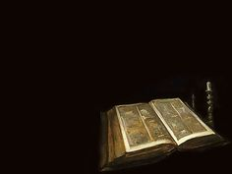
“Well Done My Good and Faithful Servant”
Acts 3:1-10

Slide 2
One day Peter and John were going up to the temple at the time of prayer—at three in the afternoon.

Slide 3
Now a man crippled from birth was being carried to the temple gate called Beautiful,

Slide 4
where he was put every day to beg from those going into the temple courts.

Slide 5
When he saw Peter and John about to enter, he asked them for money.
Peter looked straight at him, as did John.

Slide 6
Then Peter said, “Look at us!”
So the man gave them his attention, expecting to get something from them.

Slide 7
Then Peter said, “Silver or gold
I do not have, but what I have
I give you. In the name of Jesus Christ of Nazareth, walk.”

Slide 8
Taking him by the right hand, he helped him up, and instantly the man’s feet and ankles became strong.

Slide 9
He jumped to his feet and began to walk.

Slide 10
Then he went with them into the temple courts, walking and jumping, and praising God

Slide 11
When all the people saw him walking and praising God,

Slide 12
they recognized him as the same man who used to sit begging at the temple gate called Beautiful,

Slide 13
and they were filled with wonder and amazement at what had happened to him.

Slide 14
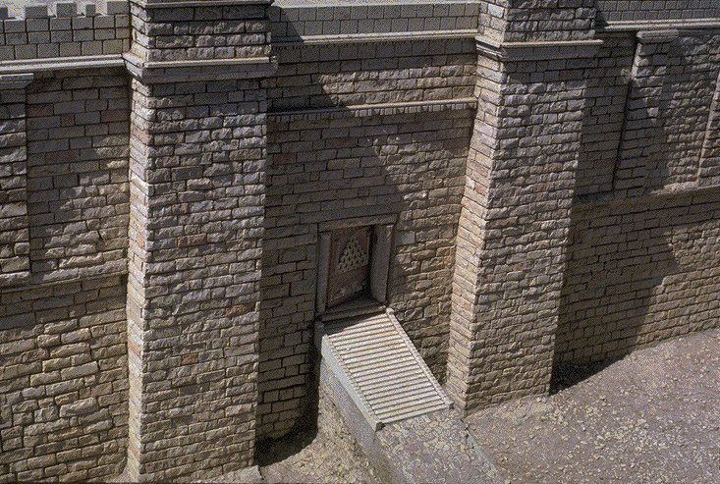

Slide 15
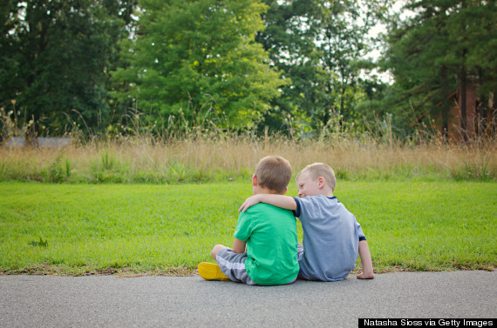
Are you the kind of person
God uses to bless others?

Slide 16
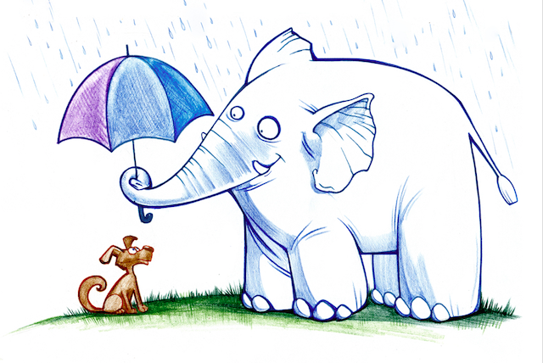

Slide 17
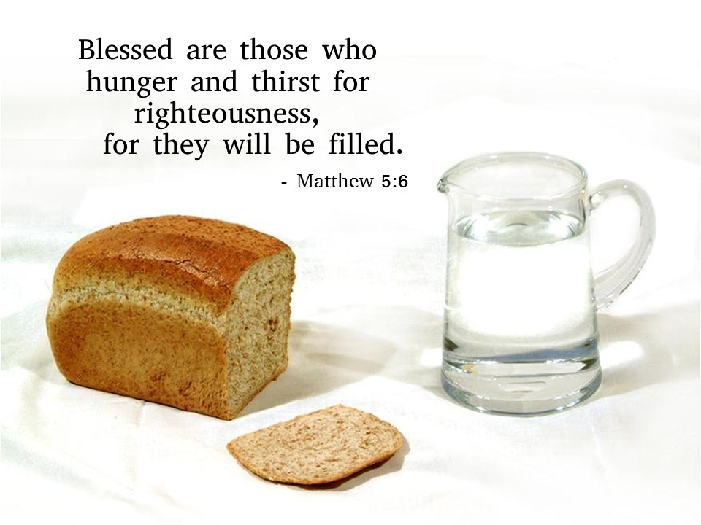

Slide 18
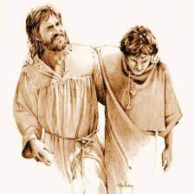
It is a God Thing !
Two gathered together,
A Temple ,
Time of Prayer

Slide 19
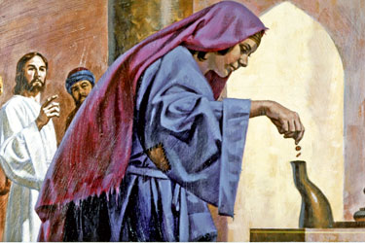
God uses people who use what they have.

Slide 20
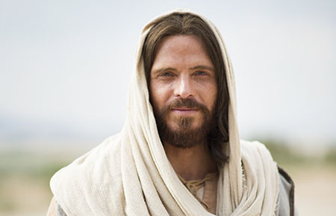
“By faith in the name of Jesus, this man whom you see and know was made strong…

Slide 21
Repent, then, and turn to God, so that your sins may be wiped out,

Slide 22
that times of refreshing may come from the Lord,

Slide 23
and that he may send the Christ, who has been appointed to you even Jesus.”
Acts 3:16; 19-20

