Slide 1
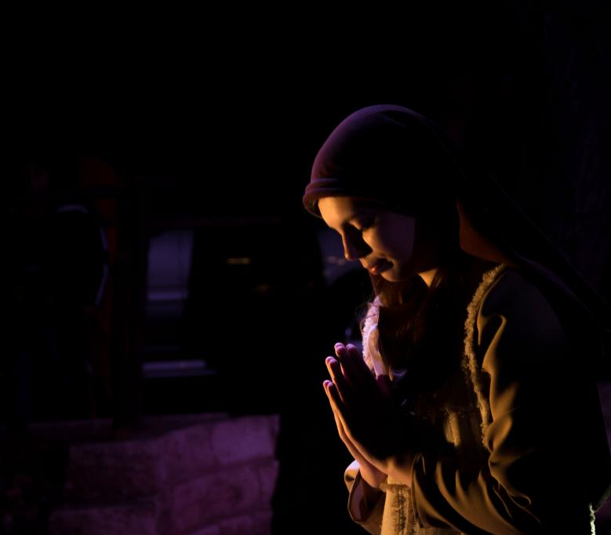
“The Gift of a Woman Who Exalts the Lord” Luke 1:26-35

Slide 2

In the sixth month, God sent the angel Gabriel to Nazareth, a town in Galilee

Slide 3
to a virgin pledged to be married to a man named Joseph, a descendant of David.

Slide 4
The virgin’s name was Mary. The angel went to her and said, “Greetings, you who are highly favored! The Lord is with you.”

Slide 5
Mary was greatly troubled at his words and wondered what kind of greeting this might be.

Slide 6
But the angel said to her, “Do not be afraid, Mary, you have found favor with God.

Slide 7
You will be with child and give birth to a son, and you are to give him the name Jesus.

Slide 8
He will be great and will be called the Son of the Most High.

Slide 9
The Lord God will give him the throne of his father David,

Slide 10
and he will reign over the house of Jacob forever, his kingdom will never end.”

Slide 11
“How will this be,” Mary asked the angel, “since I am a virgin?”

Slide 12
The angel answered, “The Holy Spirit will come upon you, and the power of the Most High will overshadow you.

Slide 13
So the holy one to be born will be called the Son of God.

Slide 14
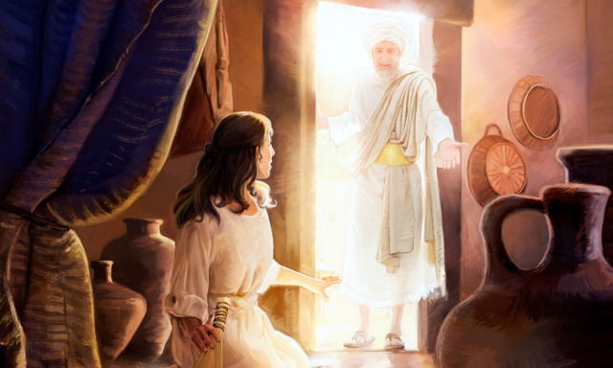
Who was Mary? She found favor with God Luke 1:28

Slide 15
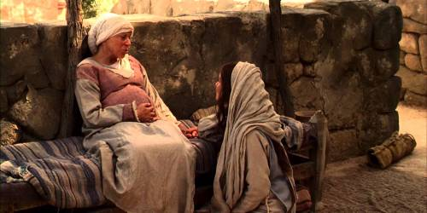
She was the Lord’s servant. Luke 1:38

Slide 16
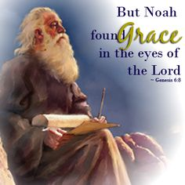
She brings to mind the memory of Noah. Genesis 6:8

Slide 17

She glorified the Lord. Luke 1:46

Slide 18
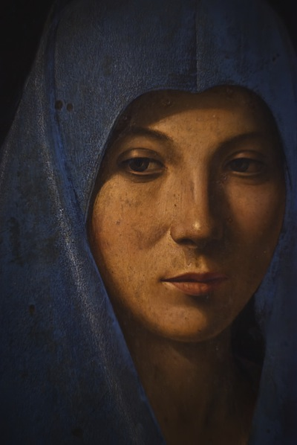
She was in need of a Savior. Luke 1:47

Slide 19
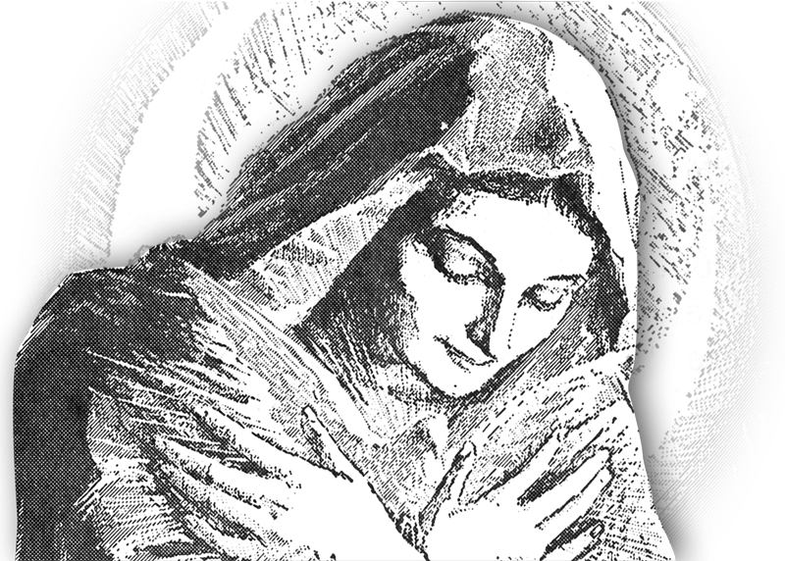
She contemplated what God was doing. Luke 2:19

Slide 20
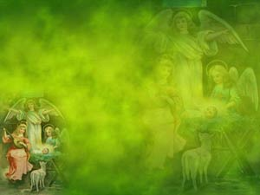
Mary’s servant-hood is an exemplary expression of her submission to God. Luke 1:38

Slide 21

What is the nature of a servant? “We are unworthy servants; we have only done our duty.” Luke 17:1-10

