Slide 1

“The Gift of a Righteous Man” Matthew 1:18-25

Slide 2

This is how the birth of Jesus Christ came about:

Slide 3
His mother Mary was pledged to be married to Joseph, but before they came together, she was found to be with child through the Holy Spirit.

Slide 4
Because Joseph her husband was a righteous man and did not want to expose her to public disgrace, he had in mind to divorce her quietly.

Slide 5
But after he had considered this, an angel of the Lord appeared to him in a dream and said,

Slide 6
“Joseph son of David, do not be afraid to take Mary home as your wife, because what is conceived in her is from the Holy Spirit.

Slide 7
She will give birth to a son, and you are to give him the name Jesus, because he will save his people from their sins.

Slide 8
All this took place to fulfill what the Lord had said through the prophet:

Slide 9
“The virgin will be with child and will give birth to a son, and they will call him Immanuel”--which means, “God with us.”

Slide 10
When Joseph woke up, he did what the angel of the Lord had commanded him and took Mary home as his wife.

Slide 11
But he had no union with her until she gave birth to a son, And he gave him the name Jesus.

Slide 12

What do you think made Joseph Righteous?

Slide 13
Do you think he was righteous because he was a good man?

Slide 14
“All of us have become like one who is unclean, and all our righteous acts are like filthy rags, we all shrivel up like a leaf, and like the wind, our sins sweep us away.” Isaiah 64:6

Slide 15
Being good isn’t good enough.

Slide 16
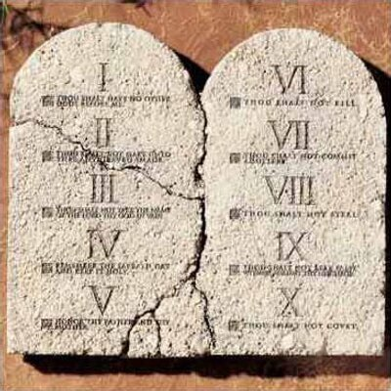
Was Joseph righteous because he obeyed the Ten Commandments?

Slide 17
The Scriptures say, “...for all have sinned and fall short of the glory of God,”

Slide 18
Obeying the Commandments isn’t good enough either!

Slide 19
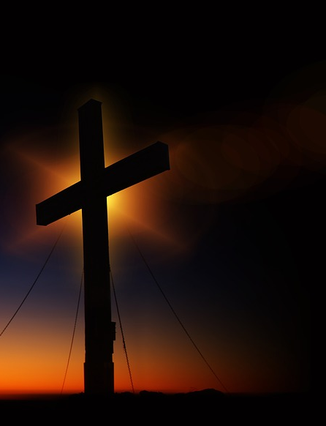
Why did God consider Joseph to be a righteous man?

Slide 20


Slide 21
“For in the gospel the righteousness of God is revealed—a righteousness that is from faith to faith; from first to last, just as it is written: Romans 1:17

Slide 22
“The righteous will live by faith.” Galatians 3:11

Slide 23
The Story of Joseph and Mary is a Story of Faith

Slide 24
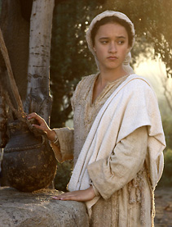
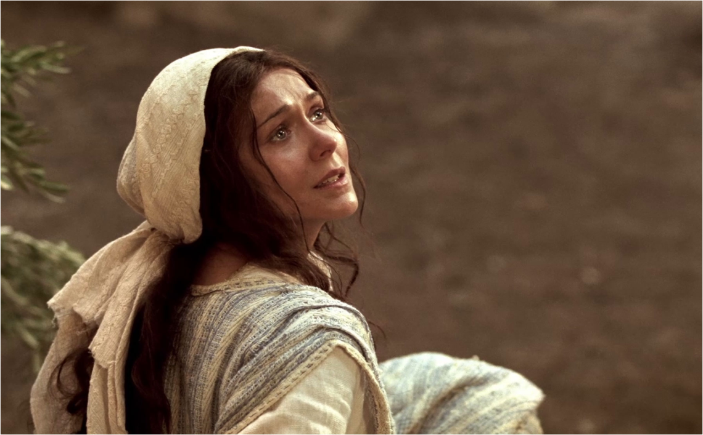
Did Mary love Joseph?

Slide 25
”Behold, the bond slave of the Lord: be it done to me according to your word.” --Mary

Slide 26
But Mary loved God more than Joseph!

Slide 27
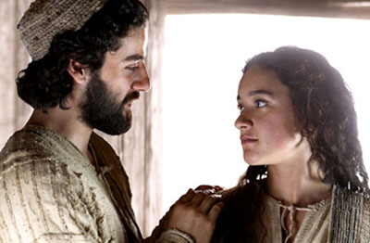
Did Joseph love Mary?

Slide 28
“He (Joseph) did not want to expose her to public disgrace,”

Slide 29
Greek Word: “Boulomai” “Joseph…. …not wanting to expose her…” …not willing to expose her”

Slide 30
“Where your treasure is, there will your heart be also.”

Slide 31
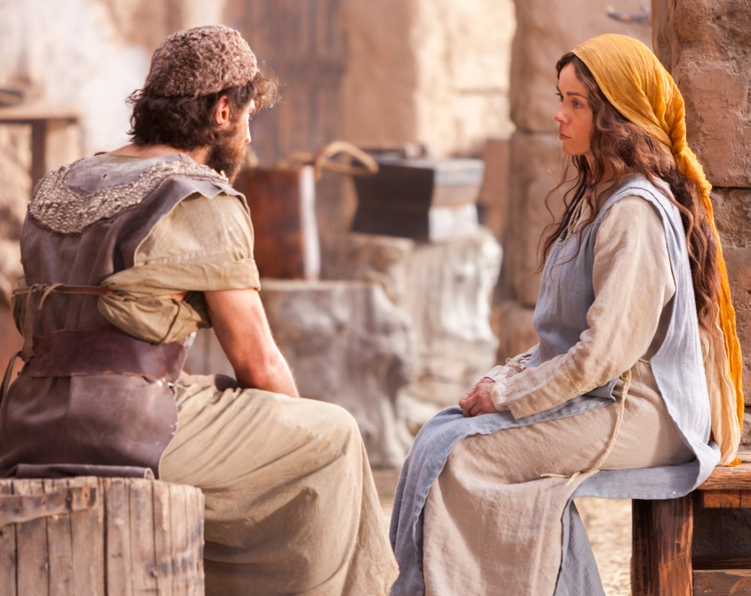
Joseph had to decide what he treasured most.
God or Mary

Slide 32
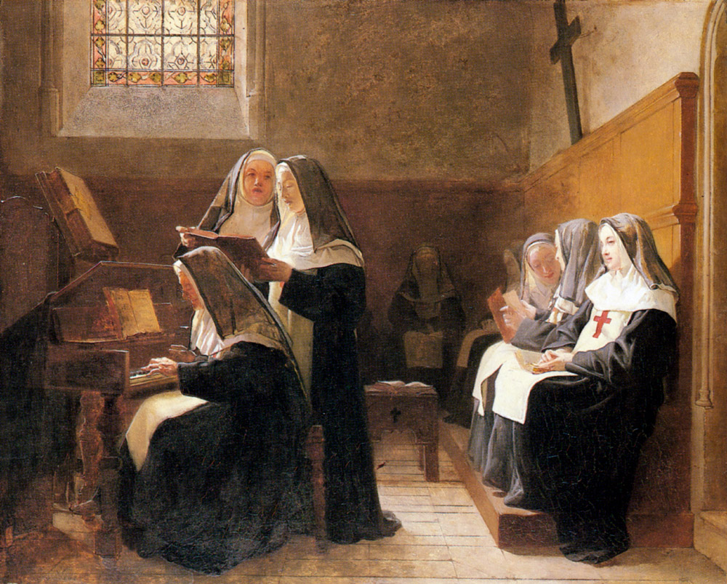
“he (Joseph) had in mind to divorce her quietly.” He had a Plan…

Slide 33
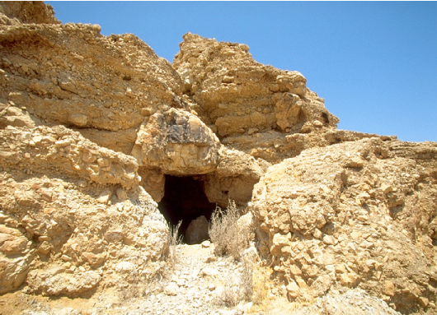
What did his plan look like? Send her to Qumran in the desert?

Slide 34


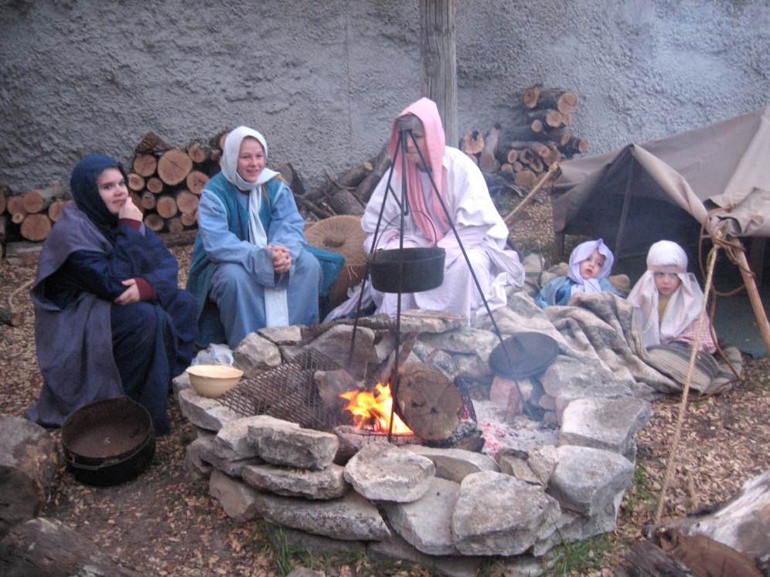
Sentence her to a life of Confinement
Commit her to Life on the streets
Write her aBill of divorce

Slide 35
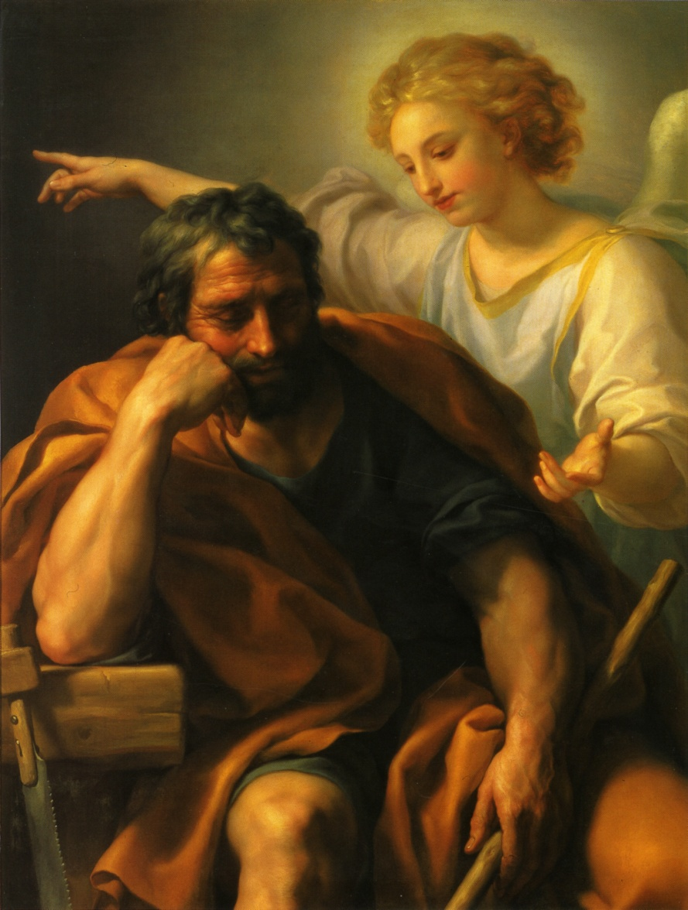
But after he had considered this, an angel of the Lord appeared to him in a dream and said, “Joseph son of David, do not be afraid…”

Slide 36
What was Joseph afraid of? _____________________ Matthew 1:20

Slide 37
What was Joseph afraid of? He was afraid to take Mary home as his wife. Matthew 1:20

Slide 38
Joseph and Mary are a man and a woman who live by Faith in the Son of God!

Slide 39

“The Holy Spirit will come on you, and the power of the Most High will overshadow you. So the holy one to be born will be called the Son of God. Luke 1:32

Slide 40
By Faith Joseph did what the angel of the Lord had commanded him

Slide 41
By Faith Joseph did not consummate their marriage until she gave birth to a son.

Slide 42
By Faith Joseph gave Him the name Jesus.

Slide 43
By Faith “she will bear a son, and you shall call His name Jesus, for it is He who will save his people from their sins.” “…and he called His name Jesus.”

