Slide 1
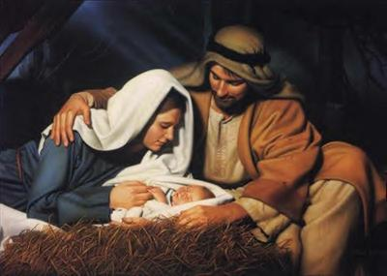
The Gift of Christmas! God’s Family

Slide 2
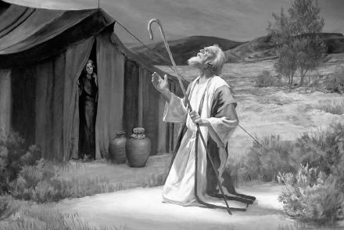
“If you belong to Christ, then you are Abraham’s seed, and heirs according to the promise.

Slide 3
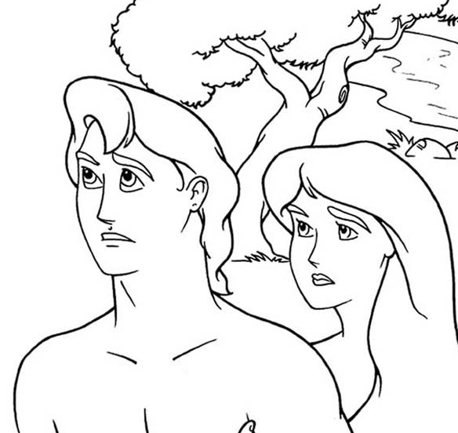
The Messiah will come from the seed of the ________.

Slide 4
The Messiah will come from the seed of the woman.

Slide 5
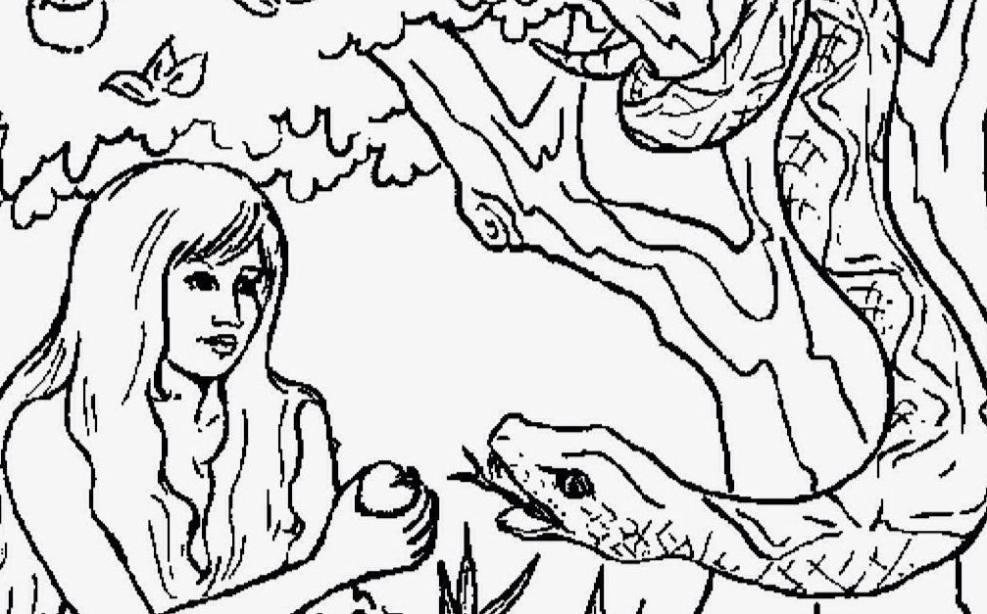
I will put enmity between you and the Woman

Slide 6
The Messiah will come from the seed of ___________.

Slide 7
The Messiah will come from the seed of Abraham.

Slide 8
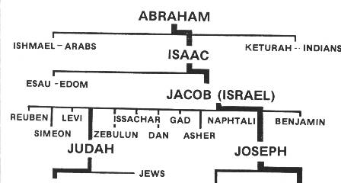
The Messiah will come form the tribe of _________.

Slide 9
The Messiah will come form the tribe of Judah.

Slide 10
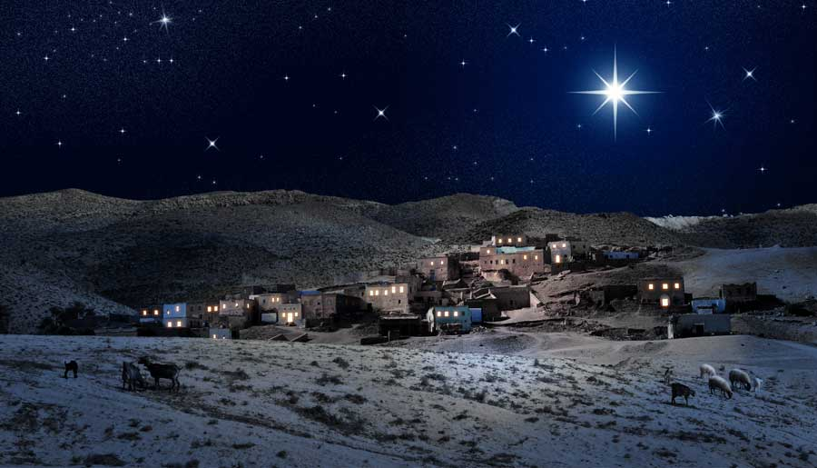
The Messiah will come from the _______ ____ ____________

Slide 11
The Messiah will come from the Town of Bethlehem.

Slide 12
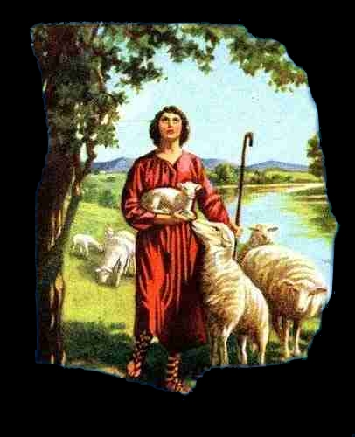
The Messiah will come from the seed of _______

Slide 13
The Messiah will come from the seed of David.

Slide 14
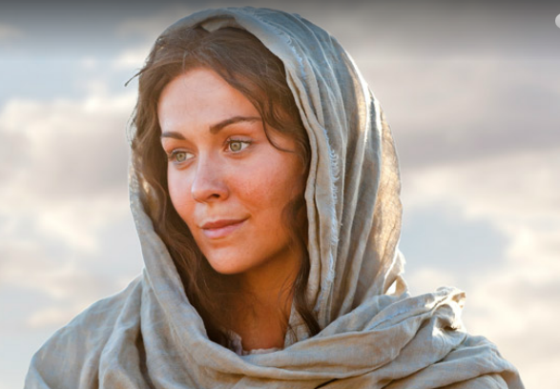
The Messiah will be born of a ______.

Slide 15
The Messiah will be born of a virgin.

Slide 16
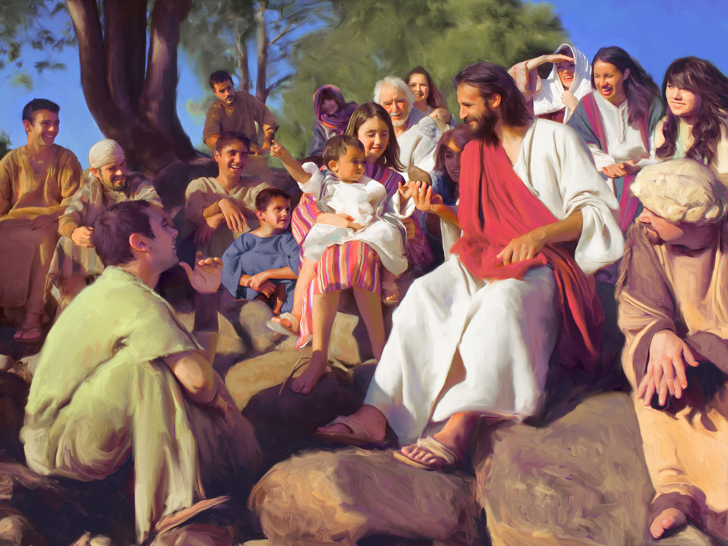
The Messiah will be ImmanueI, “God with us”

Slide 17
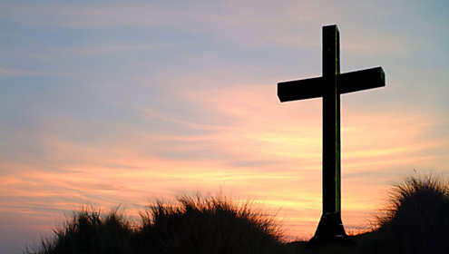
“She will give birth to a Son, and you are to give him the name Jesus, because he will save his people from their sins.”

