Slide 1

“Well Done My Good
And Faithful Servant”
1John 2:15 & 3John 1:2

Slide 2

So not love the world or anything in the world.

Slide 3
If anyone loves the world, the love of the Father is not in him.”
1 John 2:15

Slide 4
“Dear friend,
I pray that you may enjoy good health and that all may go well with you,

Slide 5
Even as your soul is getting along well.”
3 John 1:2

Slide 6
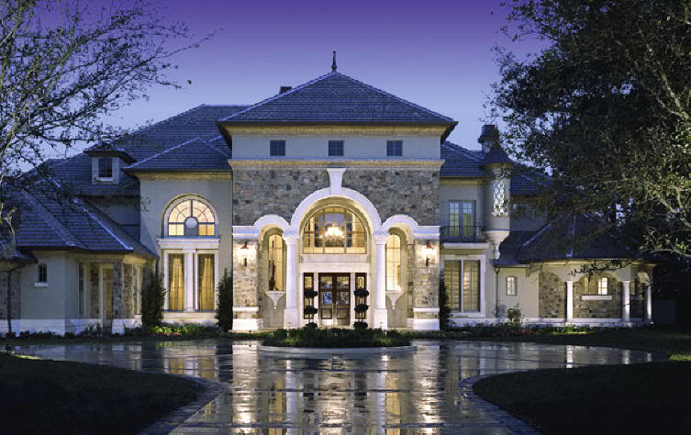
Some people believe in a theology of prosperity.

Slide 7
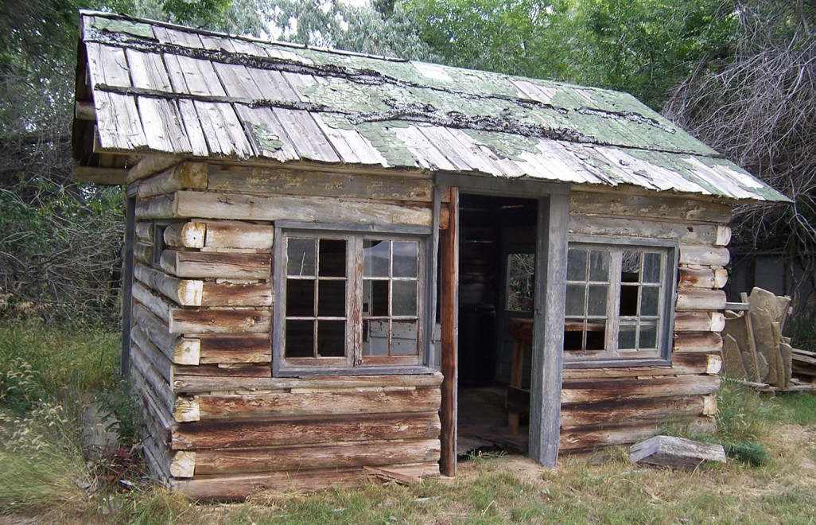
Some people believe in a theology of poverty.

Slide 8


The Problems with prosperity:

Slide 9

1. It is a sign of God’s approval.
(Psalm 5:12)

Slide 10
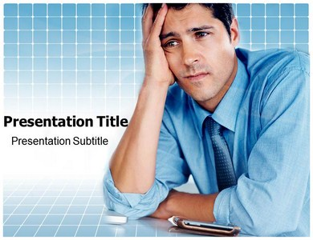
2. It produces guilt.
(Luke 6:38, 11:9-13)

Slide 11

The Problems with
Poverty:

Slide 12

1. Wealth presumes a sense of dishonesty. (Jeremiah 12:1)

Slide 13

2. Poverty is the measuring stick of spirituality.
(Hosea 6:6 & Matthew 9:13)

Slide 14
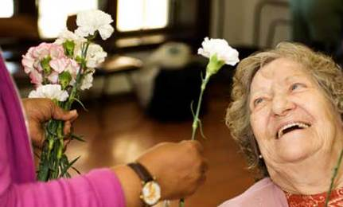
Prosperity Theology says:
Be a channel of God’s blessing.

Slide 15
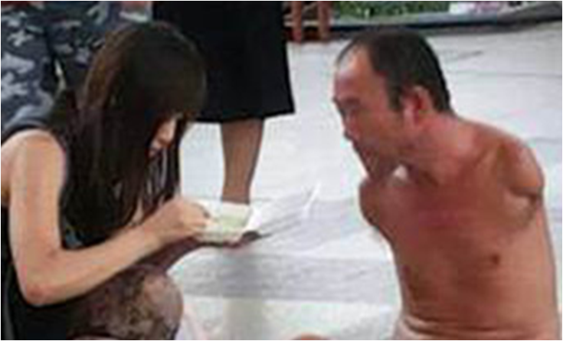
Poverty Theology says:
“Care for the poor.”

Slide 16

Some People believe in a theology of joy.

Slide 17

Cheerful givers believe:

Slide 18

1) Possessions are a trust from God.

Slide 19
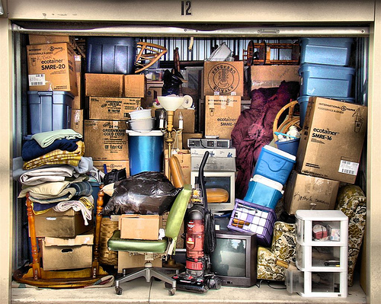
2) Possessions are given in varying proportions.

Slide 20
3) God’s interested in what we are doing with what we have.

