Slide 1

The Joy Of Gratitude!
Luke 6:27-36

Slide 2

But I tell you who hear me:
Love your enemies, do good to those who hate you, bless those who curse you, pray for those who mistreat you.

Slide 3
If someone strikes you on one cheek, turn to him the other also.
If someone takes your cloak, do not stop him from taking your tunic.

Slide 4
Give to everyone who asks you, and if anyone takes what belongs to you, do not demand it back. Do to others as you would have them do to you.

Slide 5
If you love those who love you, what credit is that to you?
Even ‘sinners’ love those who love them.

Slide 6
And if you do good to those who are good to you, what credit is that to you?
Even ‘sinners’ do that.

Slide 7
And if you lend to those from whom you expect repayment, what credit is that to you?
Even ‘sinners’ lend to ‘sinners’, expecting to be repaid in full.

Slide 8
But love your enemies, do good to them, and lend to them without expecting to get anything back.

Slide 9
Then your reward will be great, and you will be sons of the
Most High, because he is kind to the ungrateful and wicked.

Slide 10
Be merciful, just as your
Father is merciful.

Slide 11

“If you are not trustworthy in handling worldly wealth, who will trust with true riches?”
Luke 16:11

Slide 12
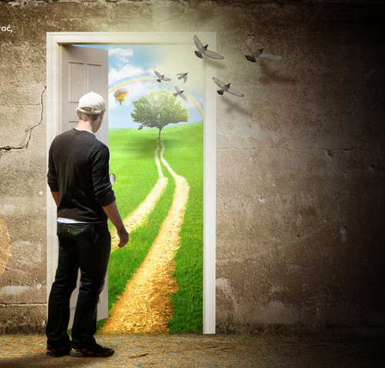
Stewardship begins with giving yourself to God.
“They gave themselves first to the Lord…”
2 Corinthians 8:5

Slide 13
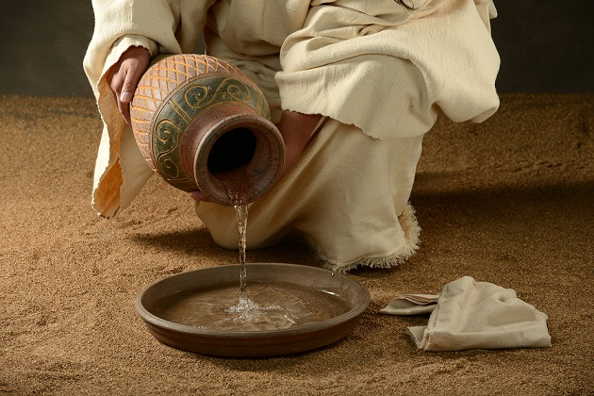
Christ like behavior is a way of life.
“Love your enemies,
Luke 6:27-36

Slide 14
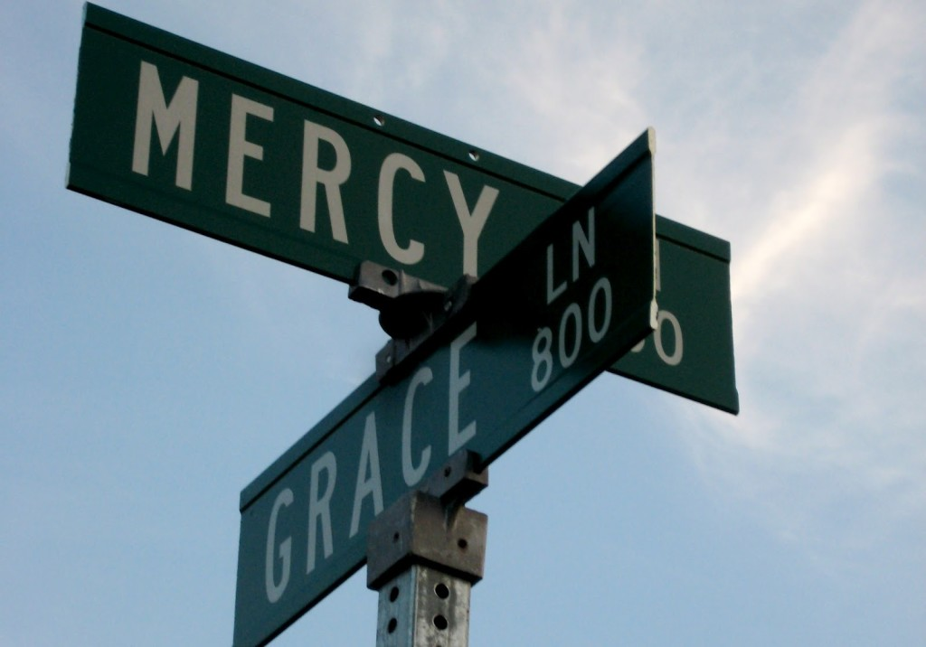
God Desires to Bless you.
It’s a fact
“Give this day our daily bread.”
Matthew 6:11

