Slide 1

The Gifts of Christmas
“The Gift of an Angel”
Luke 1:5-20

Slide 2
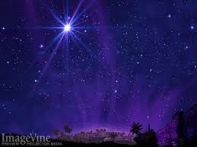
Zechariah’s name means
“Yahweh remembers.”
God always remembers.

Slide 3
Every prayer that went seemingly unanswered,
God remembers.

Slide 4
Every moment when you felt like the heavens were strangely silent, God remembers.

Slide 5
That’s the testimony of Zechariah today:
Don’t give up on your miracle—
God has not forgotten you.

Slide 6
The Gifts of Christmas
“The Gift of an Angel”
Luke 1:5-20

Slide 7
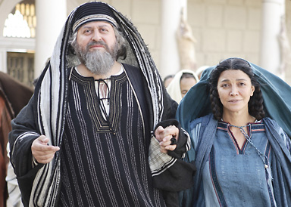
How is God is preparing
your life?
“Both of them were
Upright in the sight
of the God.”

Slide 8
How is God is preparing
your life?
“Both of them were
Upright in the sight
of the God.”

Slide 9
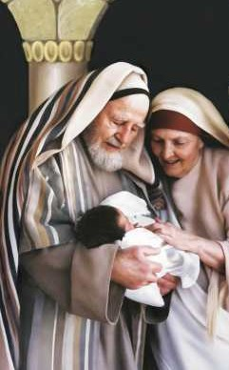
How does God clarify greatness?

Slide 10
How does God clarify greatness?
He will be a joy and a delight to you, and many will rejoice because of his birth.

Slide 11
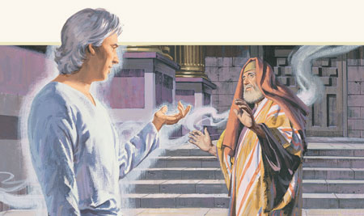
What is God’s plan for your life?

Slide 12
What is God’s plan for your life?
“I am Gabriel.
I stand in the presence of God, and I have been sent to speak to you and tell you this good news,”

