Slide 1
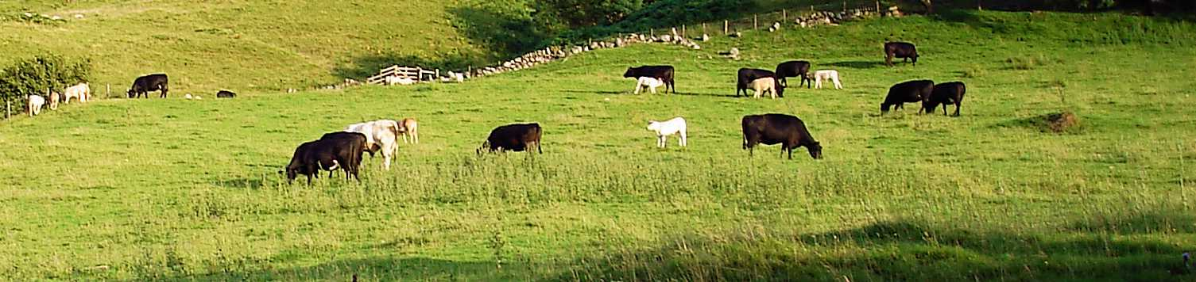
“He Owns The Cattle
On A Thousand Hills”
Matthew 25:14-30

Slide 2
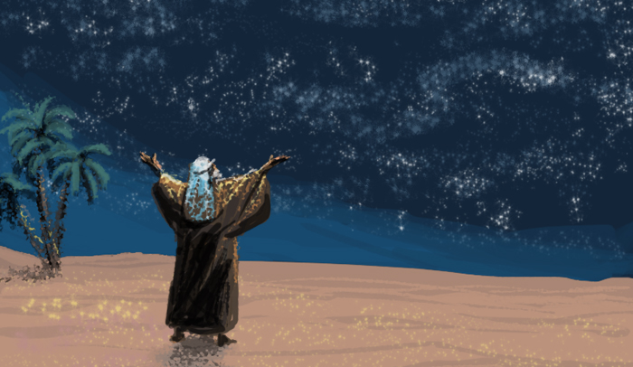
“…all of it belongs to you. “
I Chronicles 29:16

Slide 3
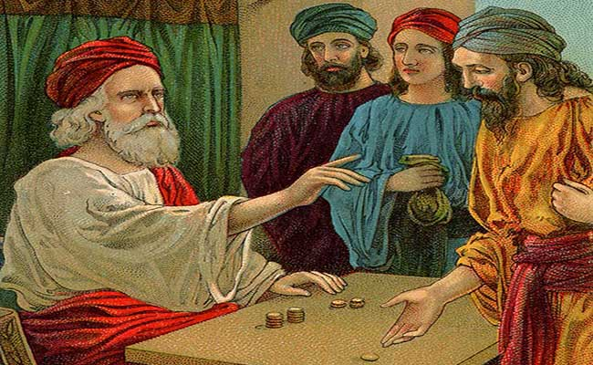
The kingdom of heaven is like a man who entrusts his possessions to his servants.

Slide 4
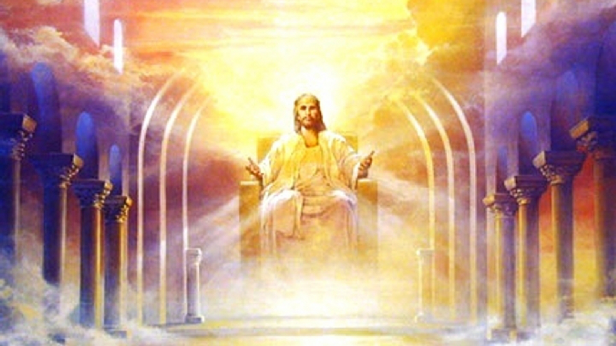
This parable is a glimpse into Kingdom life .

Slide 5
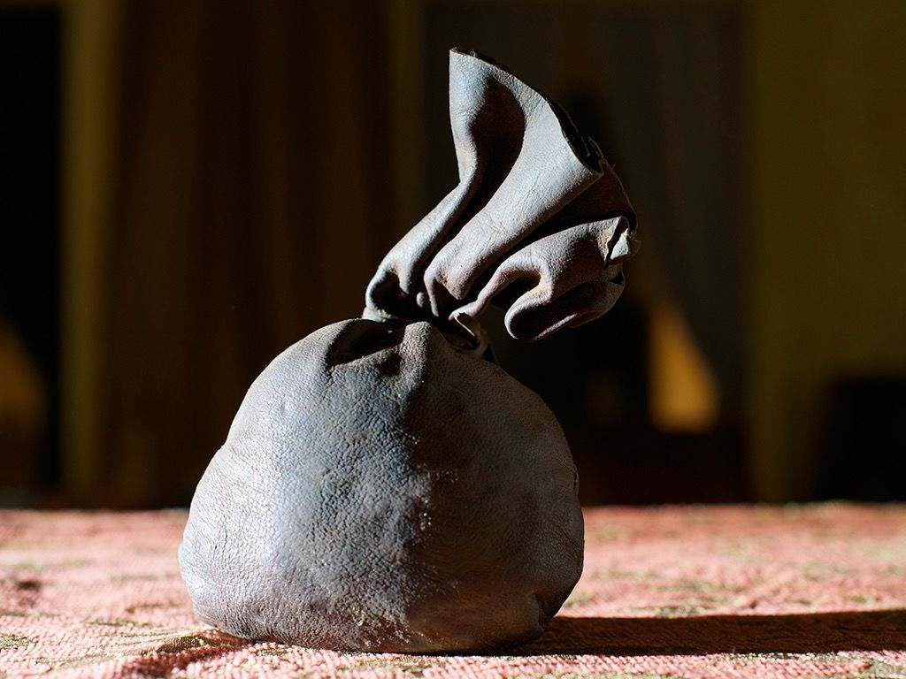
This parable is about great wealth.

Slide 6
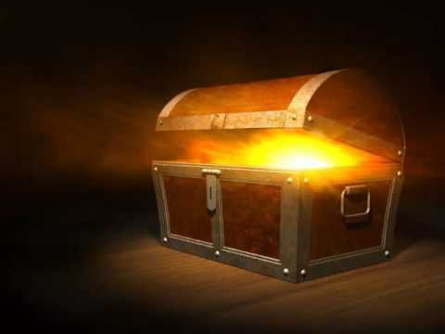
Where your treasure is, there will your heart be also.
Matthew 6:21

Slide 7

This parable is about one’s love for God.

Slide 8
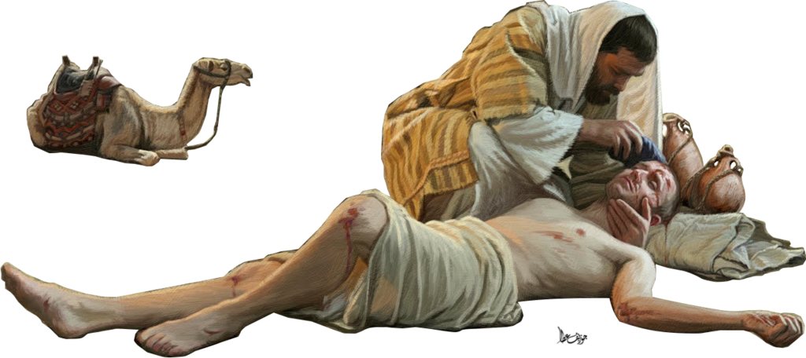
So in everything, do to others what you would have them do to you,

Slide 9
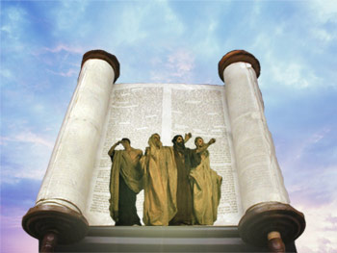
for this sums up the law and the prophets.
Matthew 7:12

Slide 10
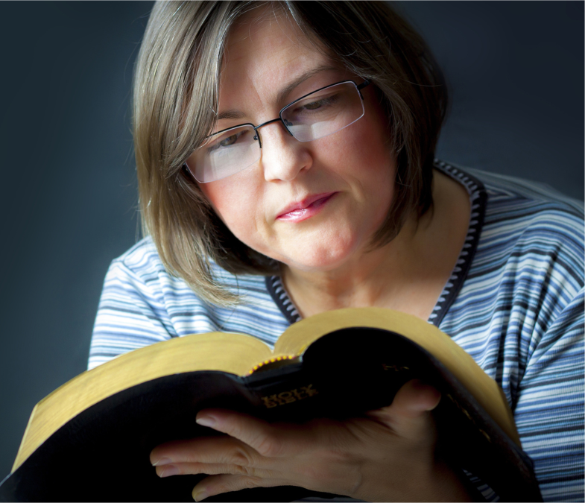
This is a parable about honoring God.

Slide 11

Give, and it shall be given unto you; good measure, pressed down,

Slide 12
and shaken together, and running over, shall men give into your bosom.

Slide 13
For with the same measure that ye mete withal it shall be measured to you again.
Luke 6:38

Slide 14
Come and Share
Your Master’s Joy. or
There will be weeping and gnashing of teeth.

