Slide 1

Waiting
1Samuel 3:1-11

Slide 2

The boy Samuel ministered before the LORD under Eli, in those days the word of the LORD was rare; there were not many visions.

Slide 3
One night Eli, whose eyes were becoming so weak that he could barely see, was lying down in his usual place.

Slide 4
The lamp of God had not yet gone out, and Samuel was lying down in the temple of the LORD, where the ark of God was.
Then the LORD called Samuel.

Slide 5
Samuel answered. “Here I am.” And he ran to Eli and said,
“Here I am, you called me.”

Slide 6
But Eli said, “I did not call; go back and lie down.”
So he went and lay down.

Slide 7
Again the LORD called, “Samuel!” And Samuel got up and went to Eli and said,
“Here I am; you called me.”

Slide 8
“My son, ‘ Eli said,
“I did not call; to back and lie down.”
.

Slide 9
Now Samuel did not yet know the LORD:
The word of the LORD had not yet been revealed to him.

Slide 10
The LORD called Samuel a third time, and Samuel got up and went to Eli and said,
“Here I am; you called me.”

Slide 11
Then Eli realized that the LORD was calling the boy.

Slide 12
So Eli told Samuel,
“Go and lie down, and if he calls you, say,
“Speak, LORD, for your servant is listening.

Slide 13
So Samuel went and lay down in his place.
The LORD came and stood there, calling as at the other times, “Samuel, Samuel!”

Slide 14
Then Samuel said, “Speak, for your servant is listening.” And the LORD said to Samuel:

Slide 15
“See, I am about to do something in Israel that will make the ears of everyone who hears of it tingle.”

Slide 16
Waiting
1Samuel 3:1-11

Slide 17

“And this is my prayer, that your love may abound more and more and more in knowledge and depth of insight,

Slide 18
so that you may be able to discern what is best and may be pure and blameless for the day of Christ.”

Slide 19
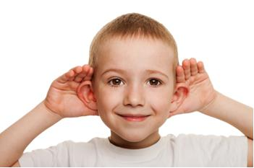
God is looking for people who will listen to Him.

Slide 20
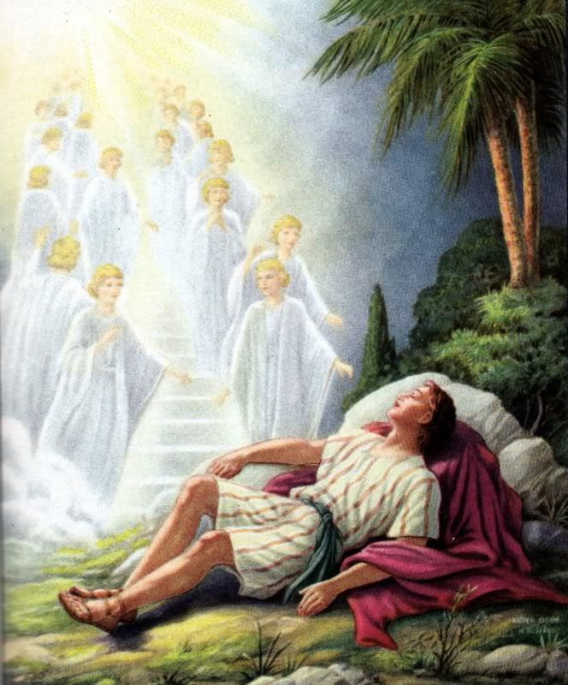
Sleeping next to God is critical to hearing him speak.

Slide 21
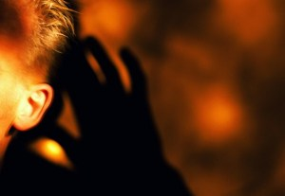
Listening to God is inconvenient.

Slide 22
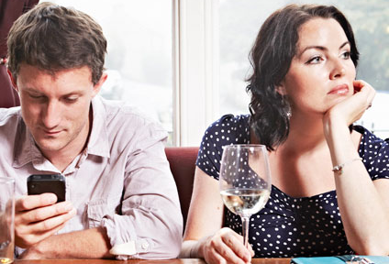
God seldom speaks to people who aren’t interested.

