Slide 1
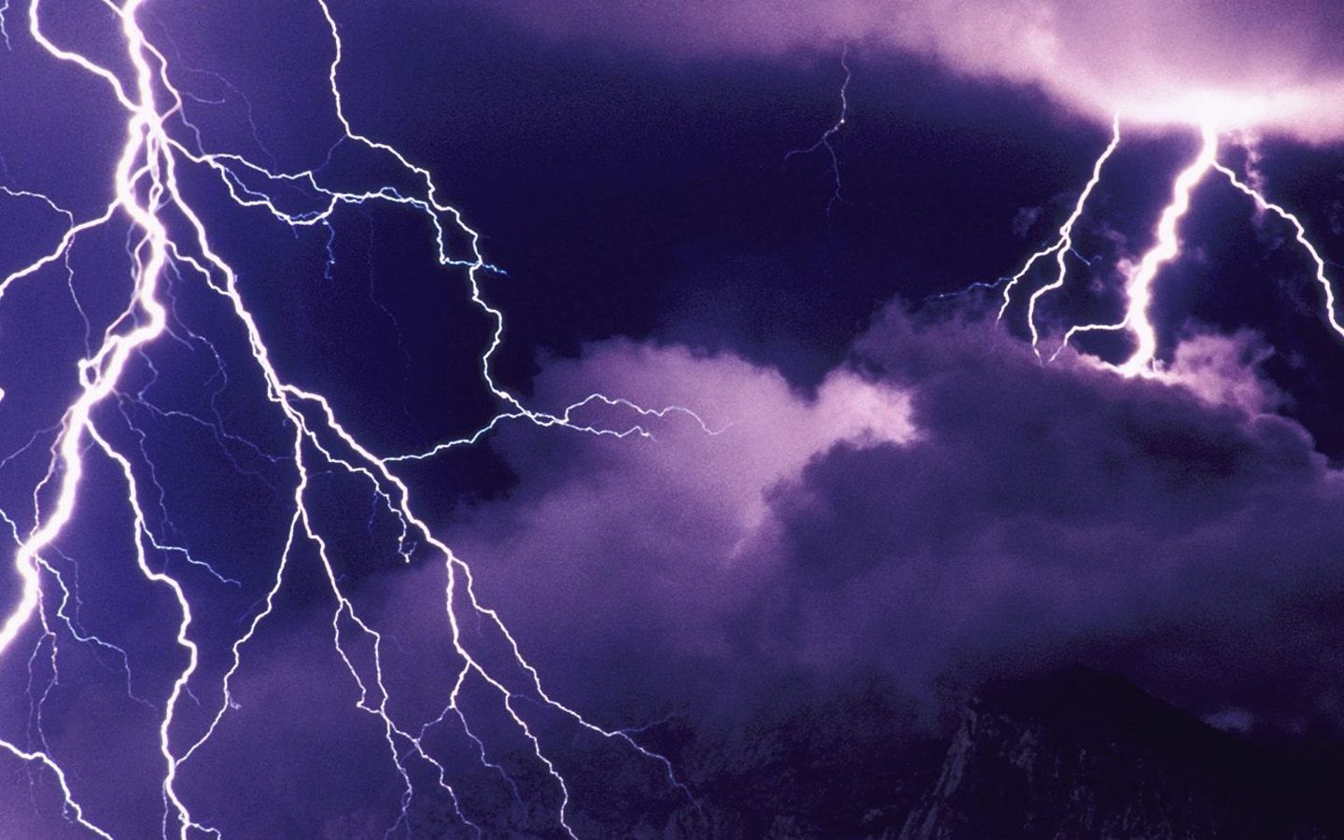
“Every One Has A Storm” Matthew 14:22-34

Slide 2

Immediately Jesus made the disciples get into the boat and go on ahead of him to the other side, while he dismissed the crowd.

Slide 3
After he had dismissed them, he went up on a mountainside by himself to pray.

Slide 4
When evening came, he was there alone, but the boat was already a considerable distance from land,

Slide 5
buffeted by the waves because the wind was against it.

Slide 6
During the fourth watch of the night Jesus went out to them, walking on the lake.

Slide 7
When the disciples saw him walking on the lake, they were terrified.

Slide 8
“It’s a ghost,” they said, and cried out in fear.

Slide 9
But Jesus immediately said to them: “Take courage! It is I, Don’t be afraid.”

Slide 10
“Lord, if it’s you,” Peter replied, “tell me to come to you on the water.” “Come,” he said.

Slide 11
Then Peter got down out of the boat, walked on the water and came toward Jesus.

Slide 12
But when he saw the wind, he was afraid and, beginning to sink, cried out, “Lord, save me!”

Slide 13
Immediately Jesus reached out his hand and caught him, “You of little faith,” he said, “why did you doubt?”

Slide 14
And when they climbed into the boat, the wind died down.

Slide 15
Then those who were in the boat worshipped him, saying, “Truly you are the Son of God.”

Slide 16
When they had crossed over, they landed at Gennesaret.

Slide 17
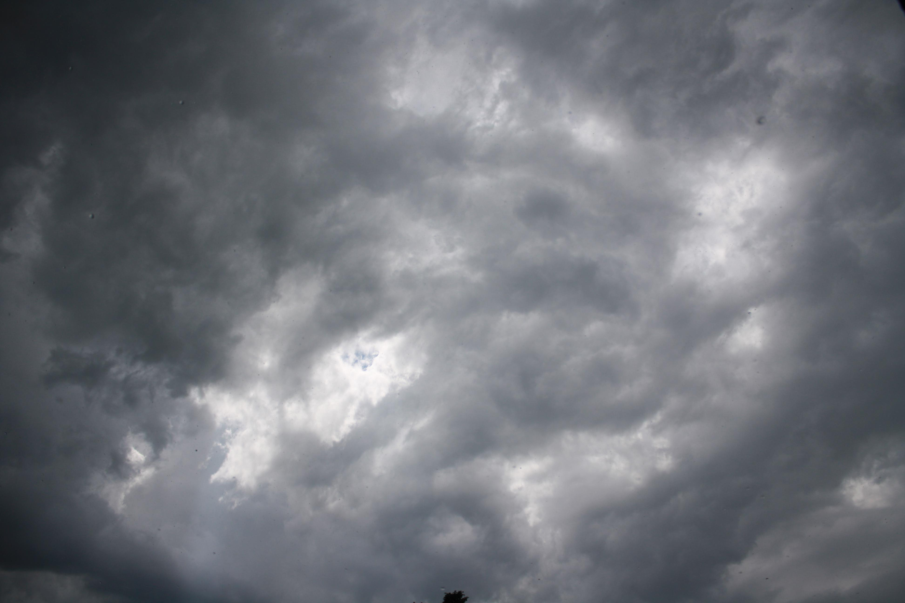
What does Jesus do for us in a storm?

Slide 18
Jesus prays for us.

Slide 19
Jesus comes to us

Slide 20
Jesus ministers to us

Slide 21
“We know that in all things God work for the good of those who love him, who have been called according to his purpose.” Romans 8:28

