Slide 1
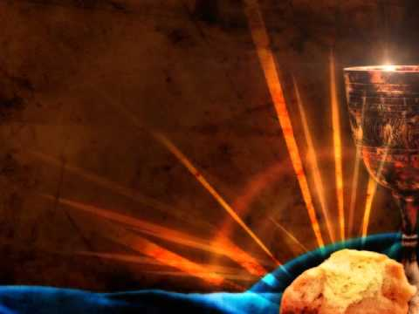
Communion Romans 15:1-13

Slide 2

We who are strong ought to bear with the failings of the weak and not to please ourselves.

Slide 3
Each of us should please his neighbor for his good, to build him up.

Slide 4
For even Christ did not please himself but, as it written:

Slide 5
“The insults of those who insult you have fallen on Me.”

Slide 6
For everything that was written in the past was written to teach us,

Slide 7
so that through endurance and the encouragement of the Scriptures we might have hope.

Slide 8
May the God who gives endurance and encouragement give you a spirit of unity among yourselves as you follow Christ Jesus,

Slide 9
so that with one heart and mouth you may glorify the God and Father of our Lord Jesus Christ.

Slide 10
Accept on another, then, just as Christ accepted you, in order to bring praise to God.

Slide 11
For I tell you that Christ has become a servant of the Jews on behalf of God’s truth,

Slide 12
to confirm the promises made to the patriarchs so that the Gentiles may glorify God for His mercy, as it is written:

Slide 13
“Therefore I will praise you among the Gentiles; I will sing hymns to your name.”

Slide 14
Again, it says, “Rejoice, O Gentiles, with His people.”

Slide 15
And again, “Praise the Lord, all you Gentiles, and sing praises to Him, all you peoples”

Slide 16
And again Isaiah says: The Root of Jesse will spring up,

Slide 17
one who will arise to rule over the nations; the Gentiles will hope in Him.”

Slide 18
May the God of hope fill you with all joy and peace as you trust in Him,

Slide 19
so that you may overflow with hope by the power of the Holy Spirit.

Slide 20
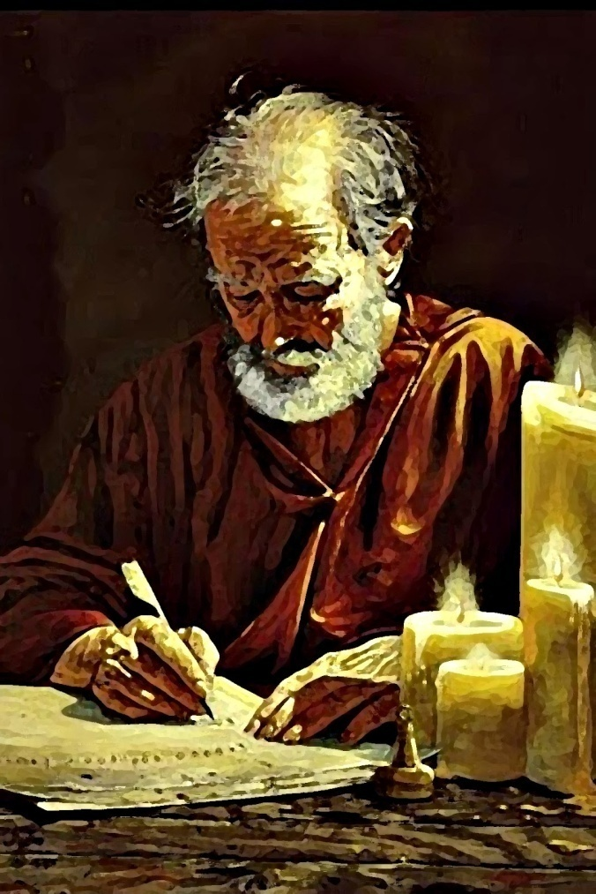
What do you think Paul was contemplating as he wrote these words?

Slide 21


What do you think of when you think of opposites?

Slide 22

Light, dark; Joy, sorrow; Strength, weakness; Loss, gain.

Slide 23
What about the word saint? sinner.

Slide 24

The cup of blessing which we bless, is it not the communion of the blood of Christ?

Slide 25
The bread which we break, is it not the communion of the body of Christ?

Slide 26
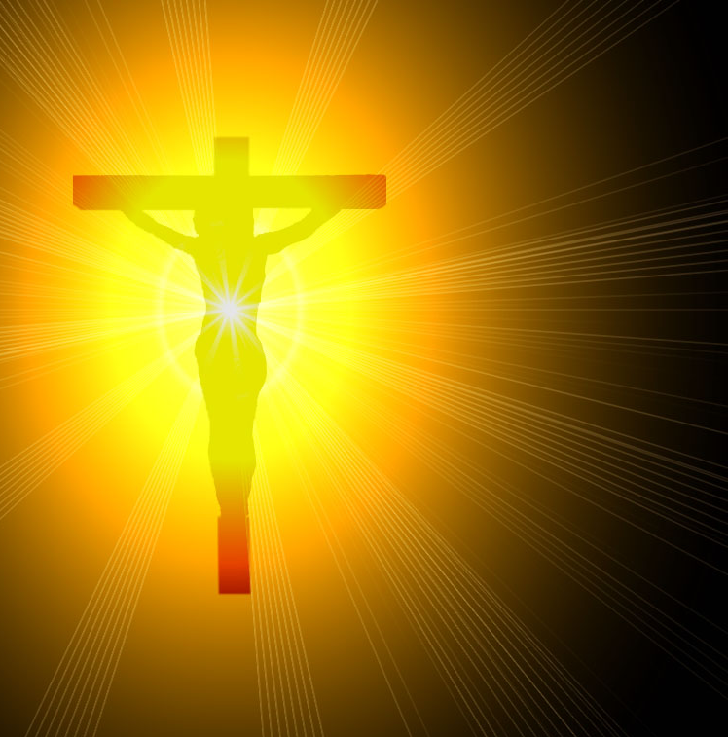
We have tended to look at the communion service as a reminder of the suffering and death of Jesus Christ.

Slide 27

Paul, after the words of instruction, speaks of “discerning the body.” Whose body is he talking about?

Slide 28

In 1 Corinthians 12:27 he says, “You are the body of Christ.”

Slide 29

Could communion be about the reality that we belong to each other?

Slide 30

The grace of the Lord Jesus Christ, and the love of God, and the communion of the Holy Ghost, be with you all. Amen.

