Slide 1

John 1:6-13

Slide 2
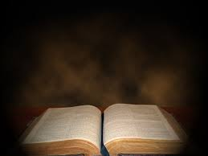
There came a man who was sent from God; his name was John.

Slide 3
He came as a witness to testify concerning that light, so that through him all men might believe.

Slide 4
He himself was not the light; he came only as a witness to the light.

Slide 5
The true light that gives light to every man was coming into the world.

Slide 6
He was in the world, and though the world was made through him, the world did not recognize him.

Slide 7
He came to that which was his own, but his own did not receive him.

Slide 8
Yet to all who received him, to those who believed in his name, he gave the right to become children of God—

Slide 9
children born, not of natural descent, not of human decision, or a husband’s will, but born of God.

Slide 10
John 1:6-13

Slide 11

There are four characteristics of a person who is born of God that we would like to look at today.

Slide 12
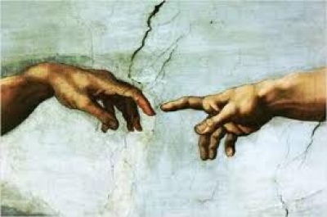
People who are born of God have fellowship with Jesus Christ. 1 Corinthians 1:9

Slide 13

People who are born of God have the inner witness of the Holy spirit.
1 Corinthians 6:19-20

Slide 14

People who are born of God have a desire to live their life for Jesus Christ. 1 Corinthians 8:6

Slide 15

People who are born of God live in light of eternity.
Colossians 1:10-14

