Slide 1


“A Shelter In The Time Of Storm” John 16:5-16

Slide 2

Now I am going to him who sent me, yet none of you asks me, “Where are you going?”

Slide 3
Because I have said these things, you are filled with grief.

Slide 4
But I tell you the truth; it is for your good that I am going away.

Slide 5
Unless I go away, the Counselor will not come to you, but if I go, I will send him to you.

Slide 6
When he comes, he will convict the world of guilt in regard to sin and righteousness and judgment:

Slide 7
in regard to sin, because men do not believe in me;

Slide 8
in regard to righteousness, because I am going to the Father, where you can see me no longer

Slide 9
and in regard to the judgment, because the prince of this world now stands condemned.

Slide 10
I have much more to say to you, more than you can now bear.

Slide 11
But when he the Spirit of truth, comes, he will guide you into all truth.

Slide 12
He will not speak on his own; he will speak only what he hears, and he will tell you what is yet to come.

Slide 13
He will bring glory to me by taking from what is mine and making it known to you. All that belongs to the Father is mine.

Slide 14
That is why I said the Spirit will take from what is mine and make it known to you. In a little while you will see me.

Slide 15
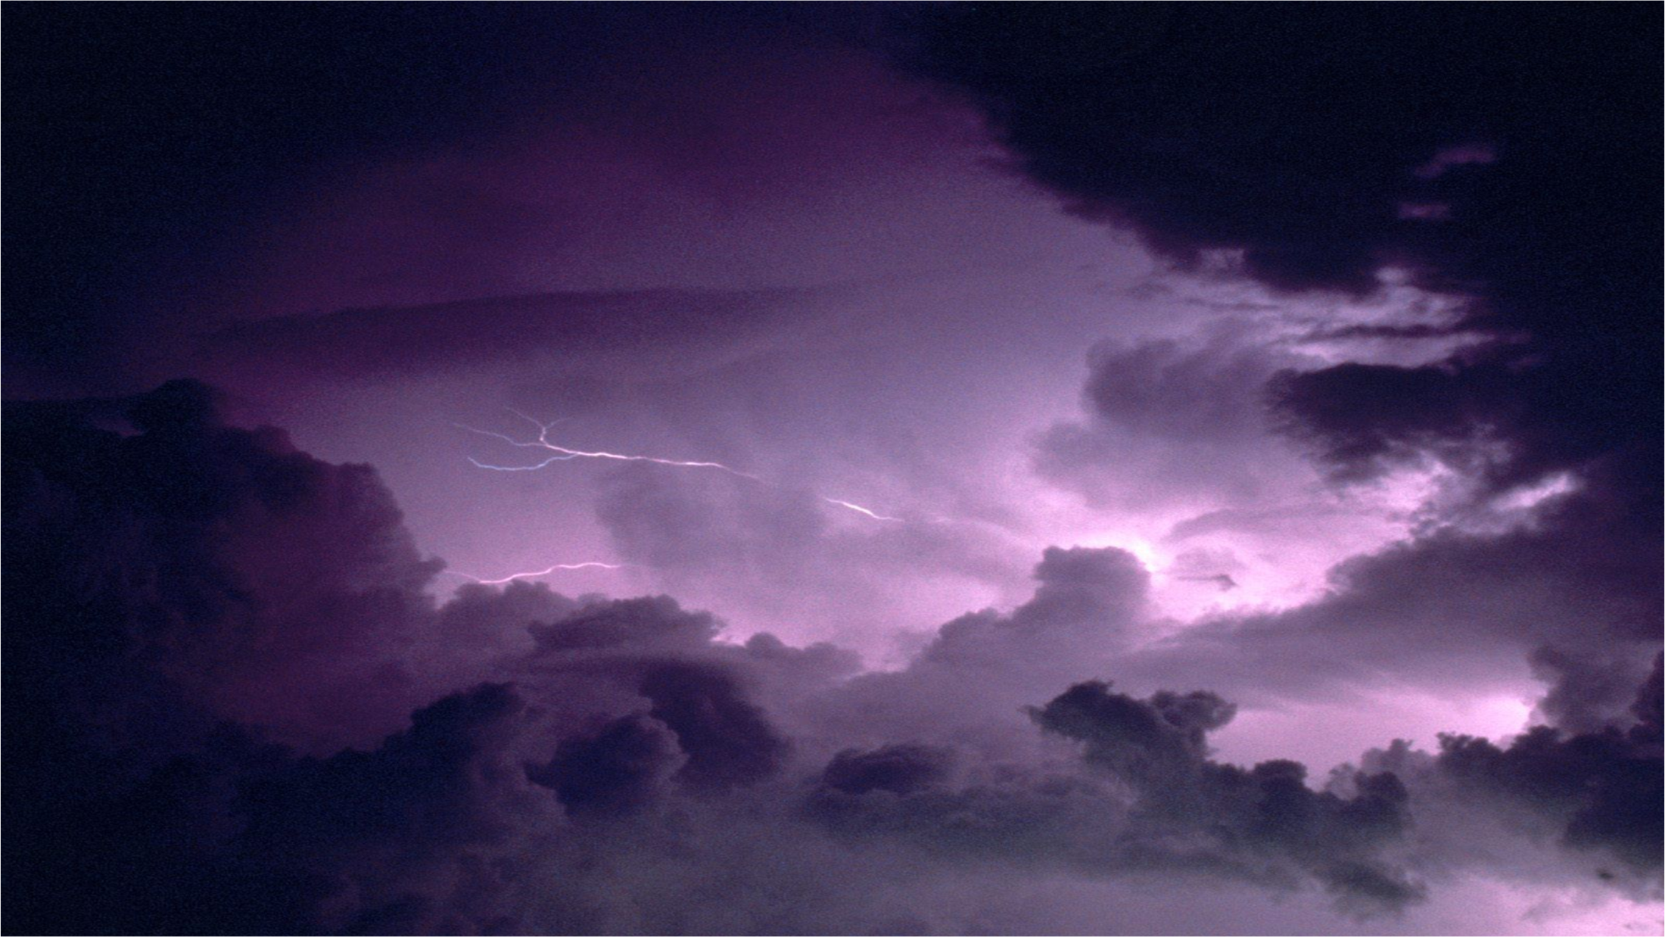
The Holy Spirit prepares us for Life’s storms.

Slide 16
“In a little while you will see me no more, and then after a little while you will see me.” John 16:16

Slide 17


The Holy Spirit Reveals Sin and Justice to us.

Slide 18
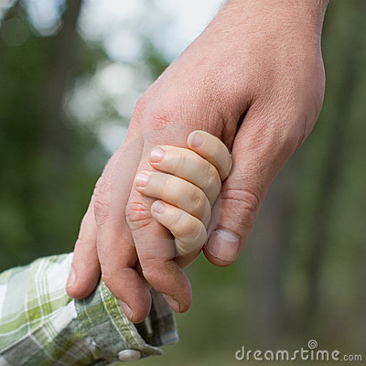
The Holy Spirit Guides us into all truth.

Slide 19
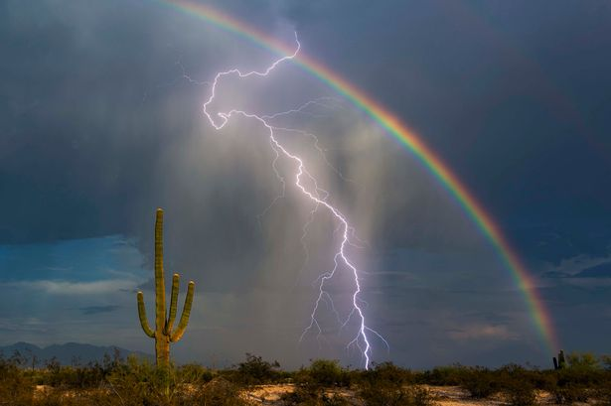
The Holy Spirit uses the storms to Glorify God.

Slide 20

“I Tell you the truth: It is for your good that I am going away.

Slide 21

Unless I go away, the Counselor will not come to you; but if I go I will send him to you.”

