Slide 1

“Peace”
Isaiah 26:3-4
Proverbs 3:5-6
Philippians 4:4-7

Slide 2
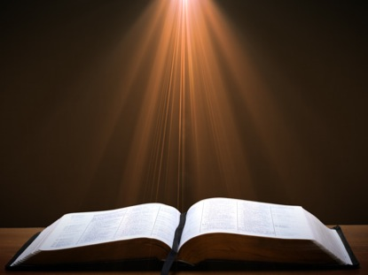
Isaiah 26; 3-4
You will keep in perfect peace him whose mind is steadfast, because he trusts in you.

Slide 3
Trust in the Lord forever, for the Lord, the Lord is the Rock eternal.

Slide 4
Proverbs 3:5-6
Trust in the Lord with all your heart and lean not on your own understanding;

Slide 5
in all your ways acknowledge him, and he will make your paths straight.

Slide 6
Philippians 4:4-7
Rejoice in the Lord always,
I will say it again: Rejoice!
Let your gentleness be evident to all.
The Lord is near.

Slide 7
Do not be anxious about anything, but in everything, by prayer and petition, with thanksgiving, present your requests to God.

Slide 8
And the peace of God, which transcends all understanding, will guard your hearts and your minds in Christ Jesus.

Slide 9
What a great promise!
The peace of God will guard your hearts and your mind.
Philippians 4:4-7

Slide 10
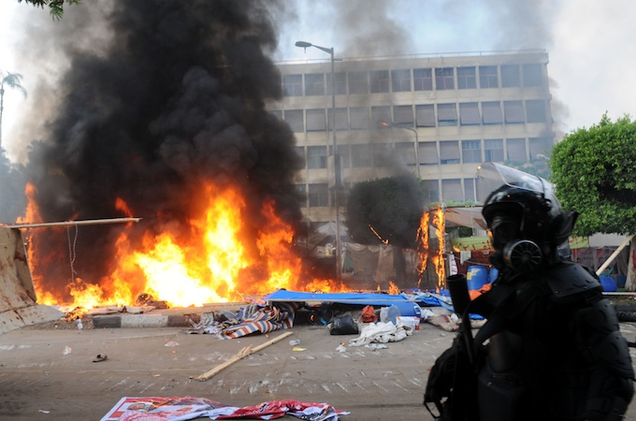
We Need Peace Today

Slide 11

Peace comes from a steadfast mind.
“ Thou wilt keep him in perfect peace whose mind is stayed on thee:…”Isaiah 26:3-4

Slide 12
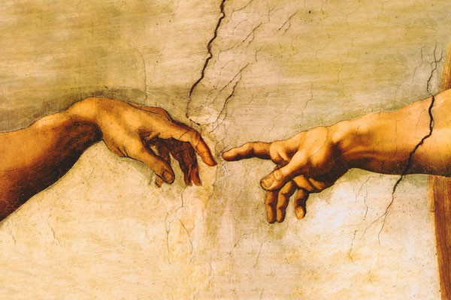
Throughout the Old Testament spiritual peace is realized in relationship.
“Trust ye in the Lord for ever: for in the Lord JEHOVAH is everlasting strength. Isaiah 26:4

Slide 13
Throughout the New Testament spiritual peace is realized in relationship.
“While they were still talking about this, Jesus himself stood among them and said to them, ‘
Peace be with you.” Luke 24:36

Slide 14
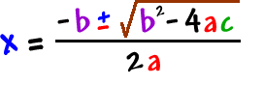
Peace is not found in a formula.
“And he will be called
Wonderful Counselor,
Might God , Everlasting Father, Prince of peace. Isaiah 9:6

