Slide 1
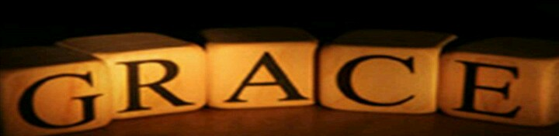
Manasseh: Old Testament
2 Kings 21:1-17

Slide 2
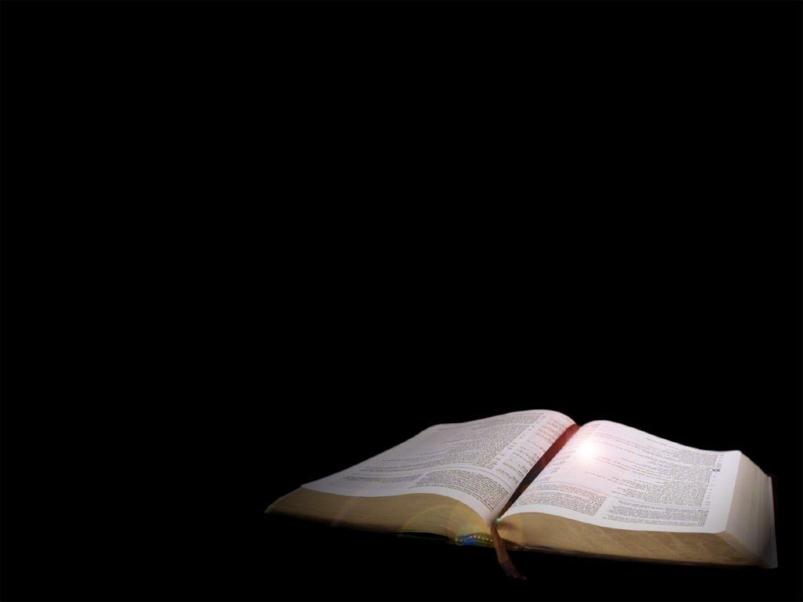
Manasseh was twelve years old when he became king, and he reigned in Jerusalem fifty-five years. His mother’s name was Hephzibh.

Slide 3
He did evil in the eyes of the Lord, following the detestable practices of the nations the
Lord had driven out before the Israelites.

Slide 4
He rebuilt the high places his father Hezekiah had destroyed; he also erected alters to Baal and made an Asherah pole, as Ahab king of Israel had done.

Slide 5
He bowed down to all the starry hosts and worshiped them.
He built altars in the temple of the Lord, of which the Lord had said, “In Jerusalem
I will put my Name.”.

Slide 6
In both courts of the temple of the Lord, he built altars to all the starry hosts.

Slide 7
He sacrificed his own son in the fire, practiced sorcery and divination, and consulted mediums and spirits.

Slide 8
He did much evil in the eyes of the Lord, provoking him to anger.

Slide 9
He took the carved Asherah pole he had made and put it in the temple, of which the Lord had said to David and to his son Solomon,

Slide 10
“In this temple and in Jerusalem, which I have chosen out of all the tribes of Israel,
I will put my Name forever.

Slide 11
I will not again make the feet of the Israelites wander from the land I gave their forefathers,

Slide 12
if only they will be careful to do everything I commanded them and will keep the whole Law that my servant Moses gave them.”

Slide 13
But the people did not listen. Manasseh led them astray, so that they did more evil than the nations the Lord had destroyed before the Israelites.

Slide 14
The Lord said through his servants the prophets: “Manasseh king of Judah has committed these detestable sins.

Slide 15
He has done more evil than the Amorites who preceded him and has led
Judah into sin with his idols.

Slide 16
Therefore this is what the Lord, the God of Israel says:
I am going to bring such disaster on Jerusalem and Judah that the ears of everyone who hears it will tingle.

Slide 17
I will stretch out over Jerusalem the measuring line used against Samaria and the plumb line used against the house of Ahab.

Slide 18
I will wipe out Jerusalem as one wipes a dish, wiping it and turning it upside down.
I will forsake the remnant of my inheritance and hand them over to their enemies.

Slide 19
They will be looted and plundered by all their foes, because they have done evil in my eyes and have provoked me to anger from the day their forefathers came out of Egypt until this day.”

Slide 20
Moreover, Manasseh also shed so much innocent blood that he filled Jerusalem from end to end—besides the sin that he had caused Judah to commit, so that they did evil in the eyes of the Lord.

Slide 21
As for the other events of Manasseh’s reign, and all he did, including the sin he committed, are they not written in the book of the annals of the kings of Judah?

Slide 22

The idea that grace is strictly a New Testament concept is foreign to the scriptures that I read.
Just look at Manasseh.

Slide 23
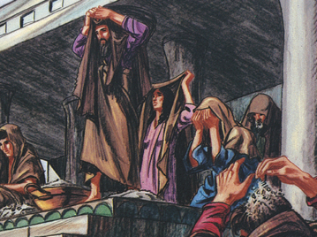
Manasseh – Pretty Much
Spit in the Face of God

Slide 24
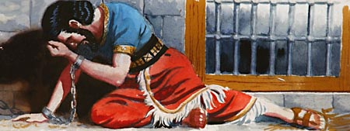
The Consequences– he knowingly and willingly disobeyed God.
II Kings 21: 10-18; II Chr. 33: 10-11

Slide 25
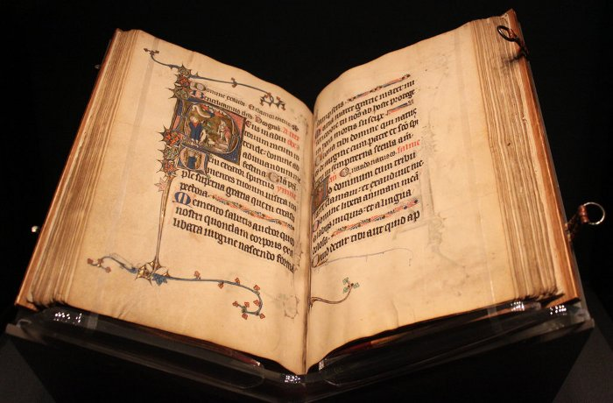
The Rest of the Story
(II Chronicles 33: 13 ff)

Slide 26
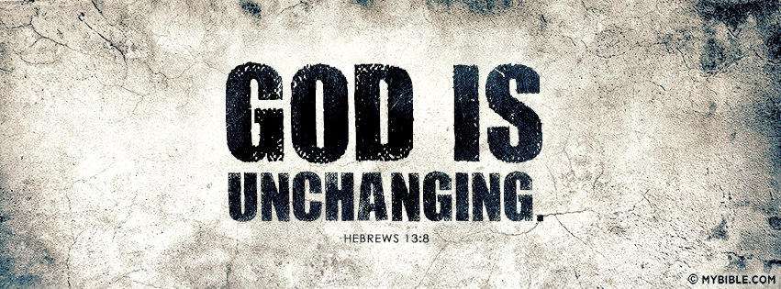
The God of the OT is the same God of the NT

Slide 27

God is the same today as He was in Manasseh’s time. Hebrews 12: 8

Slide 28
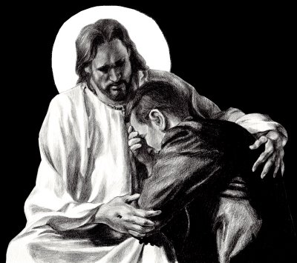
God delights in showing mercy.
Micah 7: 18 KJV

Slide 29
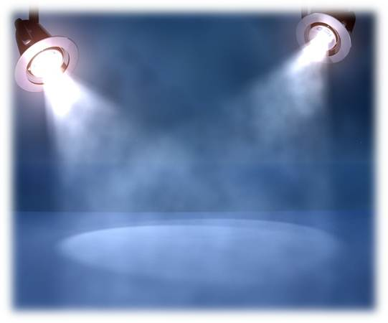
We need to study thoroughly the scriptures and life situations before coming to any kind of conclusion.

Slide 30
It takes II Chr. 33 along with II Kings 21 to get a full understanding of the life of Manasseh and God’s work in it.

