Slide 1
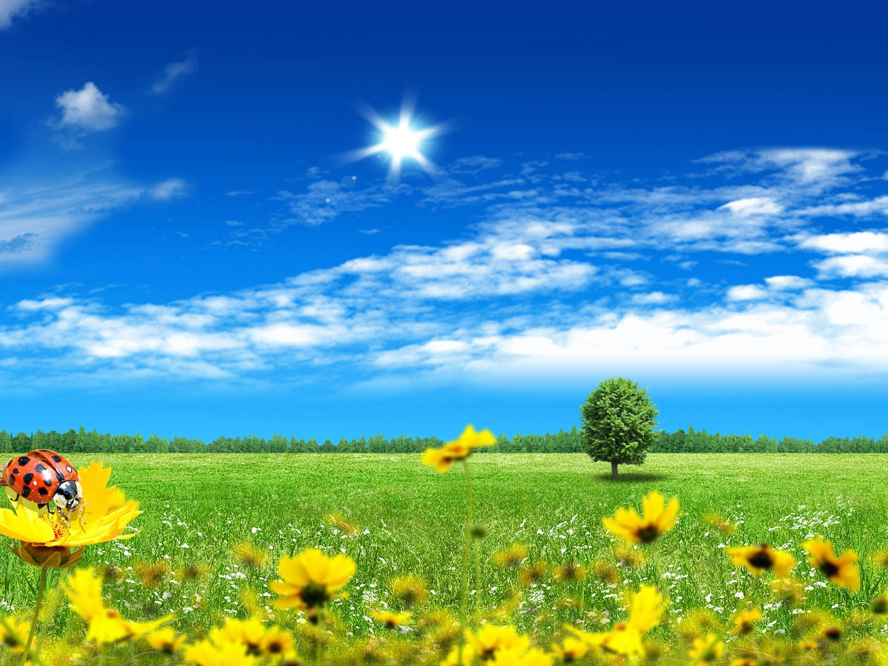
In The Garden
Mark 14:22-32

Slide 2
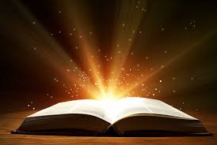
While they were eating,
Jesus took bread, gave thanks and broke it, and gave it to his disciples, saying,
“Take it; this is my body.”

Slide 3
Then he took the cup, gave thanks and offered it to them, and they all drank from it.

Slide 4
“This is my blood of the covenant, which is poured out for many,” he said to them.

Slide 5
“I tell you the truth, I will not drink again of the fruit of the vine until the day when I drink it anew in the kingdom of God.”

Slide 6
When they had sung a hymn, they went out to the Mount of Olives.

Slide 7
“You will all fall away,” Jesus told them, “for it is written:
“I will strike the shepherd, and the sheep will be scattered.’”

Slide 8
“But after I have risen,
I will go ahead of you into Galilee.”
Peter declared,
“Even if all fall away,
I will not.”

Slide 9
“I tell you the truth,” Jesus answered, “today—yes, tonight—before the rooster crows twice you yourself will disown me three times.”

Slide 10
But Peter insisted emphatically, “Even if I have to die with you,
I will never disown you.”
And all the others said the same.

Slide 11
They went to a place called Gethsemane, and Jesus said to his disciples,
“Sit here while I pray,”

Slide 12
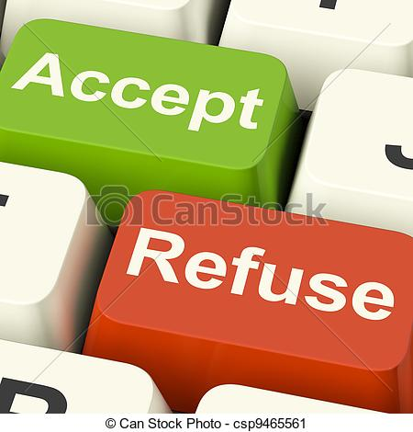
Acceptance involves struggling.

Slide 13
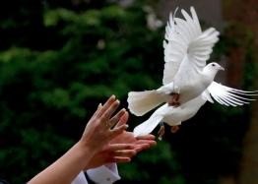
Acceptance involves releasing.

Slide 14
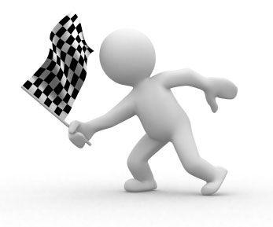
Acceptance involves the end result.

Slide 15
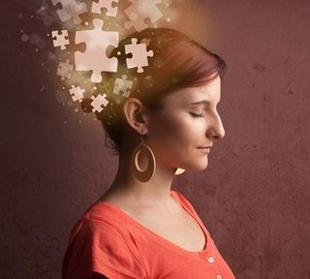
Acceptance involves processing.

