Slide 1

1 John 4:7-21

Slide 2

Dear friends, let us love one another, for love comes from God. Everyone who loves has been born of God and knows God.

Slide 3
Whoever does not love does not know God, because God is love.

Slide 4
This is how God showed his love among us: He sent his one and only Son into the world that we might love through him.

Slide 5
This is love: not that we loved God, but that he loved us and sent his Son as an atoning sacrifice for our sins.

Slide 6
Dear friends, since God so loved us, we also ought to love one another.

Slide 7
No one has ever seen God; but if we love one another, God lives in us and his love is made complete in us.

Slide 8
We know that we live in him and he in us, because he has give us of his Spirit.

Slide 9
And we have seen and testify that the Father has sent his Son to be the Savior of the world.

Slide 10
If anyone acknowledges that Jesus is the Son of God, God lives in him and he in God.

Slide 11
And so we know and rely on the love God has for us. God is love. Whoever lives in love lives in God, and God in him.

Slide 12
In this way, love is made complete among us so that we will have confidence on the day of judgment, because in this world we are like him.

Slide 13
There is no fear in love. But perfect love drives out fear, because fear has to do with punishment.

Slide 14
The one who fears is not made perfect in love.

Slide 15
We love because he first loved us. If anyone says, “I love God,” yet hates his brother, he is a liar.

Slide 16
For anyone who does not love his brother, whom he has seen, cannot love God, whom he has not seen.

Slide 17
And he has given us this command: Whoever loves God must also love his brother.

Slide 18

Is grace strictly a New Testament concept?

Slide 19

God is not sometimes loving and sometimes unloving, today loving some people and hating others, and tomorrow hating those who were previously loved.

Slide 20

In everything God does, always, in dealing with all people, God is a loving God.

Slide 21

God is patient with you, not wanting anyone to perish. 2 Peter 3:9

Slide 22
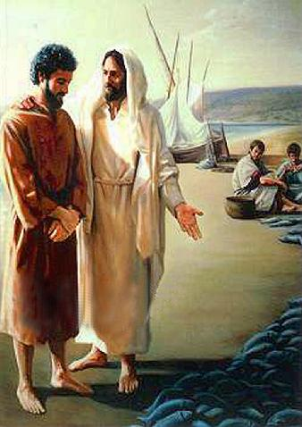
Where do you think Peter got that notion from?

Slide 23
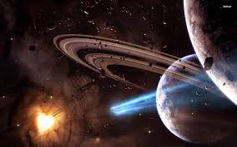

God’s love is universal. It seeks the welfare not just of a chosen few but of all people. John 3:16-17; I John 4:14; I Tim. 2:3-4

Slide 24

God’s love is unconditional. God does not say, I will love you if you prove that you deserve my love and are worthy of it. Romans 8:34

Slide 25

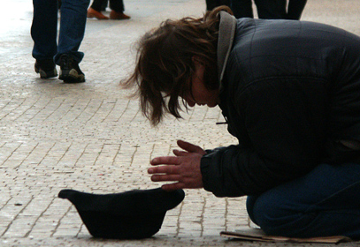
Christ died for the ungodly, the zealots, the tax collector, the immoral, the social outcast and for you and I.

Slide 26
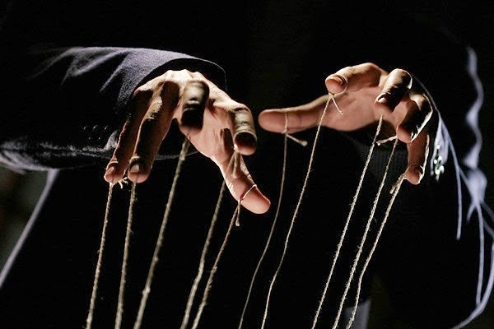
There is no strings attached to God’s love. Romans 5:6-8

Slide 27

“Jesus Christ is the same Yesterday, Today, and forever.”

Slide 28

The same God who had grace in Manasseh’s time extends grace today! Hebrews 13:8

