Slide 1
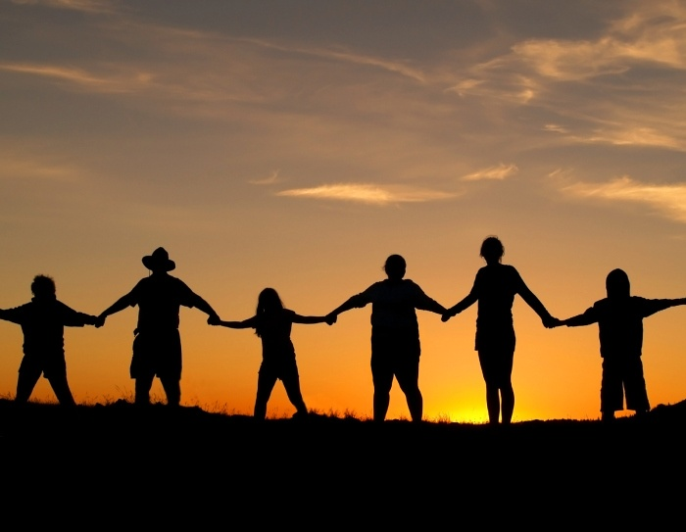
“How To Get Along When
We Don’t Get Along”
Ephesians 4:1-6

Slide 2

As a prisoner for the Lord, then, I urge you to live a life worthy of the calling you have received.

Slide 3
Be completely humble and gentle; be patient, bearing with one another in love.

Slide 4
Make every effort to keep the unity of the Spirit through the bond of peace.

Slide 5
There is one body and one Spirit—just as you were called to one hope when you were called—one Lord one faith, one baptism;

Slide 6
How do we live a life worthy of our calling?
Unity is not a call to uniformity
Unity is a requirement, not an option

Slide 7

Unity is never easy.
Unity is learning to bear with differences

Slide 8
Part 3
We Are Called To Maintain
Unity Not Create It
Why is it so hard to maintain unity?

Slide 9

1) Pride

Slide 10


2) Gift Projection

Slide 11

3) Selfishness

Slide 12

4) Impatience

Slide 13

We are called to maintain unity not create it.

