Slide 1
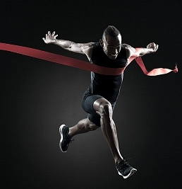

Four Characteristics of Genuine Winners Corinthians 9:24-27

Slide 2

Do you not know that in a race all the runners run, but only one gets the prize?

Slide 3
Run in such a way as to get the prize.

Slide 4
Everyone who competes in the games goes into strict training.

Slide 5
They do it to get a crown that will no last; but we do it to get a crown that will last forever.

Slide 6
Therefore I do not run like a man running aimlessly; I do no fight like a man beating the air.

Slide 7
No, I beat my body and make it my slave so that after I have preached to others, I myself will not be disqualified for the prize.

Slide 8
”I have fought the good fight, I have finished the race, I have kept the faith.

Slide 9
Now there is in store for me the crown of righteousness, which the Lord, the righteous Judge , will award to me on that day—

Slide 10
and not only to me, but also to all who have longed for His appearing.” — Paul

Slide 11

Winning is about participating. Winning is about being the best YOU can be. Winning is about crossing the finish line!

Slide 12
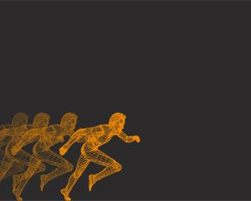
The Characteristic of a Winner are…

Slide 13
#1. Winners Are Contenders: “Do you not know that in a race all the runners run…” 1 Corinthians 9:24

Slide 14

#2. Winners Are Always In Training: “Everyone who competes in the games goes into strict training.” 1 Corinthians 9:25

Slide 15
#3. Winners Are Self-Controlled: “Do not run like a man running aimlessly…” 1 Corinthians 9:26

Slide 16
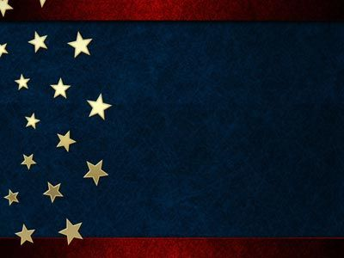
#4 Winners Seek The Prize: “I beat my body and make it my slave so that after I have preached to others, I myself will not be disqualified for the prize.” 1 Corinthians 9:27

