Slide 1

The Path of Blessing
Psalms 72:17-20

Slide 2

May his name endure forever; may it continue as long as the sun. All nations will be blessed through him, and they will call him blessed.

Slide 3
Praise be to the LORD God, the God of Israel, who alone does marvelous deeds.

Slide 4
Praise be to his glorious name forever; may the whole earth be filled with his glory, Amen and Amen.

Slide 5
This concludes the prayers of David son of Jesse.

Slide 6

We prefer blessing over cursing. We prefer to be blessed by God. And we want our country to be blessed.

Slide 7
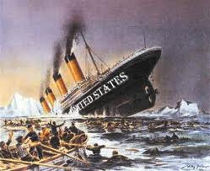
But sometimes we wonder if God has withdrawn
His blessing from America.

Slide 8
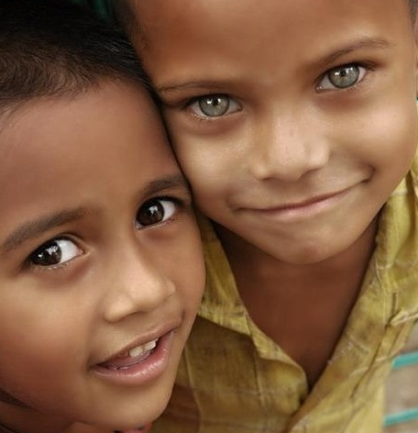
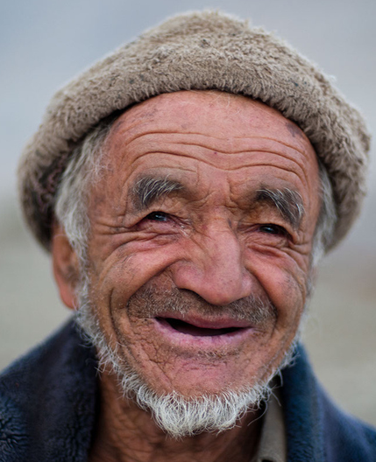

“Go into all the world & preach the gospel to every creature”
Mark 16:15

Slide 9

1- We need God’s discipline.
Job 5:17
“Blessed is the man whom God corrects; so do not despise the discipline of the Almighty.”
Psalm 94:12
“Blessed is the man you discipline,
O LORD, the man you teach from your law.”

Slide 10

2- We desire God’s friendship.
Job 29:4 “Oh, for the days when I was in my prime, when God’s intimate friendship blessed my house.”
Psalm 34:8 “Taste and see that the LORD is good; blessed is the man who takes refuge in him.”

Slide 11

3- We trust God’s wisdom.
Job 42:12
“The LORD blessed the latter part of Job’s life more than the first.
Psalms 33:12
“Blessed is the nation whose God is the Lord, the people He chose for his inheritance.

