Slide 1
“Second Hand Living”
Jeremiah 12:1-5 MSG

Slide 2

You are right, O God, and you set things right.
I can’t argue with that.
But I do have some questions:

Slide 3
Why do bad people have it so good?
Why do con artists make it big?

Slide 4
You planted them and they put down roots.
Thy flourished and produced fruit.

Slide 5
They talk as if they’re old friends with you, but they couldn’t care less about you.

Slide 6
Meanwhile, you know me inside and out.
You don’t let me get by with a thing!

Slide 7
Make them pay for the way they live, pay with their lives, like sheep marked for slaughter.

Slide 8
How long do we have to put up with this— the country depressed, the farms in ruin—

Slide 9
And all because of wickedness, these wicked lives?

Slide 10
Even animals and birds are dying off because they’ll have nothing to do with God

Slide 11
and think God has nothing to do with them.

Slide 12
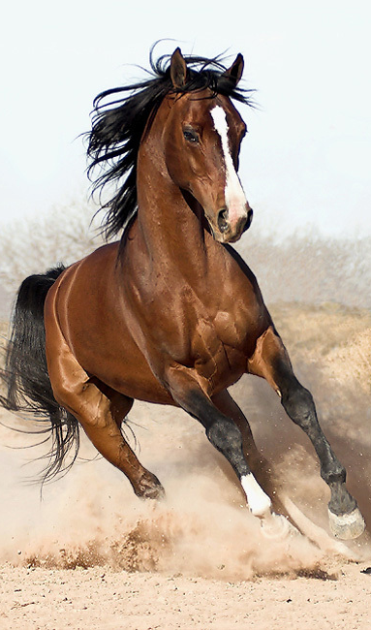
“So Jeremiah, if you’re worn out in a footrace with men, what makes you think you can race against horses?
Jeremiah 12:5

Slide 13
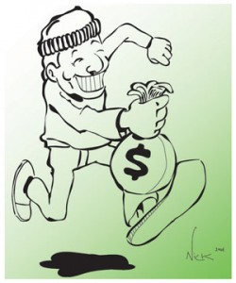
Why do so many people live so badly?

Slide 14
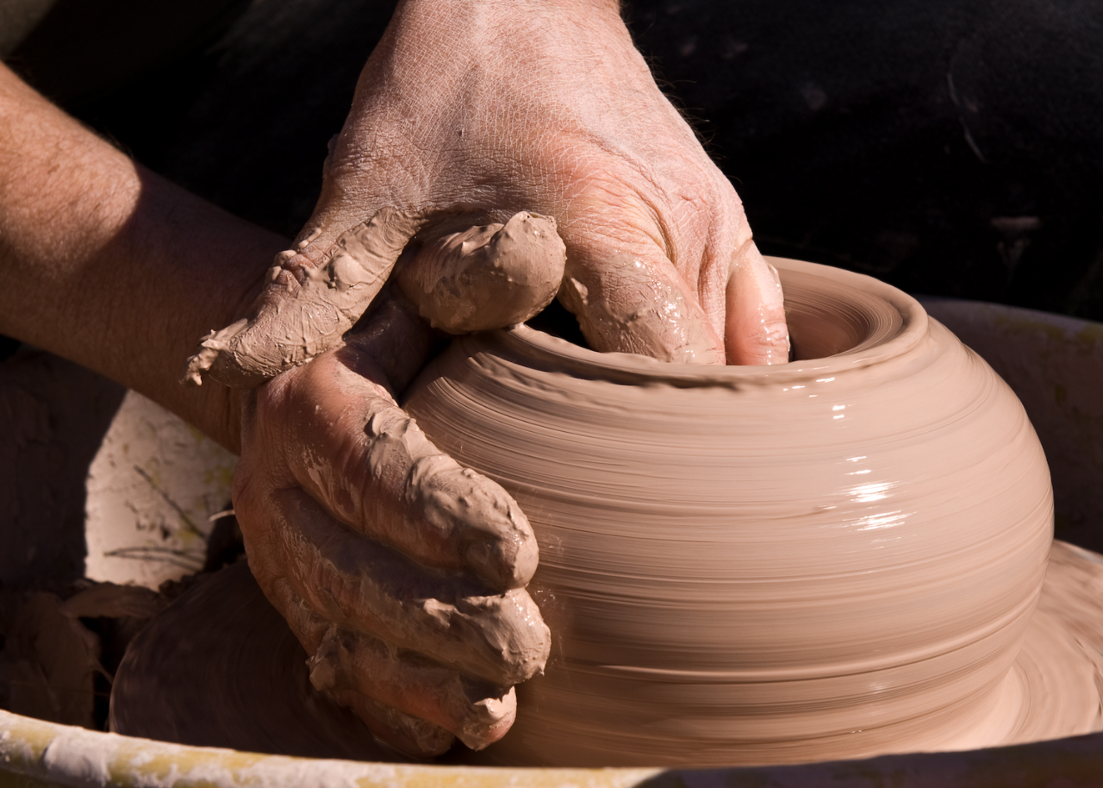
Significant figures in the life of faith are all fashioned from the same clay as the rest of us.

Slide 15
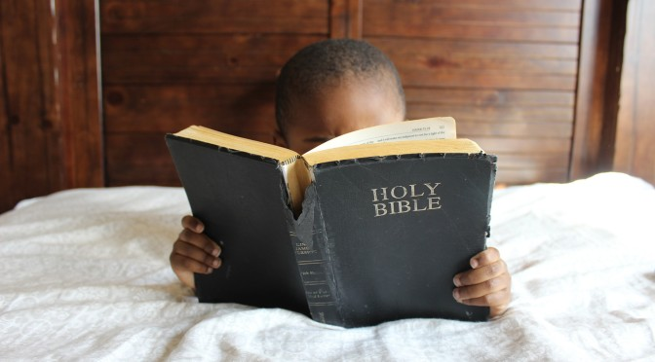
God’s word makes it clear that every time there is a story of faith, it is completely original.

Slide 16
Excellence comes from a life of faith,

Slide 17
Excellence comes from a life of faith, from being more interested in God than in self, and has nothing to do with comfort or esteem or achievement.

Slide 18

I’d rather run with the horses.

Slide 19
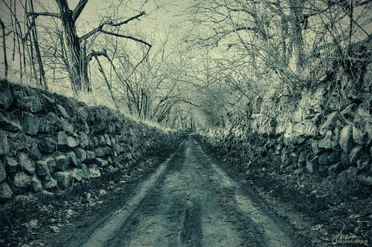
“A Long Obedience
In The Same Direction.”
Eugene H. Peterson

