Slide 1
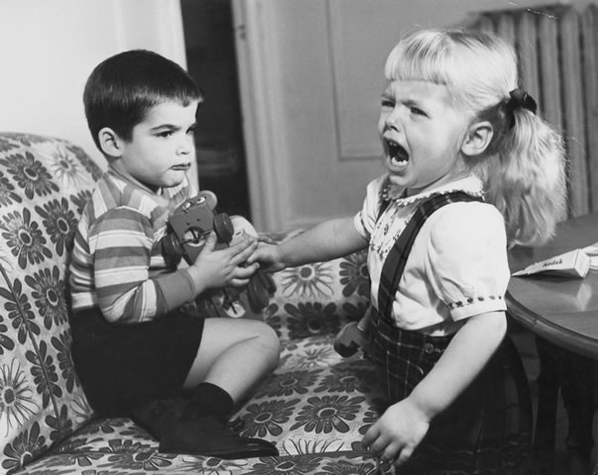
“How To Get Along When We Don’t Get Along”* Ephesians 4:1-6

Slide 2

As a prisoner for the Lord, then, I urge you to live a life worthy of the calling you have received.

Slide 3
Be completely humble and gentle; be patient, bearing with one another in love.

Slide 4
Make every effort to keep the unity of the Spirit through the bond of peace.

Slide 5
There is one body and one Spirit—just as you were called to one hope when you were called—one Lord one faith, one baptism;

Slide 6
One God and Father of all, who is over all and through all and in all.

Slide 7

How do we live a life worthy of our calling? Ephesians 4:1-4

Slide 8

Unity is not a call to uniformity Mark 10:6-9

Slide 9

God hates disunity Proverbs 6:16-19

Slide 10

Unity is a requirement, not an option* Ephesians 4:1-4

Slide 11
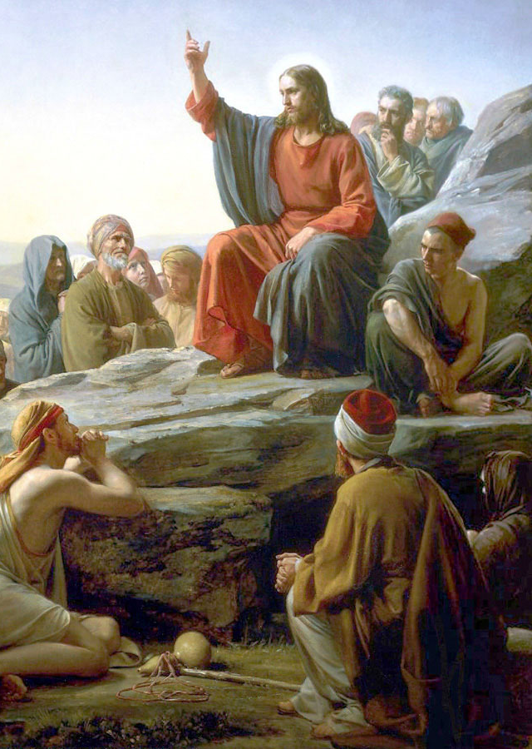
Unity is commanded by Jesus John 17:20-23

