Slide 1
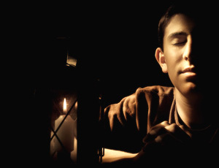
“Getting Serious
About Prayer”
Jeremiah 33:3

Slide 2

“Call to me and I will answer you and tell you great and unsearchable things you do not know”

Slide 3
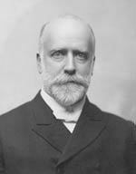
“The great people of the earth today are the people who pray; but I mean those people who take time to pray.”
S. D. Gordon

Slide 4
“This is what the LORD Almighty, the God of Israel, says to all those I carried into exile from Jerusalem to Babylon:

Slide 5
"Build houses and settle down; plant gardens and eat what they produce.

Slide 6
Marry and have sons and daughters; find wives for your sons and give your daughters in marriage, so that they too may have sons and daughters. Increase in number there; do not decrease.

Slide 7
Also, seek the peace and prosperity of the city to which I have carried you into exile.
Pray to the LORD for it, because if it prospers, you too will prosper."

Slide 8
Yes, this is what the LORD Almighty, the God of Israel, says: "Do not let the prophets and diviners among you deceive you. Do not listen to the dreams you encourage them to have.

Slide 9
They are prophesying lies to you in my name. I have not sent them," declares the LORD.

Slide 10
This is what the LORD says: "When seventy years are completed for Babylon, I will come to you and fulfill my gracious promise to bring you back to this place.

Slide 11
For I know the plans I have for you," declares the LORD,
"plans to prosper you and not to harm you, plans to give you hope and a future.

Slide 12
Then you will call upon me and come and pray to me, and I will listen to you.

Slide 13
You will seek me and find me when you seek me with all your heart.

Slide 14

“Call to me . . .”
Prayer is a command.

Slide 15

(1 Chronicles 16:11) “Look to the LORD and his strength; seek his face always.”

Slide 16
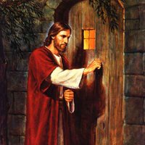
(Mat 7:7) Jesus says "Ask and it will be given to you; seek and you will find; knock and the door will be opened to you.”

Slide 17
(John 14:13-14) And I will do whatever you ask in my name, so that the Son may bring glory to the Father. {14} You may ask me for anything in my name, and I will do it.

Slide 18
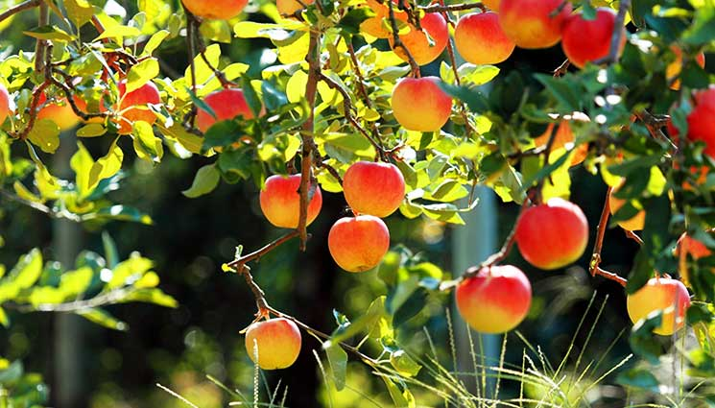
“If you remain in me and my words remain in you, ask whatever you wish, and it will be given you. {8} This is to my Father’s glory, that you bear much fruit, showing yourselves to be my disciples.” John 15:7-8

Slide 19
(John 14:13-14) And I will do whatever you ask in my name, so that the Son may bring glory to the Father. {14} You may ask me for anything in my name, and I will do it.

Slide 20
(John 16:23-24) “In that day you will no longer ask me anything. I tell you the truth, my Father will give you whatever you ask in my name. {24} Until now you have not asked for anything in my name. Ask and you will receive, and your joy will be complete.

Slide 21

Why would anyone neglect prayer?
1) discouraged
2) sin
3) unbelief.

Slide 22
“Surely the arm of the LORD is not too short to save, nor his ear too dull to hear. 2} But your iniquities have separated you from your God; your sins have hidden his face from you, so that he will not hear.” (Isa 59:1-2 NIV)

Slide 23
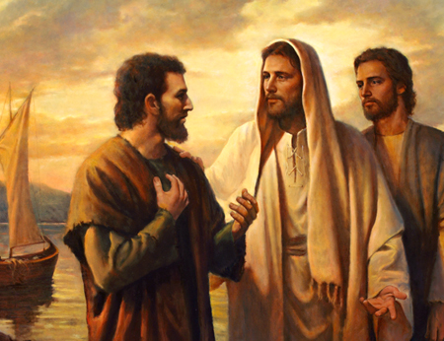
“Cast all your anxiety on Him because he cares for you!”
(1 Peter 5:7)

Slide 24
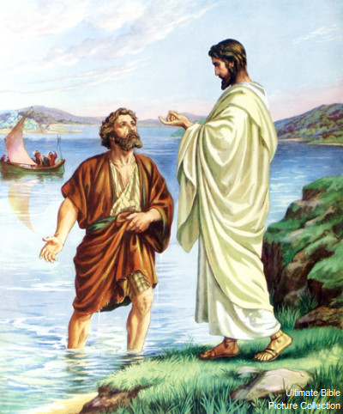
“Come to me, all you who are weary and burdened, and I will give you rest.” Matthew 11:28

Slide 25
Jesus prays for us specifically. “I pray for all those who will believe in me through their message.” Jesus has you and I in mind when he prays that we might know the Father and the Son.

Slide 26
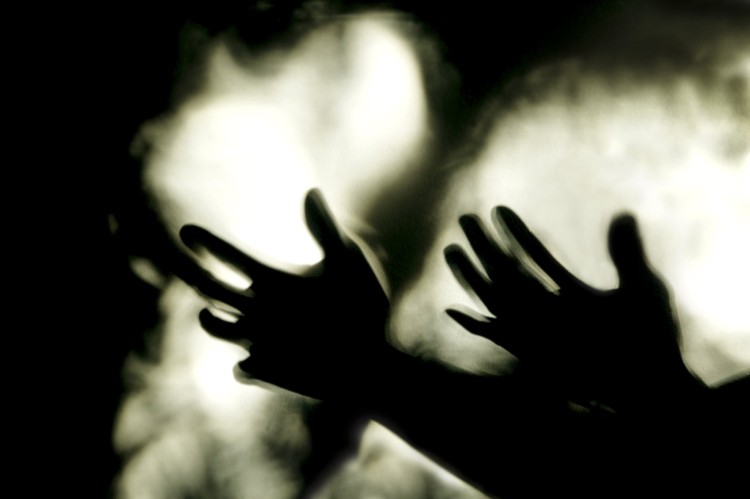
“Call to me and I will answer you.”
Prayer is a promise

Slide 27
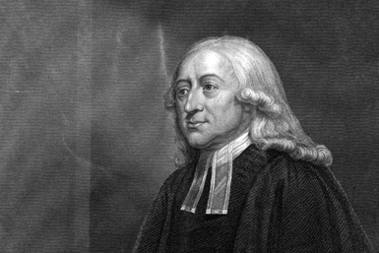
“God will do nothing but in answer to prayer.”
John Wesley

Slide 28
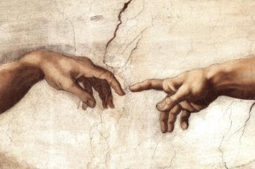
Prayer is: verbal communication with the living God, who hears and answers.

Slide 29
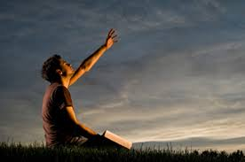
“You will seek me and find me when you seek me with all your heart. Jeremiah 29:13

Slide 30
“This is the confidence we have in approaching God: that if we ask anything according to his will, he hears us. {15} And if we know that he hears us--whatever we ask--we know that we have what we asked of him. (1 John 5:14-15 NIV)

Slide 31
Jesus prays for us specifically. “I pray for all those who will believe in me through their message.” Jesus has you and I in mind when he prays that we might know the Father and the Son.

Slide 32

I will “… tell you great and unsearchable things you do not know. “
Prayer naturally leads to results.

Slide 33
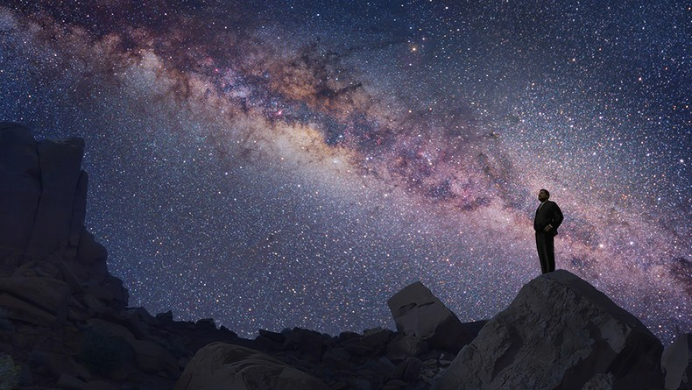
“Call to me and I will answer you and tell you great and unsearchable things you do not know.”
Prayer leads to results.

Slide 34
“Now to him who is able to do immeasurably more than all we ask or imagine, according to his power that is at work within us, {21} to him be glory in the church and in Christ Jesus throughout all generations, forever and ever!” (Eph 3:20-21 NIV)

Slide 35
“Call to me and I will answer you and tell you great and unsearchable things you do not know.’ Jeremiah 33:3

Slide 36
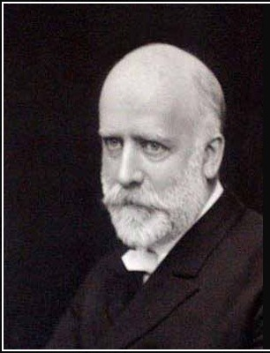
”Praying will do more to make the church what it ought to be than anything else we can do.”
R. A. Torrey,

