Slide 1

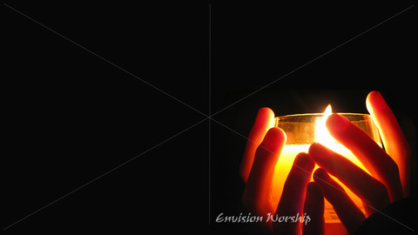
Proverbs 3:1-13

Slide 2


Trust in the Lord with all thine heart; and lean not unto thine own understanding.

Slide 3

In all thy ways acknowledge him, and he shall direct thy paths.
Proverbs 3:5-6

Slide 4
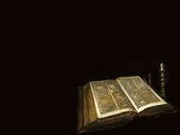
My son, forget not my law; but let thine heart keep my commandments:
For length of days, and long life, and peace, shall they add to thee.

Slide 5
Let not mercy and truth forsake thee: bind them about thy neck; write them upon the table of thine heart:
So shalt thou find favor and good understanding in the sight of God and man.

Slide 6
Trust in the Lord with all thine heart; and lean not unto thine own understanding.
In all thy ways acknowledge him, and he shall direct thy paths.

Slide 7
Be not wise in thine own eyes: fear the Lord, and depart from evil.
It shall be health to thy navel, and marrow to thy bones.

Slide 8
Honor the Lord with thy substance, and with the firstfruits of all thine increase:
So shall thy barns be filled with plenty, and thy presses shall burst out with new wine.

Slide 9
My son, despise not the chastening of the Lord; neither be weary of his correction:
For whom the Lord loveth he correcteth; even as a father the son in whom he delighteth.

Slide 10
Happy is the man that findeth wisdom, and the man that getteth understanding.
Proverbs 3:1-13 (King James)

Slide 11
When we trust in God through the saving Faith of our Lord Jesus Christ we relinquish all our life to God’s care.

Slide 12
Jesus modeled this trust for us by placing everything in the hands of God the Father.

Slide 13
Our tendency is to rely solely on our own understanding, to try to stay in control, to do things our own way.

Slide 14
“In the gospel a righteousness from God is revealed, a righteousness that is by faith, from first to last, just as it is written:
‘the righteous live by faith’ “
Romans 1.17

