Slide 1
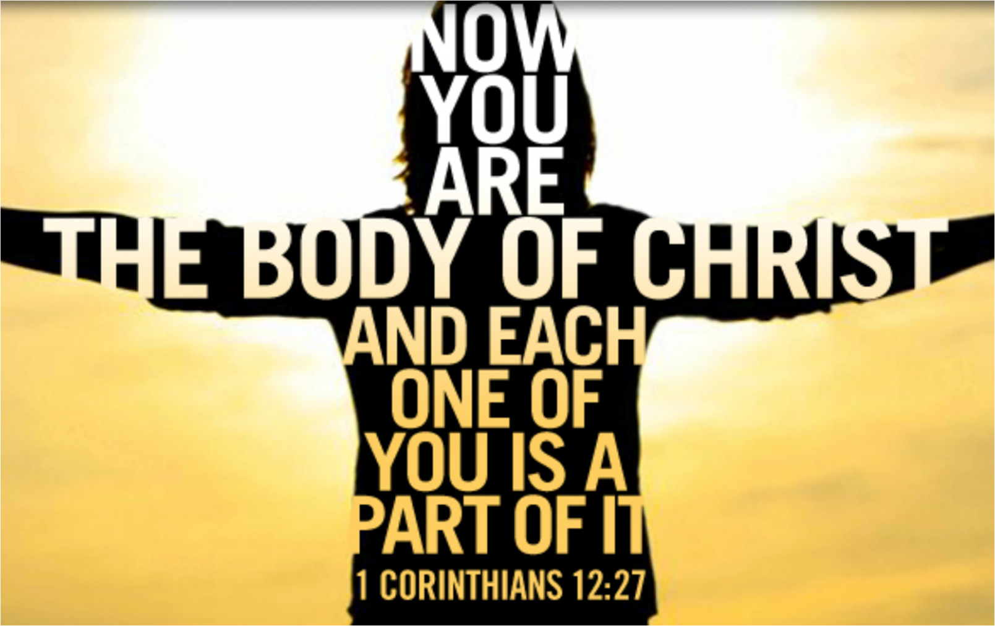
We Are The Body of Christ Luke 10:21-24

Slide 2

At that time, Jesus, full of joy through the Holy Spirit, said,

Slide 3
“I praise you, Father, Lord of heaven and earth, because You have hidden these things from the wise and learned, and revealed them to little children.

Slide 4
Yes, father, for this was Your good pleasure. All things have been committed to me by my Father.

Slide 5
No one knows who the Son is except the Father, and no on knows who the Father is except the Son and those to whom the Son chooses to reveal him.”

Slide 6
Then he turned to his disciples and said privately, “Blessed are the eyes that see what you see.

Slide 7
For I tell you that many prophets and kings wanted to see what you see but did not see it, and to hear what you hear but did not hear it.”

Slide 8
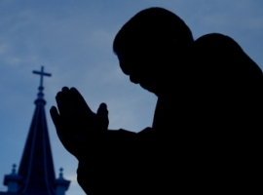
“I was glad when they said to me, “Let us go to the house of the LORD.” Psalm 122:1

Slide 9

Christians are not their own. 1 Corinthians 6:19-20

Slide 10
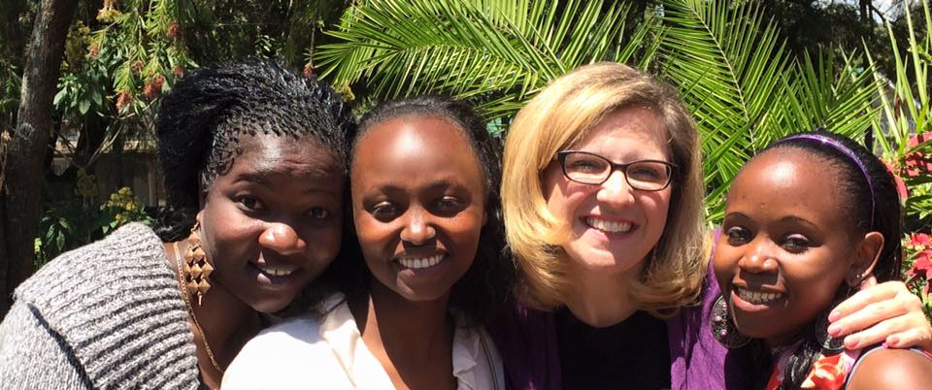

Christians are learning the joy of fellowship. Romans 16:16

Slide 11

Christians are encouraging each other to dwell in Christ’s Word. Colossians 3:16

