Slide 1
THE THREE GREATS
Matthew 8:23-27
²³ Then He got into the boat and His disciples followed Him.²⁴ Suddenly a furious storm came up on the lake, so that the waves swept over the boat. But Jesus was sleeping. ²⁵ The disciples went and woke Him, saying, “Lord, save us! We’re going to drown!”

Slide 2
²⁶ He replied, “You of little faith, why are you so afraid?” Then He got up and rebuked the winds and the waves, and it was completely calm.
²⁷ The men were amazed and asked, “What kind of man is this? Even the winds and the waves obey Him!”

Slide 3
Colossians 1:15-20
¹⁵ The Son is the image of the invisible God, the firstborn over all creation. ¹⁶ For in Him all things were created: things in heaven and on earth, visible and invisible, whether thrones or powers or rulers or authorities; all things have been created through Him and for Him.

Slide 4
¹⁷ He is before all things, and in Him all things hold together.¹⁸ And He is the head of the body, the church;
He is the beginning and the firstborn from among the dead, so
that in everything He might have the supremacy. ¹⁹ For God was pleased to have all His fullness dwell in Him,

Slide 5
²⁰ and through Him to reconcile to Himself all things, whether things on earth or things in heaven, by making peace through His blood, shed on the cross.

Slide 6
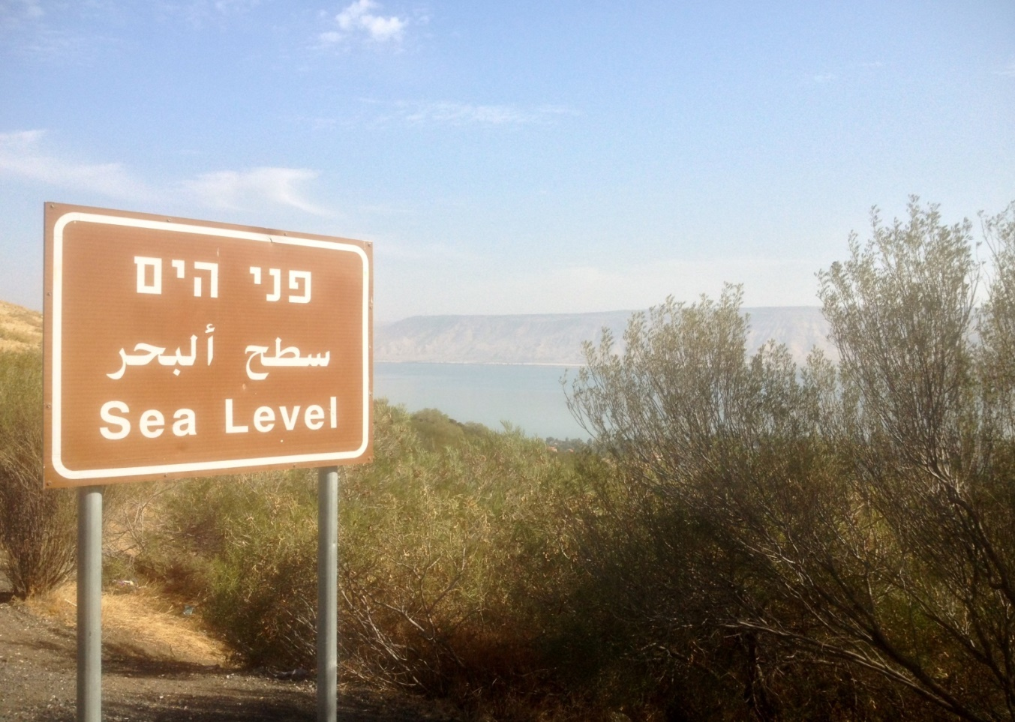
The Sea of Galilee

Slide 7
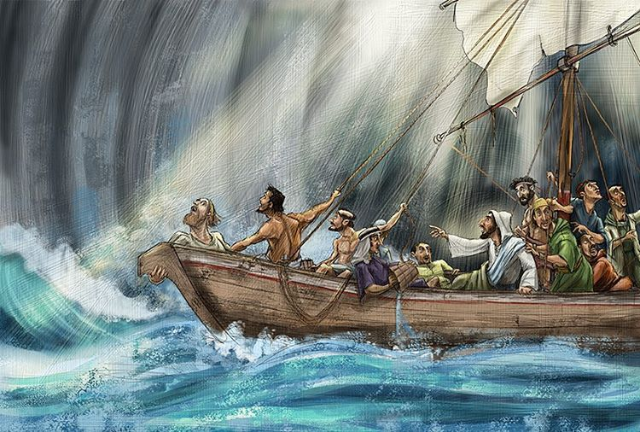
1. A Great Storm
²⁴ Suddenly a furious storm came up on the lake, so that the waves swept over the boat. But Jesus was sleeping.

Slide 8
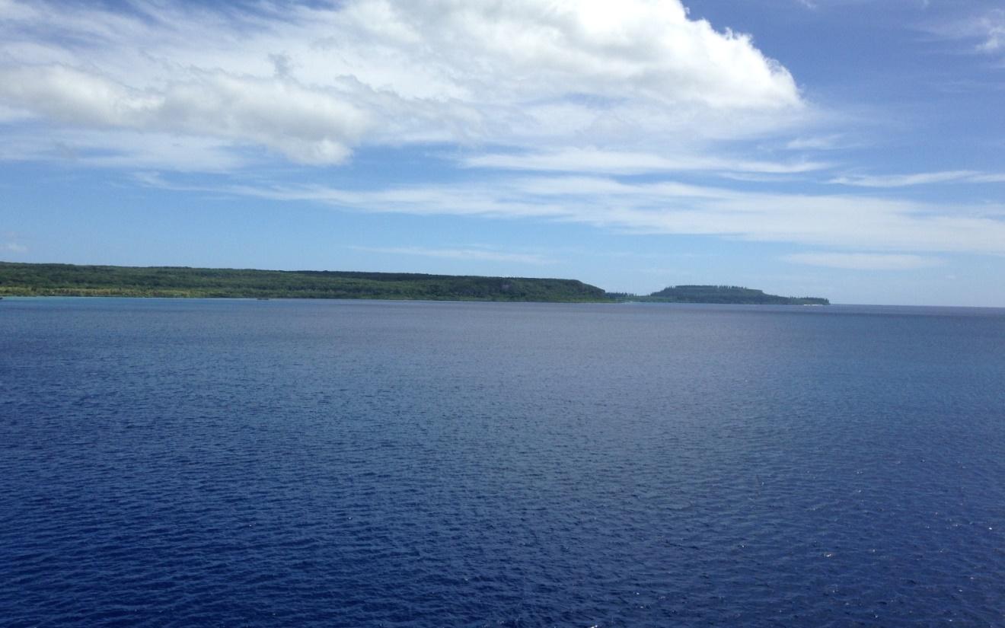
2. A Great Calm
²⁶ He replied, “You of little faith, why are you so afraid?”
Then he got up and rebuked the winds and the waves,
and it was completely calm.

Slide 9
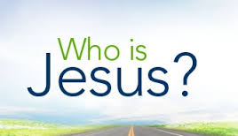
3. A Great Savior
²⁷ The men were amazed and asked, “What kind of man is this? Even the winds and the waves obey him!”

Slide 10
1. Lord of Creation
¹⁶ For in him all things were created…through him and for him. ¹⁷ … in him all things hold together.

Slide 11
2. Lord of the Church
¹⁸ And he is the head of the body, the church; he is the firstborn from among the dead, so that in everything he might have the supremacy.

Slide 12
3. Lord of the Cosmos
¹⁹ For God was pleased to have all his fullness dwell in him, ²⁰ and through him to reconcile to himself all things, whether things on earth or things in heaven…

Slide 13
Who is Jesus?
A Liar
A Lunatic
Son of God, Equal to God
and the Savior of the world

