Slide 1
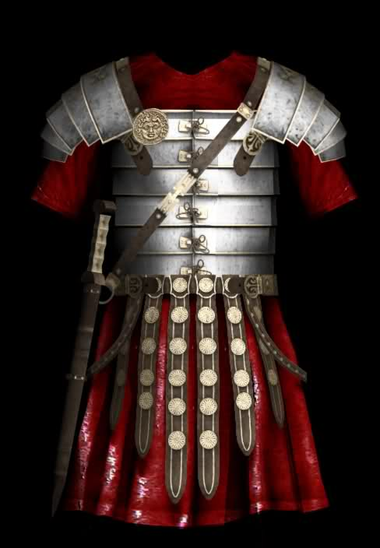
“The Armor Of God” Ephesians 6:10-20

Slide 2

Finally, be strong in the Lord and in his mighty power. Put on the full armor of God so that you can take your stand against the devil’s schemes.

Slide 3
For our struggle is not against flesh and blood, but against the rulers, against the authorities,

Slide 4
against the powers of this dark world and against the spiritual forces of evil in the heavenly realms.

Slide 5
Therefore put on the full armor of God, so that when the day of evil comes, you may be able to stand your ground, and after you have done everything, to stand.

Slide 6
Stand firm then, with the belt of truth buckled around your waist, with the breastplate of righteousness in place,

Slide 7
and with your feet fitted with the readiness that comes from the gospel of peace.

Slide 8
In addition to all this, take up the shield of faith, with which you can extinguish all the flaming arrows of the evil one.

Slide 9
Take the helmet of salvation and the sword of the Spirit, which is the word of God.

Slide 10
And pray in the Spirit on all occasions with all kinds of prayers and requests.

Slide 11
With this in mind, be alert and always keep on praying for all the saints.

Slide 12
Pray also for me, that whenever I open my mouth, words may be given me so that I will fearlessly make known the mystery of the gospel,

Slide 13
for which I am an ambassador in chains. Pray that I may declare it fearlessly, as I should.

Slide 14

Put on the full armor of God so that you can stand against the devil’s evil schemes.

Slide 15

Stand firm then, with the belt of truth buckled around your waist.

Slide 16

Stand firm with the breastplate of righteousness in place.

Slide 17

Stand firm with your feet fitted with readiness that comes from the gospel of peace.

Slide 18

Take up the shield of faith, with which you can extinguish all the flaming arrows of the evil one.

Slide 19
Take the helmet of salvation and the sword of the Spirit, which is the word of God.

Slide 20
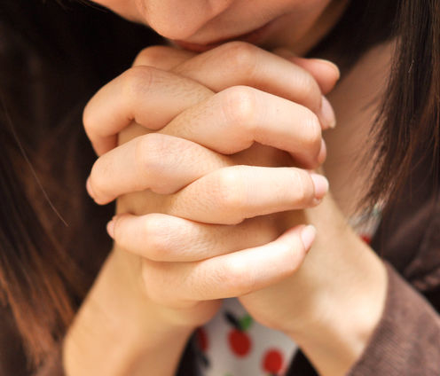
Pray in the Spirit on all occasions with all kinds of prayers…

