Slide 1

“Love Builds Up The Church” 1 Corinthians 8:1-13

Slide 2
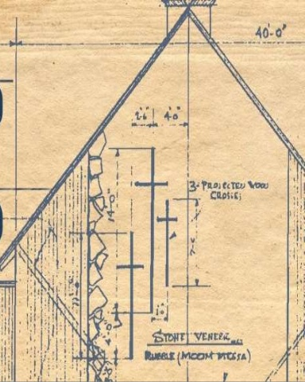
“While knowledge may make us feel important, it is love that really builds up the church.” (1 Cor. 8:1)

Slide 3
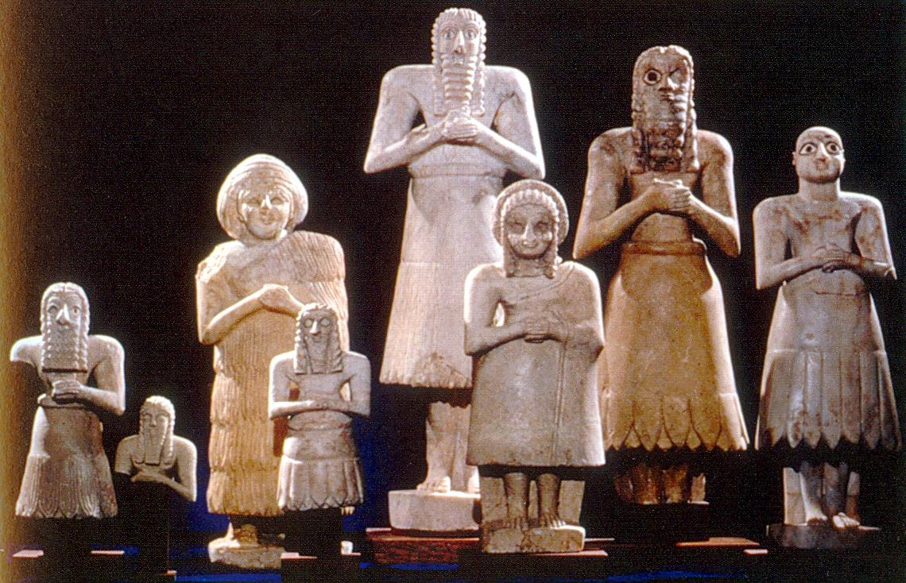
According to some people there are many so called gods and many lords, both in heaven and on earth. (1 Cor. 8:5)

Slide 4

Some Christians “are accustomed to thinking of idols as being real, so when they eat food that has been offered to idols , they think of it as the worship of real gods,…” (1 Cor. 8:7)

Slide 5
“You see this is what can happen: Weak Christians who think it is wrong to eat this food will see you eating in the temple of an idol. But they will be encouraged to violate their conscience by eating food that has been dedicated to the idol.” (1 Cor. 8:10)

Slide 6
“So because of your superior knowledge, a weak Christian, for whom Christ died, will be destroyed. (1 Corinthians 8:11)

Slide 7
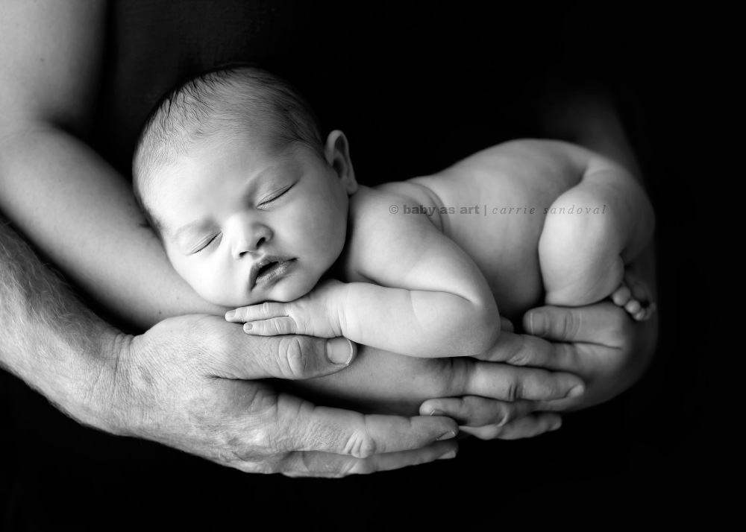
You were made for God.

Slide 8

In our Lord Jesus Christ, God has provided everything.

Slide 9

In our Lord Jesus Christ you have been given life.

