Slide 1

“Greet One Another” Romans 16:16, 1 Corinthians 16:20 2Corinthians 13:12 1 Peter 5:14

Slide 2

“Greet one another with a holy kiss. All the churches of Christ send greetings Romans 16:16

Slide 3
All the brothers here send you greetings. Greet one another with a holy kiss.” 1 Corinthians 16:20”

Slide 4
Greet on another with a holy kiss. 2 Corinthians 13:12”

Slide 5
“Greet one another with a kiss of love. Peace to all of you who are in Christ. 1 Peter 5:14

Slide 6
The church is in exile here with me—but not for a moment forgotten by God— wants to be remembered to you.

Slide 7
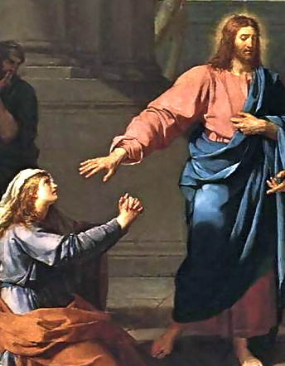
We are bond-slaves. Romans 1:1 Philippians 2:7 Matthew 24:45-46 John 15:13-15

Slide 8
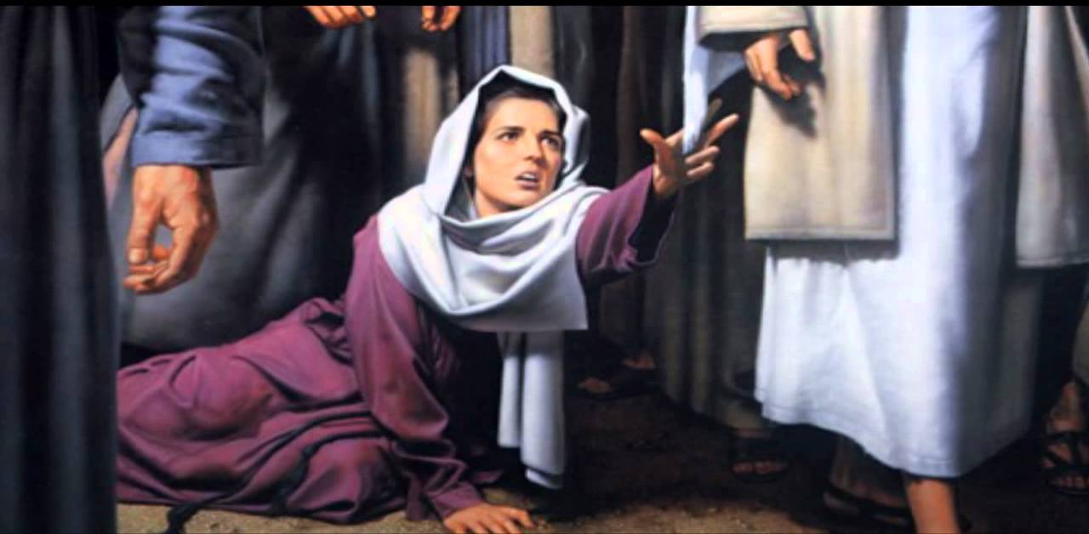
We are body of Christ. 1 Corinthians 6:19-20; 1 Corinthians 12:27; Ephesians 4:15

Slide 9
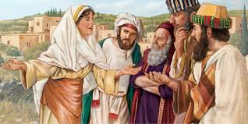
We are Christ’s ambassadors . 2 Corinthians 5:20, Colossians 3:16; Ephesians 5:19

Slide 10
We are the body of Christ. Instead, speaking the truth in love, we will grow to become in every respect the mature body of him who is the head, that is, Christ. Ephesians 4:15 NIV

