Slide 1

“There Is
In His Word”
Hebrews 10:19-25
POWER

Slide 2

“I rejoice whenever they say to me,
‘Let us go to the house of the Lord.’”

Slide 3
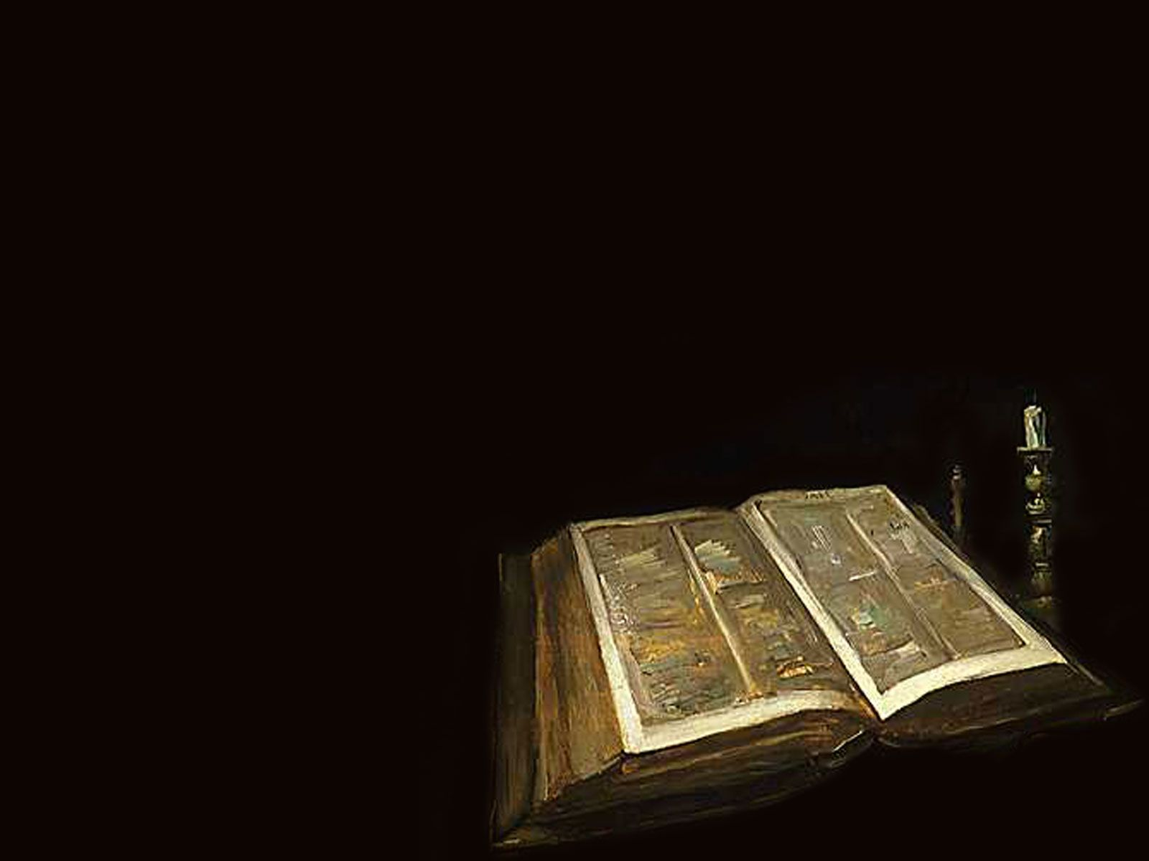
Therefore, brothers, since we have confidence to enter the Most Holy Place by the blood of Jesus,

Slide 4
by a new and living way opened for us through the curtain, that is, his body, and since we have a great priest over the house of God,

Slide 5
Let us draw near to God with a sincere heart in full assurance of faith;

Slide 6
having our hearts sprinkled to cleanse us from a guilty conscience and having our bodies washed with pure water.

Slide 7
Let us hold unswervingly to the hope we profess, for he who promised is faithful. And let us consider how we may spur one another on toward love and good deeds.

Slide 8
Let us not give up meeting together, as some are in the habit of doing, but let us encourage on another—and all the more as you see the Day approaching.

Slide 9
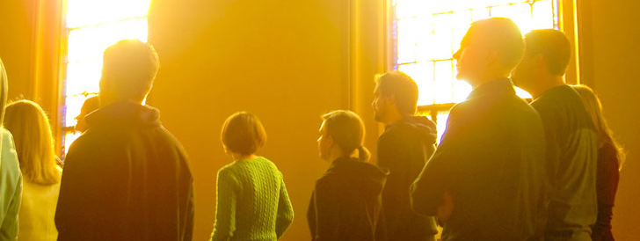
Why is David glad when he’s told, “Let’s go to the house of God” (v 1)?
He knows that he will find his true spiritual family there.

Slide 10

Sometimes when we do come to church we ought to change our attitudes. Hebrew 10:25

Slide 11

The Bible hays a lot to say about worship and praise. Psalm 34:3 says “O magnify the Lord with me, And let us exalt His name together.”

Slide 12

Psalm 133:1, “Behold, how good and pleasant it is for brethren to dwell together in unity.”

Slide 13

You ought to be glad to come to church because there is power in his word.

Slide 14

“Praise the Lord, I will praise the Lord with my whole heart, In the assembly of the upright and in the congregation.”

Slide 15

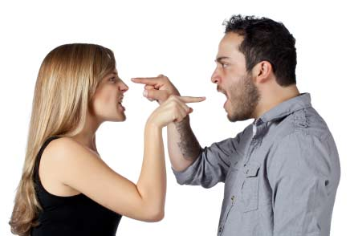
Psalm 34:1 says, “I will bless the Lord at all times, his praises shall continually be in my mouth.”

