Slide 1
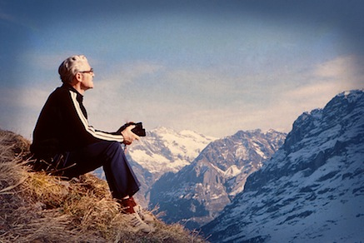
Where Does
Your Help
Come From?
Psalm 121:1-8

Slide 2

I lift my eyes to the hills— where does my help come from?
My help comes from the LORD, the Maker of heaven and earth.

Slide 3
He will not let your foot slip— he who watches over you will not slumber; indeed, he who watches over Israel will neither slumber nor sleep.

Slide 4
The LORD watches over you— the LORD is your shade at your right hand; the sun will not harm you by day, nor the moon by night.

Slide 5
The LORD will keep you from all harm— he will watch over your life; the LORD will watch over your coming and going both now and forevermore.

Slide 6
“I look up to the mountains- Does my help come from there?”

Slide 7
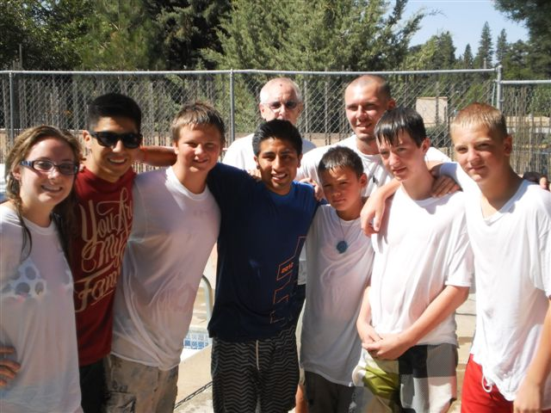
Pilgrims going up to Jerusalem at the annual feasts of Passover, Pentecost, and Tabernacles would sing songs of ascent.
(Psalm 120-134)

Slide 8
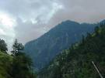
Psalm 121 is a hymn that asks the rhetorical question:
Do I trust the mountains to keep me safe — can my help come from there?

Slide 9

Mountains are a potential refuge in times of danger. Matthew 24:16, Luke 23:30

Slide 10
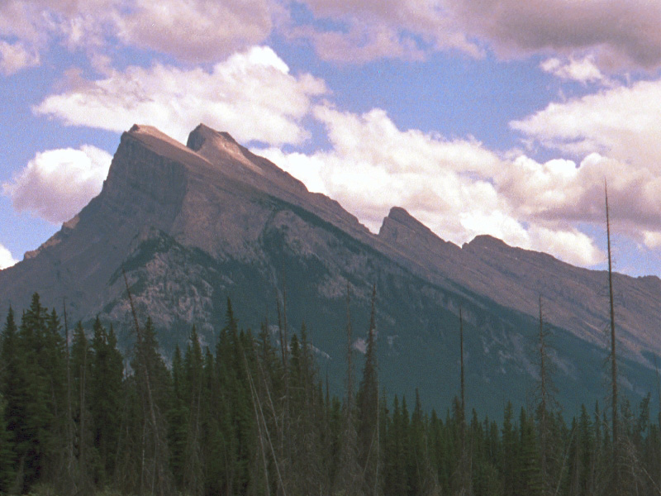
Mountains are a potential menace often used as hideouts for robbers.
Luke 10:30

Slide 11

Mountains were often a place of baal worship.
Numbers 33:52; 1 Kings 14:23

Slide 12

The Lord is your shade.
The Lord is your protection.
“The Lord keeps watch over you as you come and go, both now and forever.”
Psalm 121:8

