Slide 1

“The Lord’s Promises Are Pure” Psalms 12:1-8

Slide 2

Help, O LORD, for the godly are fast disappearing! The faithful have vanished from the earth!

Slide 3

Neighbors lie to each other, speaking with Flattering lips and deceitful hearts Psalms 12:1-2

Slide 4

Help, Lord, for the godly are no more; the faithful have vanished from among men.

Slide 5
Everyone lies to his neighbor: their flattering lips speak with deception.

Slide 6
May the Lord cut off all flattering lips and every boastful tongue that says—

Slide 7
”We will triumph with our tongues; we own our lips— who is our master?”

Slide 8
“Because of the oppression of the weak and the groaning of the needy, I will now arise,” says the Lord,

Slide 9
“I will protect them from those who malign them.”

Slide 10
And the words of the Lord are flawless, like silver refined in a furnace of clay, purified seven times.

Slide 11
O Lord, you will keep us safe and protect us from such people forever.

Slide 12

The wicked freely strut about when what is vile is honored among men.

Slide 13

Help is sometimes translated rescue or deliver or even bring salvation. (vs1)

Slide 14
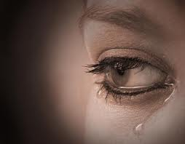
We always hurt people when we fail to tell the truth. (vs. 2)

Slide 15
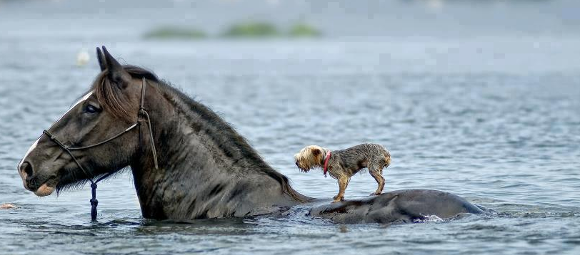
God acts to protect the weak. (vs. 5)

Slide 16
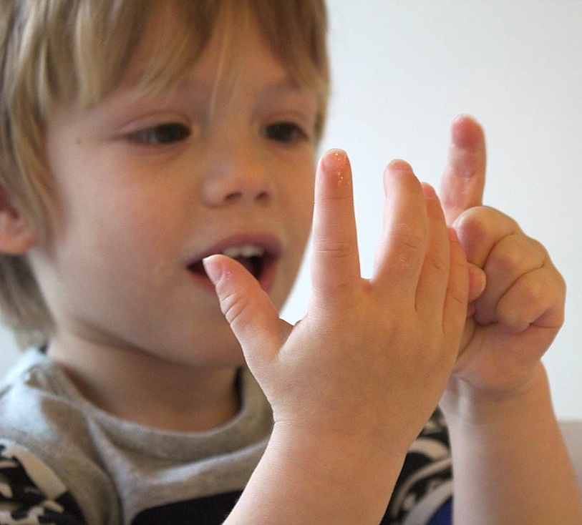
One thing we know is that God’s word can be counted on. (vs6)

Slide 17

Therefore, Lord, we know you will protect the oppressed Preserving then forever from this lying generation

Slide 18
Even though the wicked strut about, And evil is praised throughout the land. Psalm 12:7-8

