Slide 1
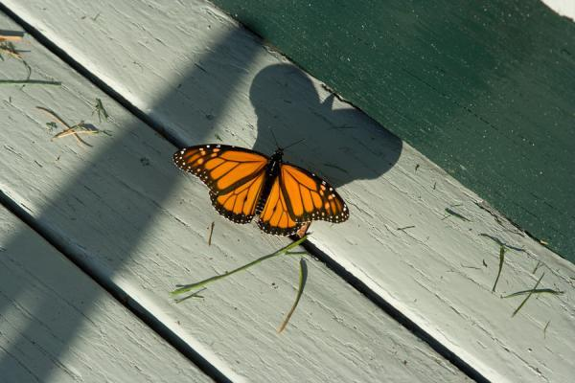
“In The Shadow of the Almighty”
Psalm 91:1-16

Slide 2

He who dwells in the shelter of the Most High will rest in the shadow of the Almighty

Slide 3
I will say of the Lord,
“He is my refuge and my fortress, my God, in whom I trust.”

Slide 4
Surely he will save you from the fowler’s snare and from the deadly pestilence.

Slide 5
He will cover you with his feathers, and under his wings you will find refuge; his faithfulness will be your shield and rampart,

Slide 6
You will not fear the terror of the night, nor the arrow that flies by day,

Slide 7
nor the pestilence that stalks in the darkness nor the plague that destroys at midday.

Slide 8
A thousand may fall at your side, ten thousand at your right hand, but it will not come near you.

Slide 9
You will only observe with your eyes and see the punishment of the wicked.

Slide 10
If you make the Most High your dwelling—even the Lord, who is my refuge— then no harm will befall you,

Slide 11
no disaster will come near your tent, for he will command his angels concerning you to guard you in all your ways;

Slide 12
they will lift you up in their hands, so that you will not strike your foot against a stone.

Slide 13
You will tread upon the lion and the cobra; you will trample the great lion and the serpent.

Slide 14
“Because he loves me,” says the Lord, “I will rescue him; I will protect him, for he acknowledges my name.

Slide 15
He will call upon me, and I will answer him;
I will be with him in trouble,
I will deliver him and honor him.

Slide 16
With long life will I satisfy him and show him my salvation.”

Slide 17

It is worth noting that the devil know the Bible better than we do. Psalm 91:11-12

Slide 18
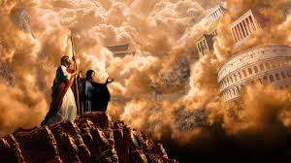
Jesus knows the Bible even better. He responded to the devil with understanding and humility. Matthew 4:5-7

Slide 19

Jesus was crucified, humiliated, and crushed.
But God would nevertheless be his refuge and safety; he would reward him with long life.
Psalm 91:9-12

Slide 20

Jesus went to the cross “because of the joy awaiting him.” Hebrews 12:2

Slide 21

“When the call on me,
I will answer;
I will be with them in trouble.
I will rescue them and honor them.
I will satisfy them with long life and give them my salvation.”
Psalm 91:15-16

