Slide 1
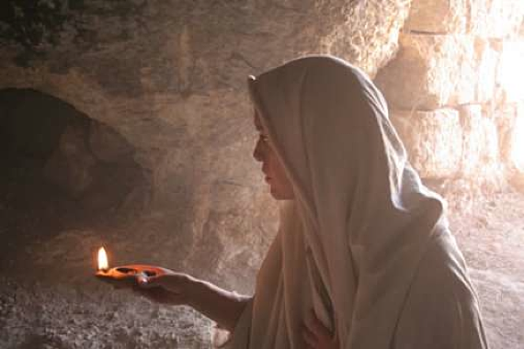
A Witness to the Resurrection
Psalm 22:1-31

Slide 2
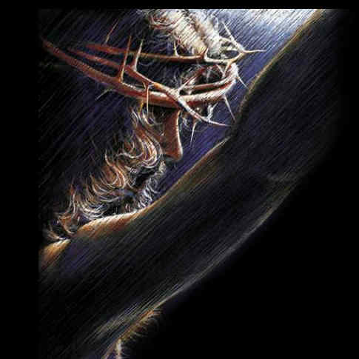
What was Jesus thinking on the cross?

Slide 3
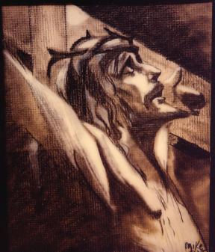
What did he mean when he cried out, ‘My God, My God , why have you forsaken me.” (vss. 1-2)

Slide 4

He did not choose Psalms 22 exclusively to acknowledge his abandonment by God. Some other Psalms of abandonment (vss. 16-18)
He did not choose Psalms 22 exclusively to acknowledge his abandonment by God. Some other Psalms of abandonment (vss. 16-18)

Slide 5

Jesus did not choose Psalms 22 exclusively because it was prophetic.

Slide 6

Jesus chose Psalms because it begins with anguish and ends with soaring hope. (v.25)

Slide 7
What was Jesus thinking as he hung on the cross?

Slide 8
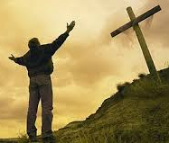
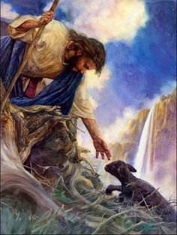
He was passionate about fulfilling the will of the Father.
(vss. 27, 30-31)

